Slide 1
Completing the Language Instruction Educational Program (LIEP) Template
Thomas Kirk
Office of English Language Proficiency

Slide 2
Completing the Language Instruction Educational Program (LIEP) Template
Thomas Kirk
Director of EL Identification and Monitoring
Office of English Language Proficiency

Slide 3
Topics
Legal Requirements
The LIEP Template and Submitting the Completed Form
  The LEA Information Page
  I. Assurances
  II. Language Instruction
  III. Parent and Family Involvement
  IV. Professional Development
  V. Civil Rights Requirements

Slide 4
Legal Requirements
Under Title VI of the Civil Rights Act of 1964 and the Equal Educational Opportunities Act of 1974 (EEOA), all States and all Local Education Agencies (LEAs) must ensure that English learners (ELs) can participate meaningfully and equally in educational programs and services. To meet these obligations LEAs must:
Identify and assess all potential EL students in a timely, valid, and reliable manner;
Provide EL students with a language assistance program that is educationally sound and proven successful, consistent with Castañeda v. Pickard and the Supreme Court decision in Lau v. Nichols.
Provide sufficiently well-prepared and trained staff and support the language assistance programs for EL students;

Slide 5
Legal Requirements (cont.)
Ensure that EL students have equal opportunities to meaningfully participate in all curricular and extracurricular activities;
Avoid unnecessary segregation of EL students;
Ensure that, in accordance with the Individuals with Disabilities Education Act (IDEA) or Section 504 of the Rehabilitation Act of 1973, EL students who have or are suspected of having a disability are identified, located, and evaluated in a timely manner and that the language needs of students who requiring special education and disability related services are considered in evaluations and delivery of services;
Meet the needs of EL students who opt out of language assistance programs;

Slide 6
Legal Requirements (cont.)
Monitor and evaluate EL students in language assistance programs to ensure their progress with respect to acquiring English proficiency and grade level content knowledge, exit EL students from language assistance programs when they are proficient in English, and monitor exited students to ensure they were not prematurely exited and that any academic deficits incurred in the language assistance program have been remedied;
Evaluate the effectiveness of the school district’s language assistance program;
Ensure meaningful communication with parents whose own English language proficiency may be limited.

Slide 7
The LIEP Template and Submitting the Completed Form
The template discussed in this presentation is available on the English Learners page of the OSDE website (https://sde.ok.gov/english-language-proficiency-assessments).
The completed form should be saved as a PDF file and uploaded with the LEA’s Consolidated Application.
The due date for submission is the same as that for the Consolidated Application – September 30, 2022.
The LIEP should be reviewed annually and revised as needed.

Slide 8
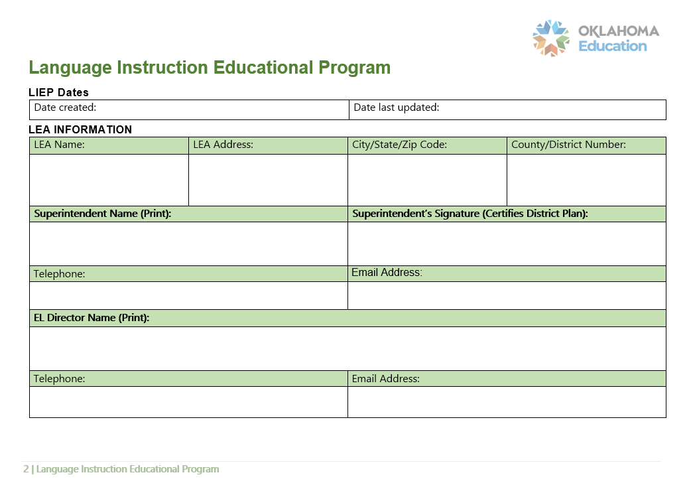
The LEA Information Page

Slide 9
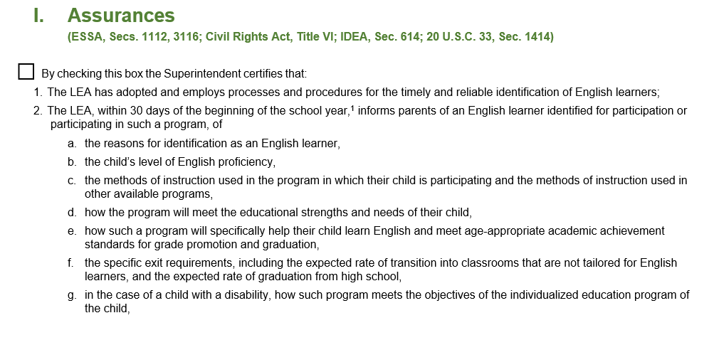
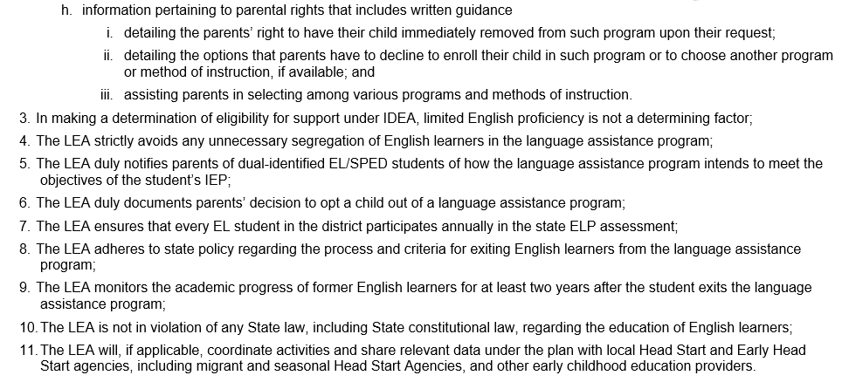
I. Assurances

Slide 10
The Remainder of the Template
The remainder of the LIEP Template is divided into four sections, each covering a series of program requirements. These sections are:
Language Instruction
Parent and Family Involvement
Professional Development
Civil Rights Obligations

Slide 11
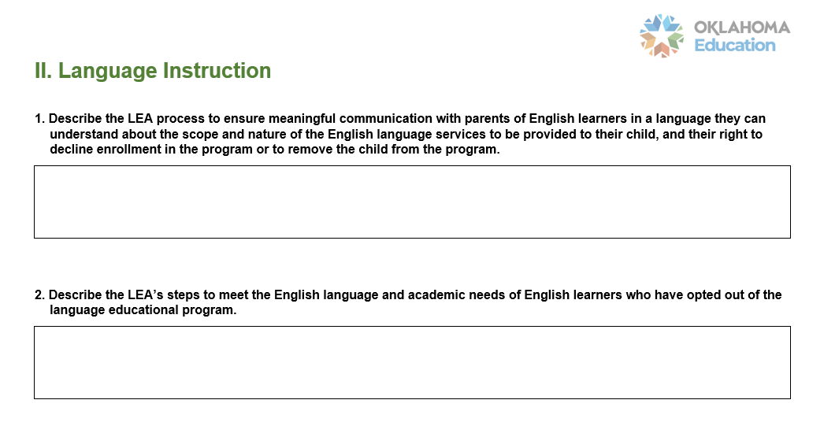
II. Language Instruction

Slide 12
II. Language Instruction (cont.)
Question 3 asks the LEA to indicate which strategy or strategies have been adopted and to describe how the strategy will A) achieve English proficiency, and B) meet State academic standards.
The options are:
Transitional Bilingual
Dual Language or Two-way Immersion
English as a Second Language (ESL) or English Language Development (ELD)
Content Classes with integrated ESL support
Newcomer Programs
Other

Slide 13
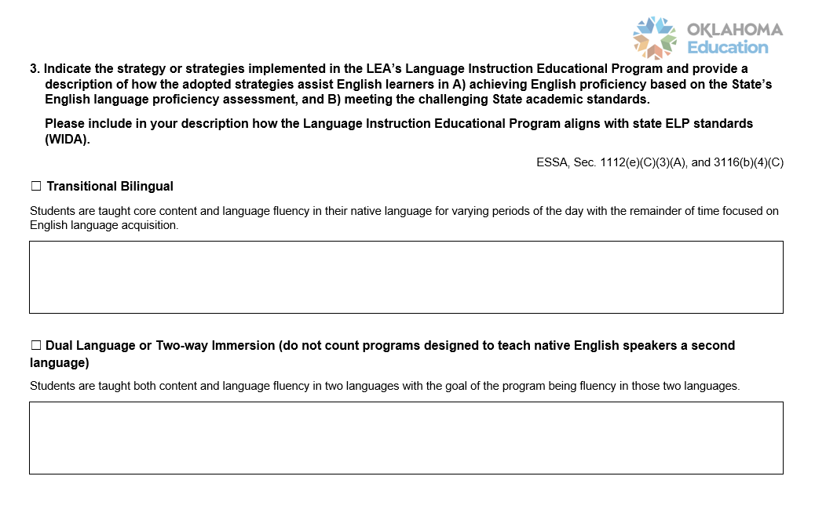
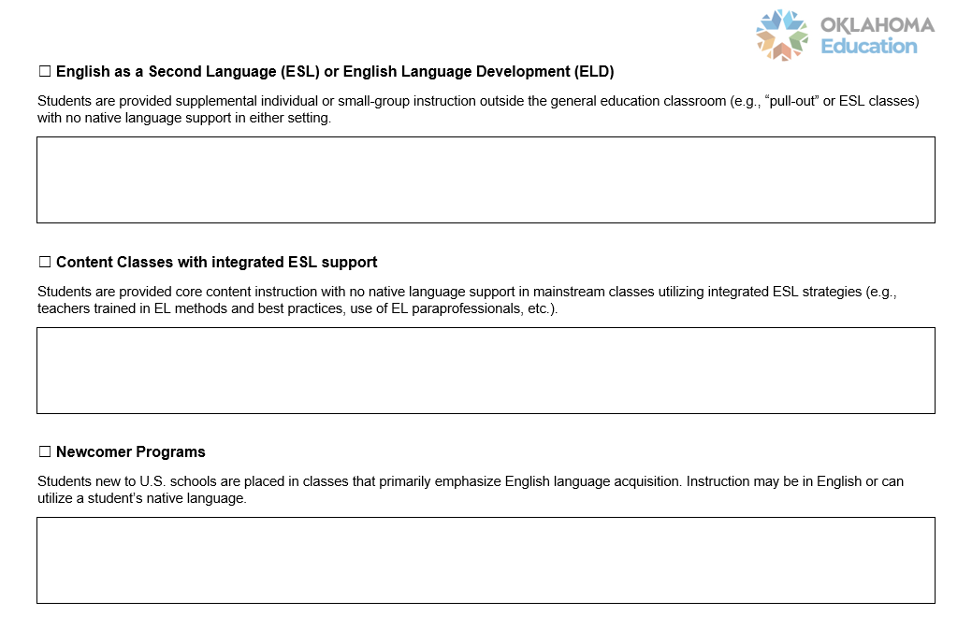
II. Language Instruction (cont.)

Slide 14
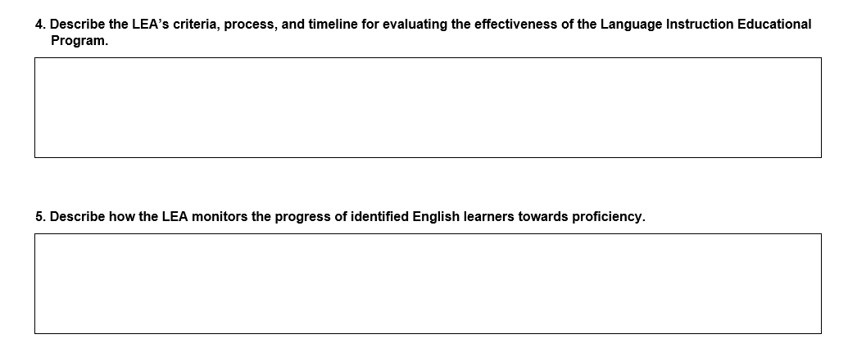
II. Language Instruction (cont.)

Slide 15
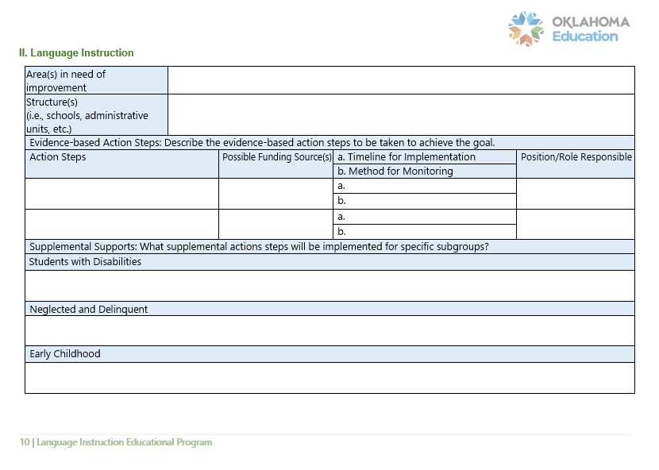
II. Language Instruction (cont.)

Slide 16
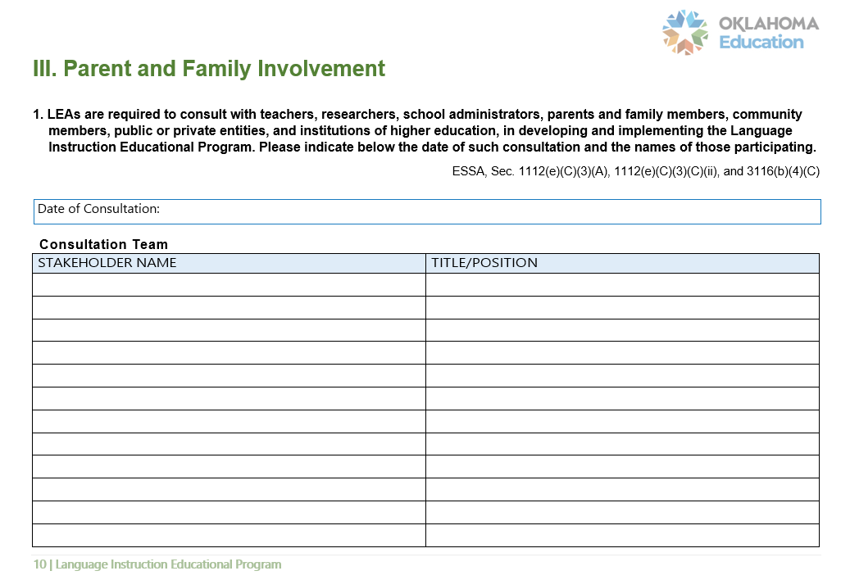
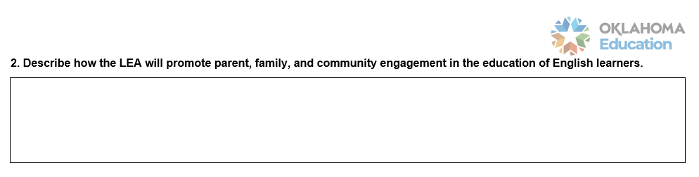
III. Parent and Family Involvement

Slide 17
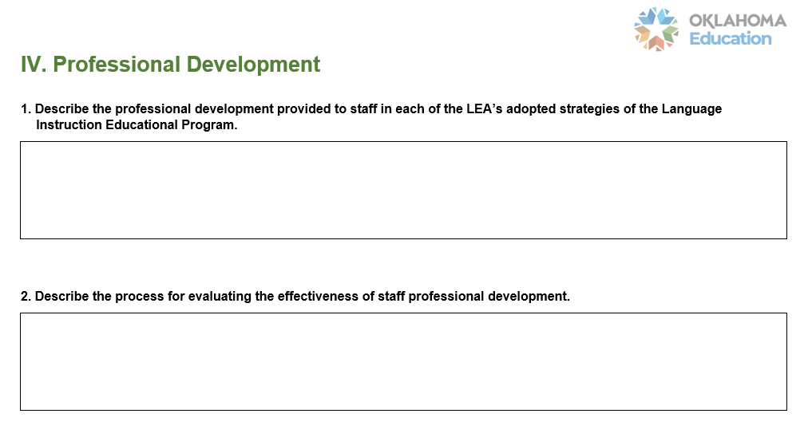
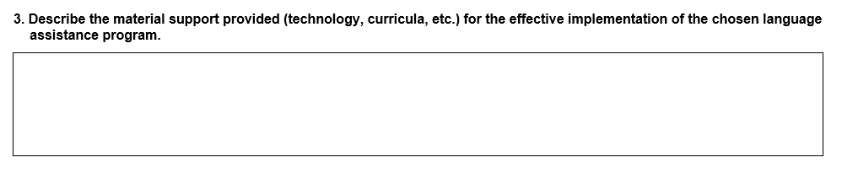
IV. Professional Development

Slide 18
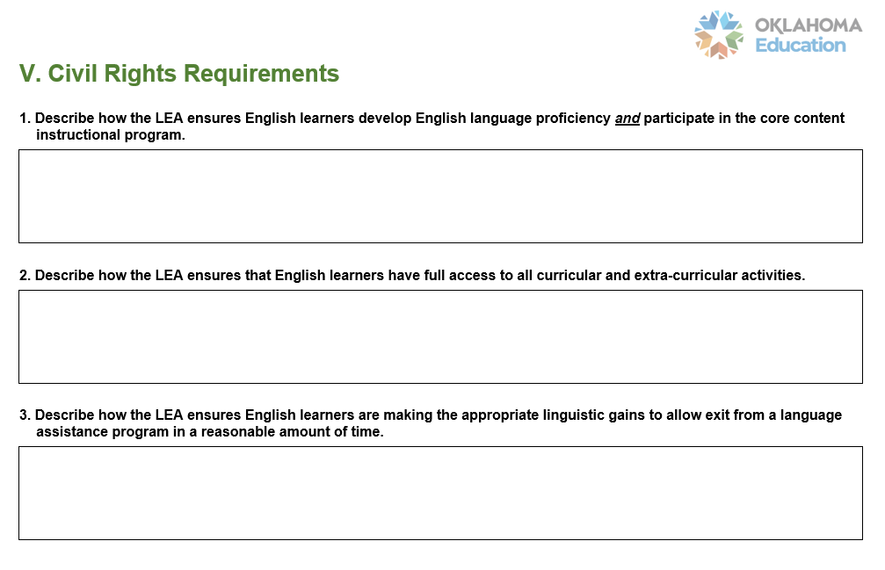
V. Civil Rights Requirements

Slide 19
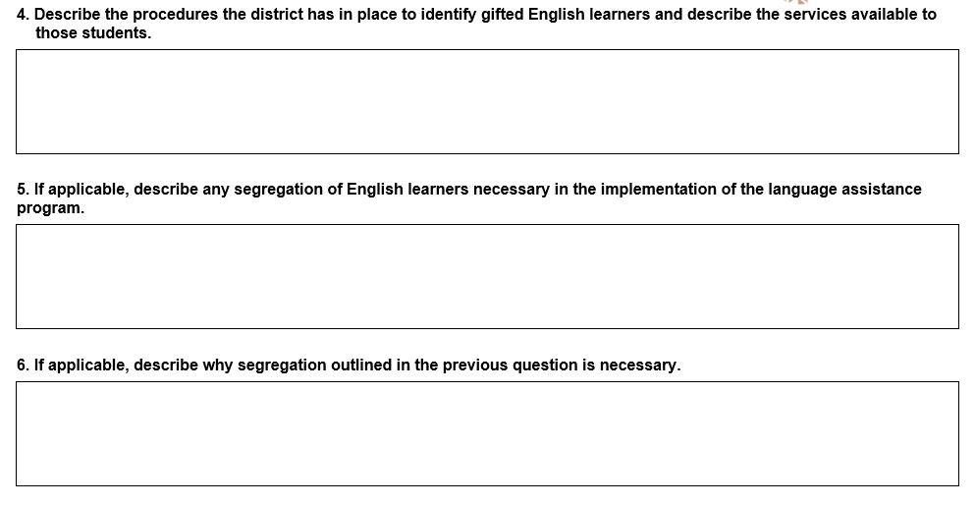
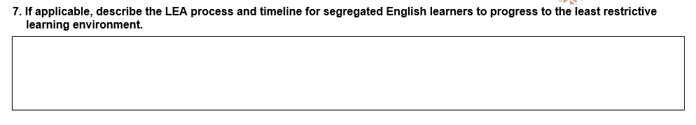
V. Civil Rights Requirements (cont.)

Slide 20

Questions and Feedback

Slide 21
The End
Thomas Kirk
Director of EL Identification and Monitoring
Office of English Language Proficiency
Oklahoma State Department of Education
Thomas.Kirk@sde.ok.gov

