Slide 1
FY25 Title III Consortium Packet
Dr. Tina Alvarado
Office of English Language Proficiency

Slide 2
FY25 Title III Consortium Packet
Dr. Tina Alvarado
Project Manager of English Language Identification and Monitoring
Office of English Language Proficiency

Slide 3
Title III, Part A Allocations
Title III, Part A – EL allocations are based on the previous fiscal year’s October 1 count.
In order for an LEA to receive an allocation, they must have enough English Learners to generate an allocation of $10,000.
The per pupil amount varies from year to year, so it is impossible to say in advance how many students are necessary to generate an allocation of $10,000.

Slide 4
Title III, Part A – EL Allocations (cont.)
LEAs that do not reach the $10,000 threshold, can join together to form a consortium, combining their counts in order to reach the $10,000 allocation threshold.
Each consortium then designates a lead LEA that will receive and manage the allocation, spending funds across the member LEAs.

Slide 5
Allocations in GMS
Once the grant has been awarded it will appear as any other grant award in the Grants Management System (GMS), under the “Allocations” tab of the Consolidated Application.
Each LEA in the consortium will find a small blue link to the consortium allocations page on their own Consolidated Application, in the Title III, Part A – EL column of the “Allocations” tab.

Slide 6
Board of Education Approval
Beginning with the 2018-2019 School Year, OSDE has required documentation of local Board of Education approval to participate in a Title III consortium.
In addition to the previously required carryover and signature forms, a completed Board of Education approval form is also required.
Separate Board of Education approval forms for the Lead Fiscal Agent and Member Districts are available in the FY25 Title III Consortium Packet.
The 2024-2025 Title III Consortium Packet is available in the Title III section of the English Learners page of the OSDE website (https://sde.ok.gov/english-language-proficiency-assessments).
The deadline for submitting FY25 Title III Consortium Packets is May 31, 2024.

Slide 7
Lead Fiscal Agent Responsibilities
The primary responsibilities of the Lead Fiscal Agent are:
Complete and submit the FY25 Title III Consortium Packet to OSDE, Office of English Language Proficiency by May 31, 2024 (Please submit to Tina.Alvarado@sde.ok.gov);
Complete the Title III component of the Consolidated Application in GMS;
Meet the financial management requirements of the Title III award in GMS;
Provide fiscal and programmatic guidance to consortium member districts through the Title III Consultation requirement;
Fulfill additional responsibilities as detailed in the Consortium agreement.

Slide 8
Title III Consultation
The Lead Fiscal Agent is responsible for conducting a Title III Consultation meeting with the EL leadership of member LEAs.
This meeting should…
Occur within the first thirty days of the school year;
Outline the three primary statutory requirements of a Title III program (program improvement, professional development, parent/family engagement);
Assist member LEAs in creating a local Language Instruction Education Plan (LIEP) that satisfies the requirements of a Title III program.
The Title III Coordinator in the Office of Title Services should be invited to attend each consultation meeting.

Slide 9
Title III, Part A Program Requirements
The Every Student Succeeds Act (ESSA) mandates that Title III, Part A – EL funds be used to supplement three EL-specific requirements [ESSA, Section 3115(c)]
Provide effective language instruction educational programs that meet the needs of English learners and demonstrate success in increasing English language proficiency and student achievement;
Provide effective professional development designed to improve the instruction and assessment of English learners;
Provide effective activities that include parent, family, and community engagement activities.
The Lead Fiscal Agent will describe how these requirements will be met in the consortium. The strategies adopted will be apparent in the proposed Title III budget in GMS.

Slide 10
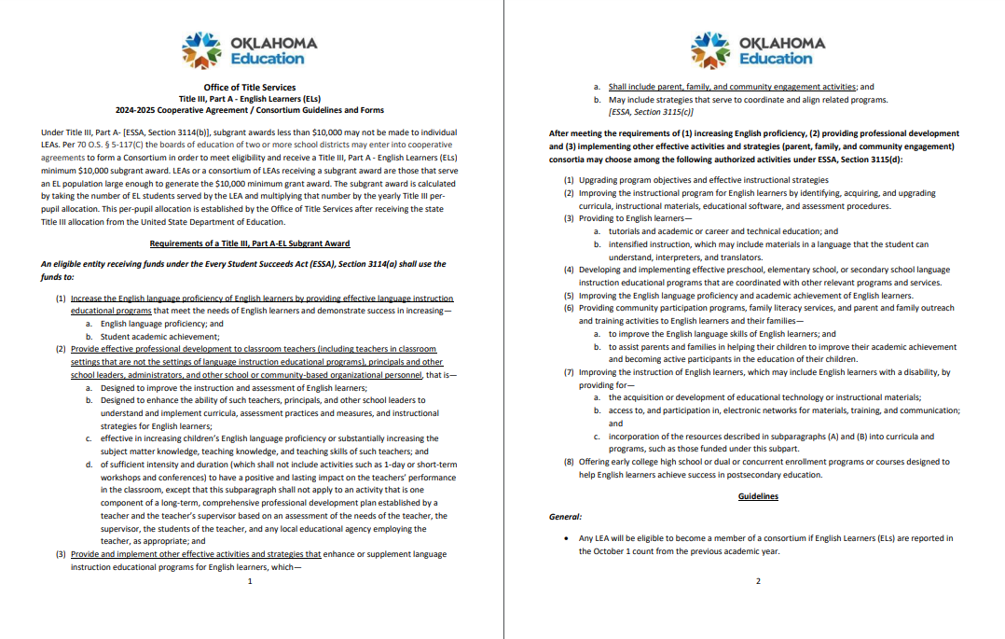
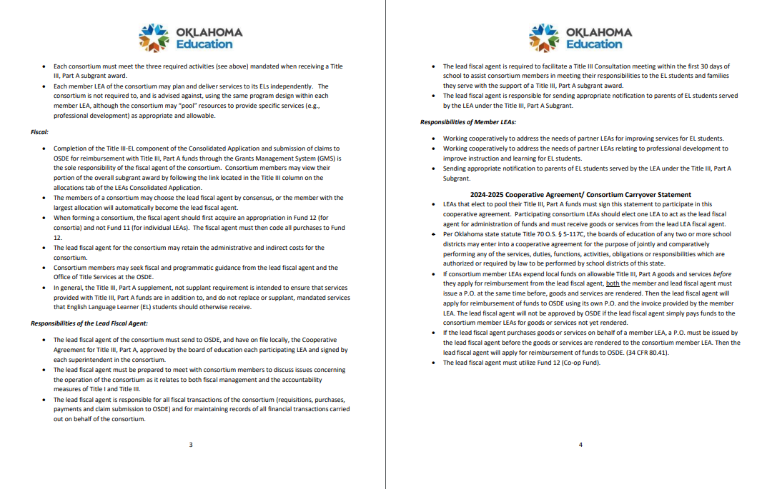
The Paperwork
The first four pages of the Consortium Packet cover the material we’ve discussed so far in this presentation.

Slide 11
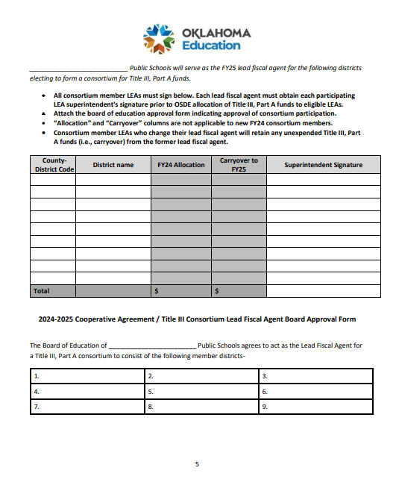
More Paperwork
The Lead Fiscal Agent will have to complete the form on page 5 of the packet, including FY24 Title III allocations, amounts of carryover to FY25 and superintendent signatures.

Slide 12
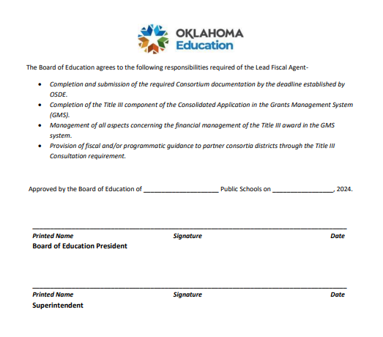
Lead Fiscal Agent Board Approval
The Lead Fiscal Agent will also complete the form on page 6 attesting Board Approval.

Slide 13
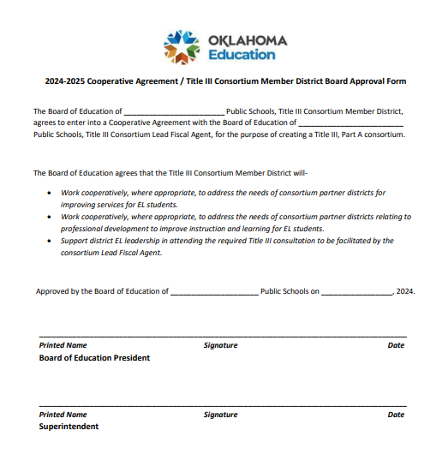
Member LEA Board Approval Form
And finally, each member LEA will complete the form on page 7 indicating local Board Approval.

Slide 14
Submitting Completed Consortium Packets
When the FY25 Title III Consortium Packet is signed and complete, the Lead Fiscal Agent will submit a scanned copy to Tina.Alvarado@sde.ok.gov no later than June 30, 2024.

Slide 15
Thank you.
Dr. Tina Alvarado
Program Manager of English Language Identification and Monitoring
Office of English Language Proficiency
Oklahoma State Department of Education
Tina.Alvarado@sde.ok.gov

