Slide 1
Financial Management of
Special Education Programs
Federal IDEA Part B Funds
Special Education Services

Slide 2
Federal IDEA Part B Funds
IDEA Part B funds are Federal funds the Local Education Agency (LEA) receives to help support the special education program and implement IDEA.
(IDEA stands for Individuals with Disabilities Education Act)

Slide 3
Federal IDEA Part B Funds
Part B is so named because it’s the second part of the law itself. The four parts are:
Part A – General Provisions
Part B – Assistance for Education of all children with disabilities
Part C – Infants and toddlers with disabilities
Part D – National Activities to improve education of children with disabilities
For school-aged children with disabilities (including preschoolers), Part B is the foundation upon which special education and related services rest.

Slide 4
Allowable Use of Federal Funds
All federal funds are to be used on a reimbursement basis only.
IDEA Part B Federal Funds may be used for:
  Special Education & Related Services
  Appropriate Technology for Special Education
  Coordinated Early Intervening Services

Slide 5
Use of IDEA Part B Funds
When an LEA accepts IDEA-B funds they are agreeing those funds will be used to supplement and not supplant state and/or local funds.
Funds must be used to:
  Pay the excess costs of special education and related services.
  Supplement State and Local funds.
(supplement is to provide or make a supplement to something while supplant is to take the place of; to replace, to supersede).

Slide 6
Excess Cost/Maintenance of Effort
Excess Cost / Maintenance of Effort

Slide 7
Excess Cost / Maintenance of Effort
IDEA contains two separate requirements for LEAs to ensure sufficient funding for special education programs:
    Excess Cost
    Maintenance of Effort (MOE)
While these requirements have some similarities, there are separate requirements requiring separate calculations.

Slide 8
Excess Cost
Excess costs are costs that are above what the LEA spends on average for students enrolled at the elementary and secondary level.
Every student enrolled in a public school receives educational support, including students with disabilities. Because a student with a disability is a student entitled to an education first, the concept of excess costs establishes that:
  Students with disabilities receive educational support like non-disabled students, and
  IDEA Part B funds only pay for the excess cost of educating students with disabilities.

Slide 9
Excess Cost
If an LEA has not met excess cost in both elementary and secondary, the district will be issued a citation, and a reduction in State Aid funding will be imposed.

Slide 10
Excess Cost
An LEA not meeting their Excess Cost has the right to appeal their penalty within 30 calendar days of receiving their first notification. All appeals must be submitted in writing, to OSDE-SES. As with Maintenance of Effort, miscoding is not an acceptable reason for the appeal. Should the LEA refute the OSDE-SES decision the LEA can make an appeal to the Secretary of the U.S. Department of Education within 20 days of the OSDE-SES rejection. For districts choosing to submit an appeal, the penalty amount will be withheld from their State Aid funds until the final decision has been made. Should the appeal be in favor of the district, the funds will be returned.
Districts can view their Excess Cost online through the Oklahoma Cost Accounting System.

Slide 11
Unlike MOE, There are no exceptions for Excess Cost

Slide 12
Excess Cost
Tips for determining Excess Cost
Ask the following questions:
In the absence of special education needs, would this cost exist? If no, then the cost is an excess cost. If yes, then the cost is not an excess cost.
Is this cost also generated by students without disabilities? If no, then the cost is an excess cost. If yes, then the cost is not an excess cost.
If it is a student specific service, is the service documented in the student’s IEP? If yes, then the cost is an excess cost. If no, then the cost is not an excess cost.

Slide 13
Excess Cost
Things to check if you receive a NOT MET:
  Check expenditures coded to site code 050.
  Review services are coded to the correct site code.
  Are capital expenditures coded correctly?
  Salaries coded to Elementary but might also need to be coded to Secondary. Should be coded to site child attends.
  Any expenditures coded to 450 or 700 are removed from the equation.
  Review the Excess Cost calculation work sheet on page 54 of the OCAS manual.

Slide 14
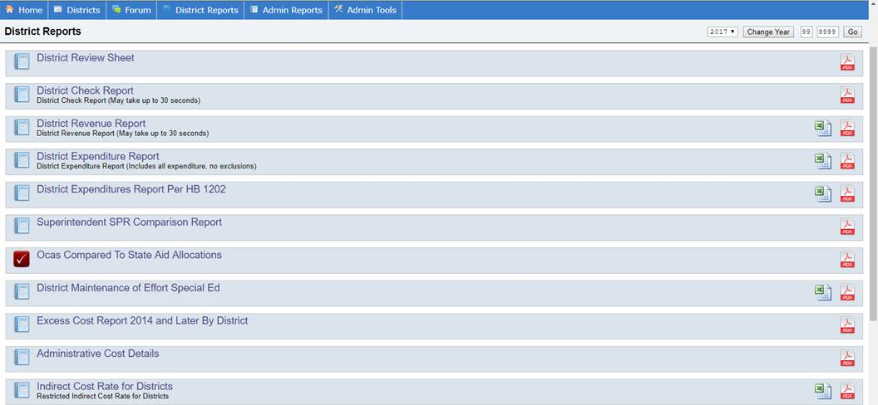

Slide 15
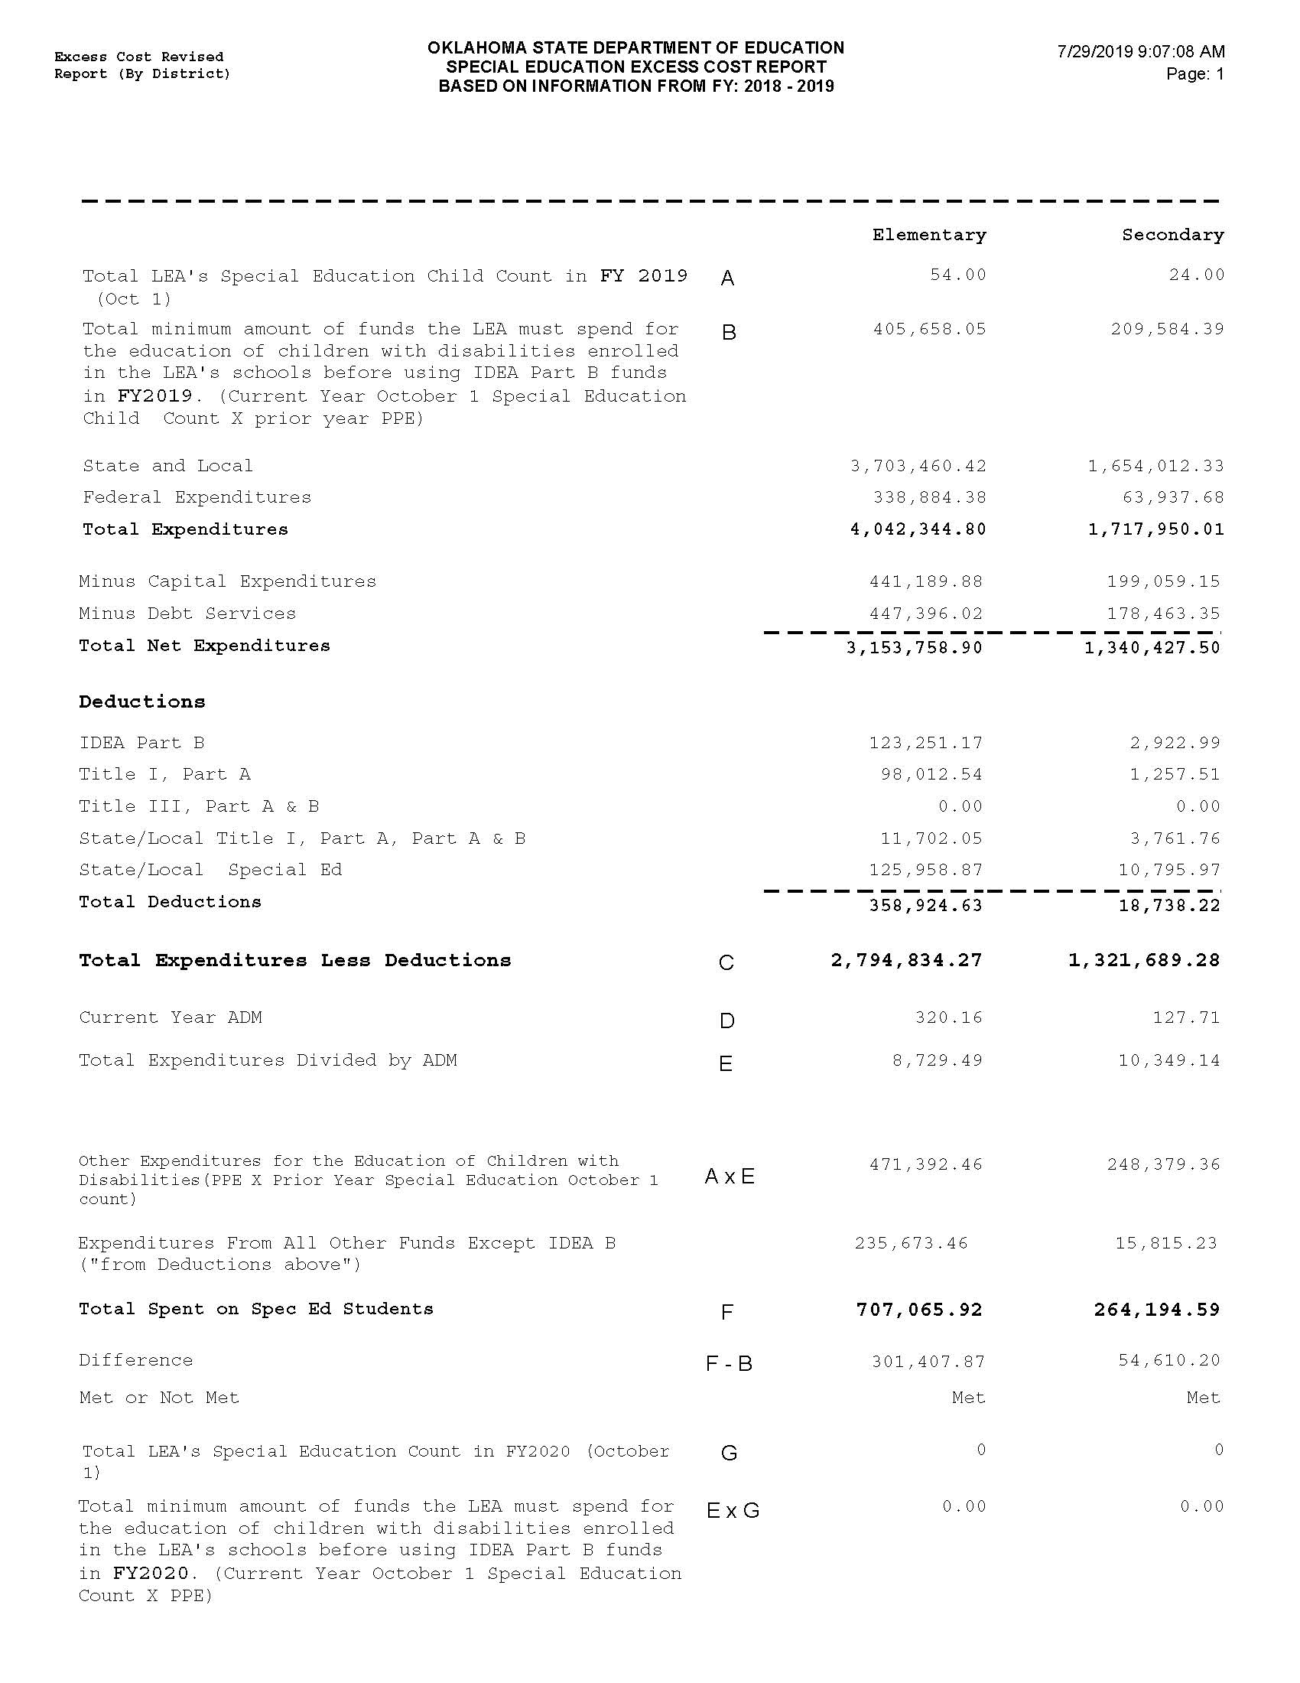

Slide 16
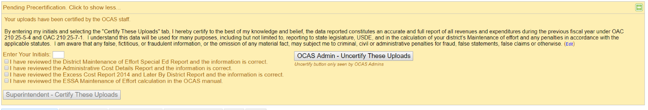
Excess Cost

Slide 17
Maintenance of Effort
The purpose of the MOE requirement is to help ensure sufficient non-federal funding is available for students with disabilities. The U.S. Department of Education does not intend for LEAs to use federal funds as the primary means of providing services to students with disabilities.
LEAs must maintain 100% level of expenditures from State and/or Local funds spent on special education and related services.

Slide 18
Maintenance of Effort
An LEA may use one of four methods to demonstrate they have met MOE requirements under IDEA.
  local total expenditures
  local per capita
  state and local total expenditures
  state and local per capita

Slide 19
Maintenance of Effort
Oklahoma Cost Accounting System (OCAS) calculates Special Education MOE only 2 ways:
  The total expenditures of the LEA for special education and related services (state and local).
  Per capita amount spent on children receiving special education services (state and local).
If either the total amount of expenditures or the per capita amount decreased in the second (i.e., subsequent) year, the LEA has failed to meet the MOE requirement.

Slide 20
Maintenance of Effort
Districts are required to input MOE data information when completing their new fiscal year LEA Agreement.
IDEA Consolidated Application budgets cannot be approved unless the MOE tab has been completed and the district has demonstrated compliance.
All MOE data information must match data submitted through Oklahoma Cost Accounting Services (OCAS).
LEAs must update the MOE data in their LEA Agreement once their data has been certified through OCAS.

Slide 21
Maintenance of Effort
Starting in February an LEA will receive notification that the MOE requirement has not been met. An opportunity will be provided for the LEA to submit documentation of allowable exceptions.

Slide 22
Maintenance of Effort
There are 5 exceptions that may apply to MOE.
Exceptions:
  Voluntary departure, by retirement or otherwise, or departure for just cause, of special education or related services personnel.
  A decrease in the enrollment of children with disabilities.

Slide 23
Maintenance of Effort
Exceptions:
  The termination of the obligation of the agency, consistent with this part, to provide a program of special education to a particular child with a disability that is an exceptionally costly program, as determined by the SEA, because the child
    has left the jurisdiction of the agency;
    has reached the age at which the obligation of the agency to provide Free Appropriate Public Education to the child has terminated; or
    no longer need the program of special education.

Slide 24
Maintenance of Effort
Exceptions:
  The termination of costly expenditures for long-term purchases, such as the acquisition of equipment or the construction of school facilities.
  The assumption of cost by the high-cost fund operated by the SEA.

Slide 25
NO EXCEPTIONS FOR MISCODING

Slide 26
Maintenance of Effort
Special Education Services (SES) can assist your district.
  SES will receive a list of LEAs failing to meet MOE from OCAS.
  Working with LEAs, SES will contact and request specific documentation.

Slide 27
Maintenance of Effort
LEAs failing to then meet MOE, will be issued a citation and receive a reduction to their State Aid funding.
If a district does not receive State Aid, the district will be required to submit a check in the amount of the penalty to OSDE-SES.
Paying the penalty does not reduce your base. You must maintain the MOE base set prior to the penalty.
Everyone loses when MOE is not met, funds leave your district and our State.

Slide 28
Maintenance of Effort
An LEA not meeting Maintenance of Effort has the right to appeal their penalty within 30 calendar days of receiving their first notification. All appeals must be submitted in writing, to OSDE-SES. Since miscoding is not an acceptable exception, it will not be accepted as an allowable reason for the appeal. Should the LEA refute the OSDE-SES decision the LEA can make an appeal to the Secretary of the U.S. Department of Education within 20 days of the OSDE-SES rejection. For districts choosing to submit an appeal, the penalty amount will be withheld from their State Aid funds until the final decision has been made. Should the appeal be in favor of the district, the funds will be returned.

Slide 29
Maintenance of Effort
Example:
During FY2021-22, the LEA had a required level of effort of $100,000.00, and an actual level of $100,000, the LEA met MOE requirements.
During FY22-23, the LEA had an actual level of $90,000, the LEA did not meet MOE by $10,000.
During FY23-24, the LEA will have a required level of $100,000 rather than $90,000.00

Slide 30
Maintenance of Effort
If an LEA meets one of the exceptions, then the base amount will change to reflect that exception.

Slide 31
Assurances, LEA Agreement, and Consolidated Application

Slide 32
Assurances and LEA Agreement
Superintendents must complete Assurances and LEA Agreement each year prior to the start of the new fiscal year.
Assurances and LEA Agreement are required by law to be completed prior to July 1st.
Assurances and LEA Agreement must be completed before the IDEA Consolidated Application will become available.

Slide 33
Assurances and LEA Agreement
You will be required to upload specific documentation in your LEA Agreement:
  District policies and procedures regarding Child Find or the identification process.
  Policies/Procedures on Discipline/Expulsion.

Slide 34
IDEA Consolidated Application
Once the Assurances and LEA Agreement are completed and submitted, and the Special Education allocation has been awarded, a district will be able to complete the Consolidated Application.

Slide 35
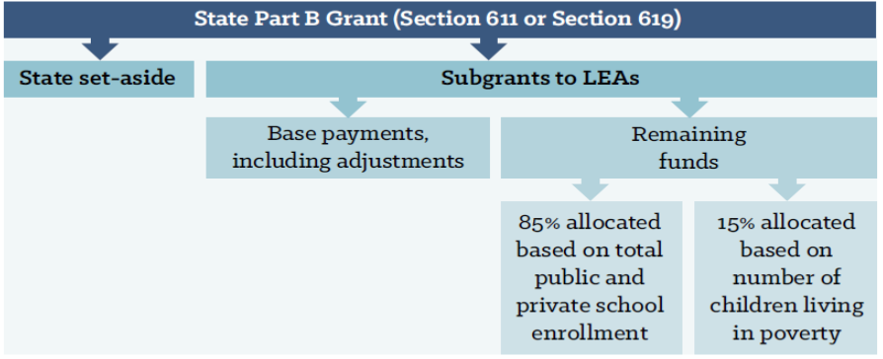
Federal IDEA Part B Funds

Slide 36
Use of IDEA Part B Funds
IDEA Part B Federal funds must be fully budgeted in the Grants Management System (GMS).
All expenditures must be submitted through the GMS.
Expenditures must be necessary and reasonable.

Slide 37
Coordinated Early Intervening Services (CEIS)

Slide 38
Coordinated Early Intervening Services (CEIS)
CEIS are services provided to children who are not currently identified as needing special education or related services, but who need additional academic or behavioral support to succeed in general education.
  LEAs may voluntarily reserve up to 15 percent of their IDEA funds for CEIS.
  Starting in 2018-2019, LEAs identified as having significant disproportionality will be required to set aside 15 percent of their total IDEA funds to provide comprehensive CEIS to children in the LEA, particularly, but not exclusively, to children in those groups that were significantly over identified.

Slide 39
Coordinated Early Intervening Services
CEIS is important for identifying and addressing learning difficulties early.
Research indicates that the earlier the intervention, the more effective the support and the less severe the learning difficulties will be.
Delays in providing support may increase the intensity, and the cost of the services needed to address learning difficulties.

Slide 40
Coordinated Early Intervening Services
CEIS activities that may be funded under IDEA include:
Provide educational and behavioral evaluations, services, and supports, including based literacy instruction.
Provide professional development for teachers and other school staff to enable such personnel to deliver scientifically based academic and behavioral intervention-based literacy instruction and where appropriate, instruction on the use of adaptive and instructional software and;

Slide 41
Comprehensive Coordinated Early Intervening Services (CCEIS): Significant Disproportionality

Slide 42
CCEIS / Significant Disproportionality
Revised regulations on significant disproportionality (34 CFR §300.636) have been finalized by the Office of Special Education Programs (OSEP). These regulations enforce the use of IDEA funds to be used on mandatory Comprehensive Coordinated Early Intervening Services (CCEIS).

Slide 43
CCEIS / Significant Disproportionality
LEAs found to be significantly disproportionate are required to set aside 15 percent of their total allocations (IDEA FlowThrough, IDEA PreSchool). This would also include allocation adjustments.
The LEA must serve children age 3 through grade 12 who are and are not currently identified as needing special education or related services but are in need of additional academic and behavioral support.
Funds must be used to identify and address the factors which contributed to the significant disproportionality for the identified category.

Slide 44
CCEIS / Significant Disproportionality
LEAs may use CCEIS funds for training, professional development, behavioral evaluations, and supports such as:
-Functional Behavioral Assessments
-Behavioral Intervention plans
But only to the extent to address the factors identified as contributing to the significant disproportionality identified by the State.

Slide 45
CCEIS / Significant Disproportionality
LEAs are required to submit a Summary Analysis within their CCEIS application. The summary must be approved through the SES Assistant Program Director prior to any claim approvals.

Slide 46
CCEIS / Significant Disproportionality
LEAs required to set aside funds for CCEIS cannot reduce the districts MOE (50% Reduction).
Funds cannot be used to provide services already required by law.
Funds cannot be used to provide services that were paid for with other funds in a previous year.

Slide 47
COOP / co-op
COOP / Interlocal co-op

Slide 48
COOP / Interlocal co-op
LEAs that select to pool their funds must sign a letter of intent to participate in a special education cooperative arrangement (this is an arrangement that exists under federal law) or an interlocal cooperative (this is a cooperative entity that is created through a specific process under Oklahoma statute 70 O.S. 5-117b. also known as an “interlocal co-op”). Participating cooperative LEAs other than interlocal co-ops should elect one LEA to act as the fiscal agent for funds.

Slide 49
COOP / Interlocal co-op
All LEA’s participating in a COOP/Interlocal co-op must complete a COOP/Interlocal Arrangement For Consolidated Funding application. The application can be found in the districts LEA Agreement under the COOP/Interlocal tab within the GMS. The application must be signed by all LEAs superintendents participating in a COOP/Interlocal and will instruct SES Finance the amount of funding to be transferred to the lead LEA.

Slide 50
COOP / Interlocal co-op
Once this is completed the application page(s) must be uploaded under the COOP/Interlocal tab in the GMS.
The transfer of funds must address both, IDEA B Flow Through and Pre-School funding.

Slide 51
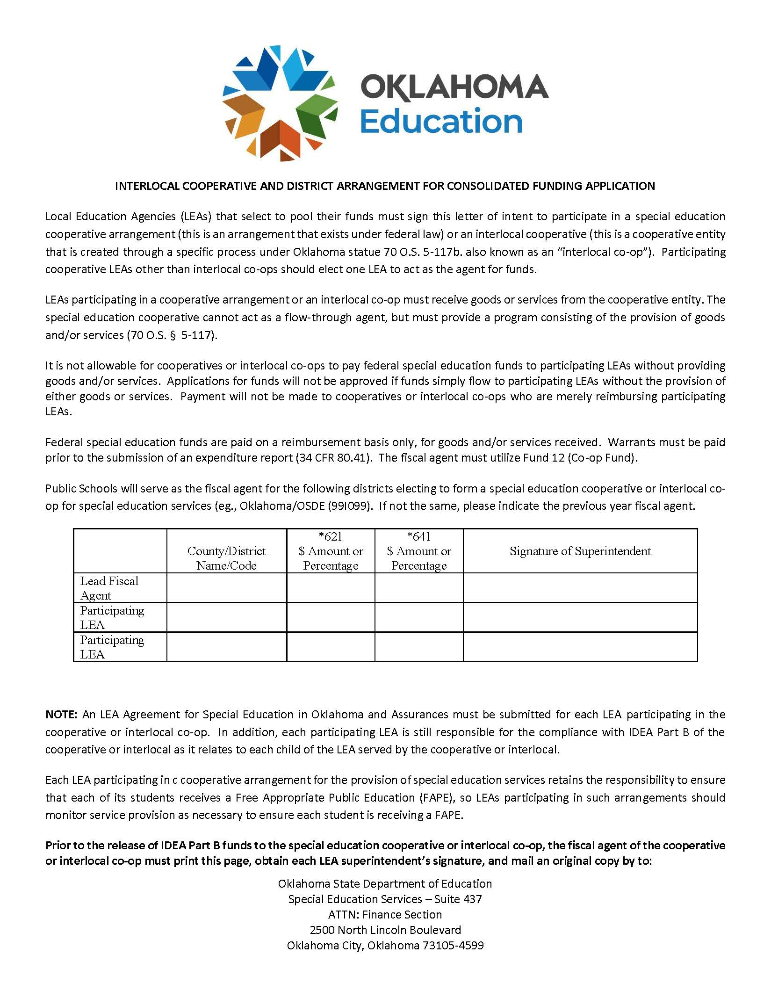

Slide 52
COOP / Interlocal co-op
LEAs participating in a cooperative arrangement or an interlocal co-op must receive goods or services from the cooperative entity. The special education cooperative cannot act as a flow-through agent but must provide a program consisting of the provision of goods and/or services (70 O.S. § 5-117).

Slide 53
COOP / Interlocal co-op
Assurances and LEA Agreement for Special Education must be submitted for each LEA participating in the cooperative or interlocal co-op. In addition, each participating LEA is still responsible for the compliance with IDEA Part B of the cooperative or interlocal as it relates to each child of the LEA served by the cooperative or interlocal.

Slide 54
COOP / Interlocal co-op
Each LEA participating in a cooperative arrangement for the provision of special education services retains the responsibility to ensure that each of its students receives a Free Appropriate Public Education (FAPE), so LEAs participating in such arrangements should monitor service provision as necessary to ensure each student is receiving a FAPE.

Slide 55
Submitting Expenditure Reports for Reimbursement of Funds

Slide 56
Expenditure Reporting
LEAs must have completed an online budget application within the GMS for all funds and receive approval from SES before applying for expenditure reimbursement.
All special education expenditures must be necessary and reasonable.

Slide 57
Expenditure Reporting
Reimbursement claims are submitted online through the Single Sign On, Grants Management and Expenditure Reporting.
NO claim will be paid without a valid UEI number and current expiration date.
Attach supporting documents which must include the Summary Expenditure Report, the Detailed Expenditure Report and all required invoices and receipts.

Slide 58
Expenditure Reporting
Supporting documentation includes:
Requisition
Receipt(s)
Invoice Payment
Without supporting documentation, LEAs cannot prove compliance with IDEA Part B federal grant requirements.

Slide 59
Expenditure Reporting
Summary and Detail Expenditure Report must be signed by the Superintendent, or a representative authorized by the local board of education.
Do NOT use special characters in your PDF title. (#, @, &, etc.)

Slide 60
Expenditure Reporting
If an authorized representative has signed the report, the district must have completed the Board Authorization tab located in their Federal Programs Consolidated Application.
The district must also upload the authorization on school letterhead indicating the appointment.

Slide 61
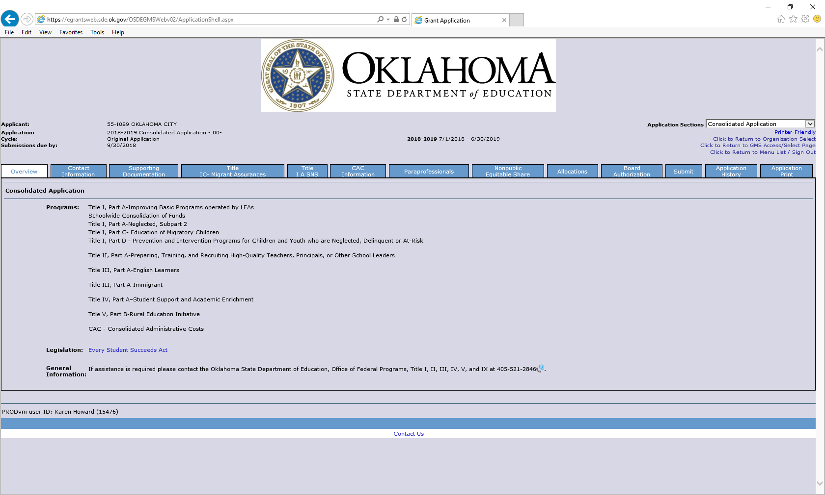

Slide 62
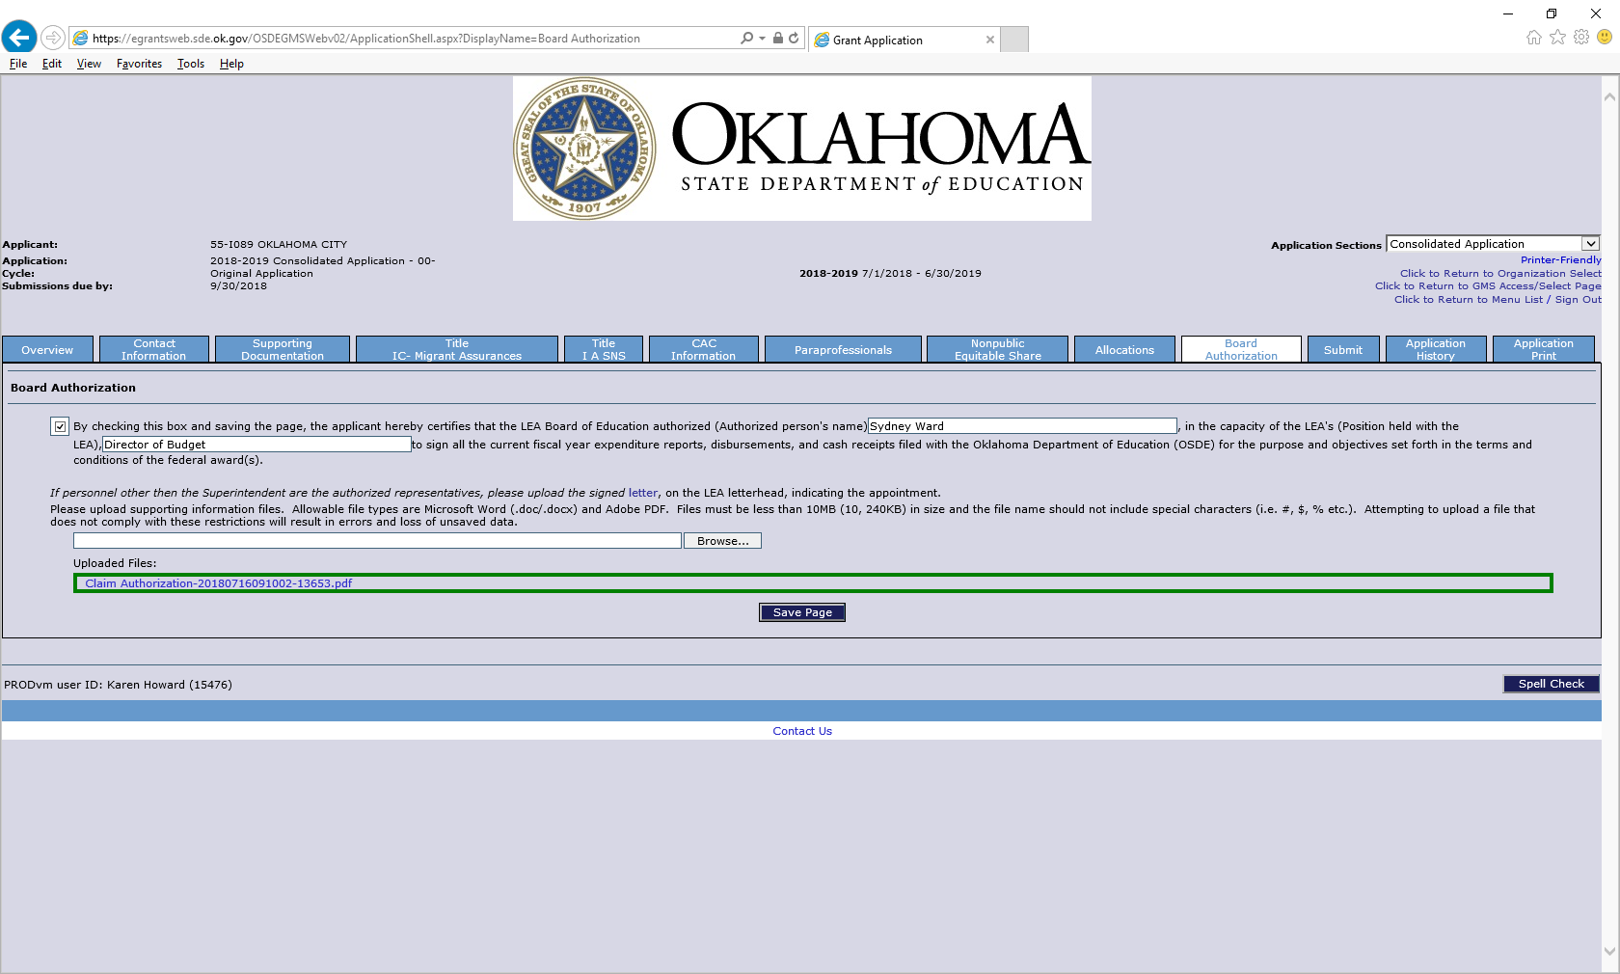

Slide 63
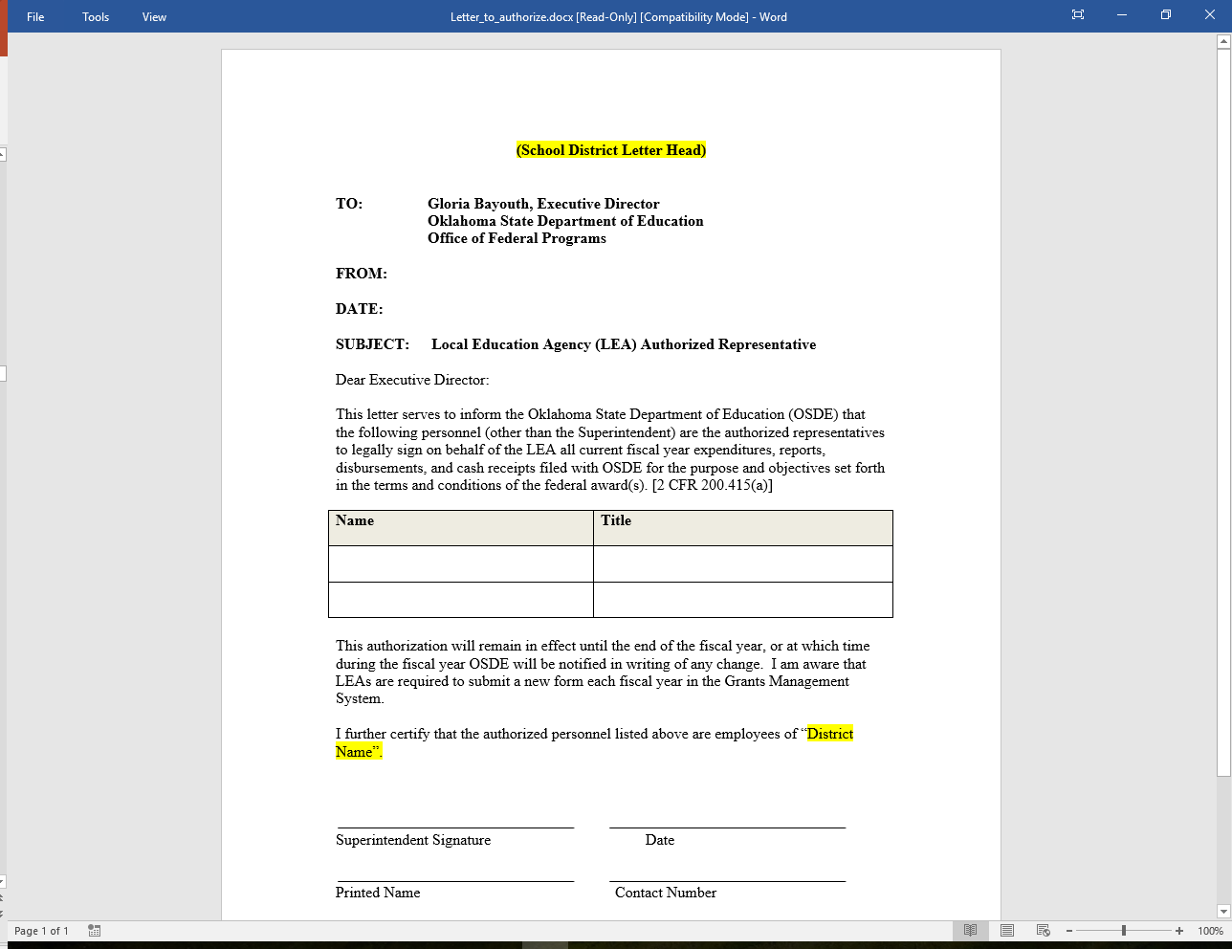

Slide 64
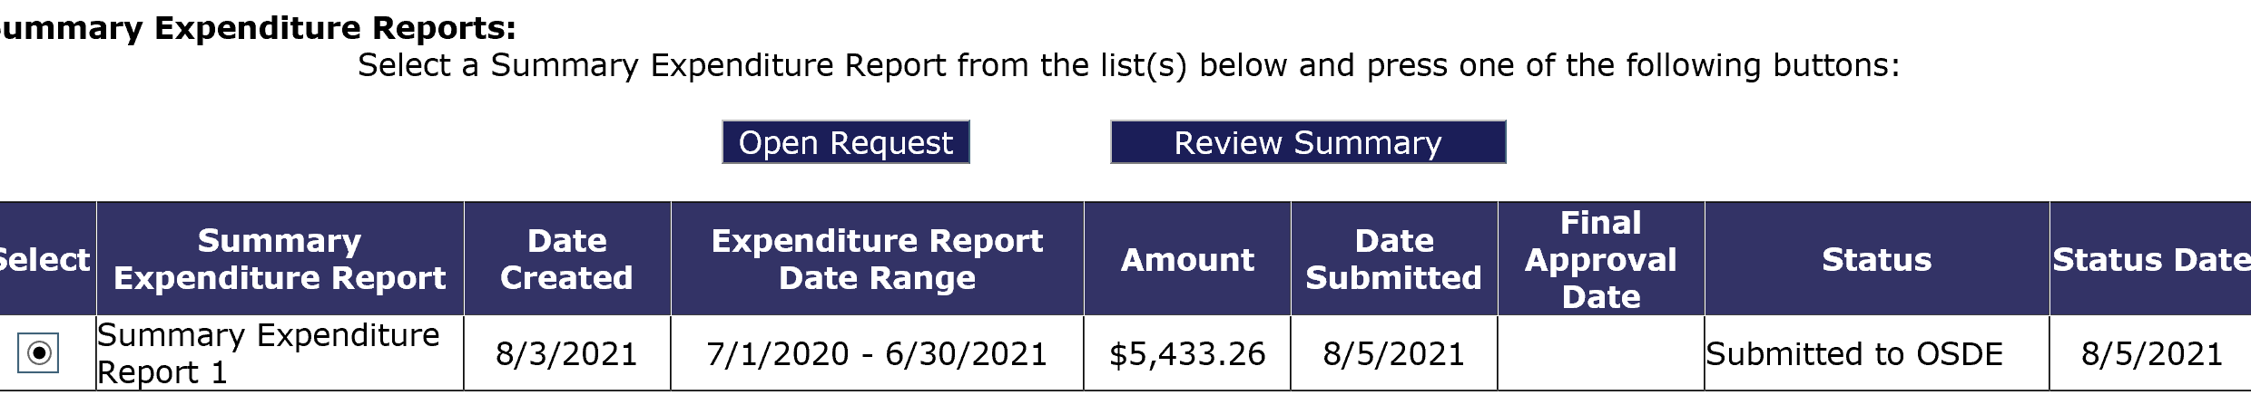
Expenditure Reporting
If a claim is returned, you can review the reason by going onto the Summary Expenditure Report Menu, select which report has been returned, then click the Review Summary button.

Slide 65
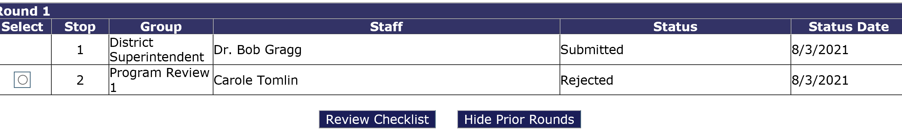
Expenditure Reporting
Select which program review, then click on the Review Checklist button. Once the checklist appears, you will be able to review the message informing why the claim has been returned.

Slide 66
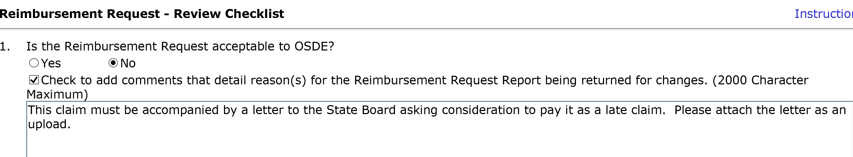
Expenditure Reporting
If you do not see the below screen, check to see if your pop-up blockers are on.

Slide 67
Proper Use of Codes
For a list of proper use of codes in Special Education please see the State Department of Education website, listed under Oklahoma Cost Accounting.
  http://sde.ok.gov

Slide 68
Time and Effort
Year End CloseOut

Slide 69
Year End Closeout
Districts must perform a closeout to end the fiscal year.
  SES requires closeout completion by September 1.
  The closeout informs the SDE that the district has concluded expenditure reporting for the year.
  Closeouts also move all unspent funds to the next fiscal year for budgeting.
  The closeout process is a simple procedure that closely resembles the creation of an expenditure report.

Slide 70
Year End Closeout
Projects requiring a closeout to be completed are:
Projects 621, 623, 625, 641, 642
Projects NOT requiring a closeout to be completed are:
Projects 613, 615, 616, 626, and 627.

Slide 71
Year End Closeout
When completing the closeout report, a district must upload a Time and Effort Report and a Vendor Performance Review form, if applicable.
  A Time and Effort report is required if IDEA Part B funds are used to pay any salary (object code 100).
  A Vendor Performance Review is required for each vendor if IDEA Part B funds are used to pay any Contract Service (object code 300).

Slide 72
Time and Effort
Time and Effort

Slide 73
Time and Effort
In general, salaries and wages of employees who work on federally funded programs may be paid with federal funds as long as they are working on the grant objectives and appropriate time and effort records are maintained.

Slide 74
Time and Effort
All employees must maintain documentation showing that their salaries are allocable to a federal program.
That documentation must be based on records that accurately reflect the work performed.

Slide 75
Time and Effort
Federal regulation requires that any salaries and benefits charged to a federal award(s) must be documented in writing.
  Reflect actual time spent on activities to which federal program(s) are being charged.
  It is recommended documentation is to be signed by the employee and the employee’s supervisor.

Slide 76
Time and Effort
Time and effort reports should be prepared for any staff with salary and benefits that are charged:
  Directly to a federal award.
  Directly to multiple federal awards.
  Directly to any combination of federal awards and other State or Local fund sources.
Keep time and effort reports on file at the district.

Slide 77
Time and Effort
Single Cost Objective
A single work activity that may be funded by one or more fund sources.
Semi-annual time and effort documentation is made in arrears.
(Arrears is a financial and legal term that refers to the status of payments in relation to their due dates. The word is most commonly used to describe an obligation or liability that has not received payment by its due date.)

Slide 78
Time and Effort
Remember:
  One time and effort report of an actual employee must be uploaded during the district’s closeout.

Slide 79
Time and Effort
Multiple Cost Objectives
  For employees who have different jobs or are paid with different funds;
  Must reflect an after-the-fact distribution of the actual activity of each employee;
  Must account for the total activity for which each employee is compensated;
  Must be prepared at least monthly and coincide with one or more pay periods; and
  Must be signed by the employee and supervisor.

Slide 80
Special Education Professional Development
Project 613

Slide 81
Project 613
The intent of this grant is to encourage district involvement in Professional Development opportunities. Funds may be used to help pay costs associated with attending SES sponsored events.

Slide 82
Project 613
The application is located on the Grant Management System. This project is to reimburse districts the costs of travel, substitute teachers, registration, and hotel for eligible events/training.
Funds for this project are limited and based on availability.
Required information:
  Name and title of staff members attending the event/training
  Event/training title and date
  Estimated cost breakdown

Slide 83
Project 613
Reimbursement will include:
  Mileage
  Substitute cost
  Registration
  Hotel
  OSDE will consider the US General Service Administration (GSA) rate as the reasonable and necessary rate for reimbursement.

Slide 84
Project 613
Reimbursement will not include:
  Individual Reimbursement
  Per Diem / Food

Slide 85
Special Education Professional Development/District
Project 615

Slide 86
Project 615
The purpose of this project is to provide additional funds to districts, based on their most recent child count, and are used only for professional development activities that increase the ability of teachers to ensure positive outcomes for students with disabilities.

Slide 87
Project 615
Examples of usage are:
  Inviting Speakers
  Purchasing Books for Staff
  Attending Conferences
  Conducting Trainings
  Attending Webinars

Slide 88
Project 615
The application will be completed online through the Grant Management System.
The application will ask for an explanation of the activity and must be completed for the entire allocation.
Districts must complete an online budget by December 31 or forfeit their allocation, in which the funds will be retrieved back by Special Education Services.

Slide 89
Project 615
If found in noncompliance and/or has not met the state target in the same area/indicator across three consecutive years (for indicators 4,9,10,11,12,13, and DMR Level 3 or 4) LEAs will be required to use a portion of their 615 funds to address their improvement plan implementation.
The amount of funds to be directed will be determined within a consultation with SES.

Slide 90
Certification Examination Reimbursement
Project 616

Slide 91
Project 616
The purpose of this project is to reimburse districts for assisting teachers that need to take and pass additional subject area certification examinations.
It is limited to one exam per individual and districts must provide justification for the necessity of each individual to take and pass the subject area examination.

Slide 92
Project 616
Funds for this project are limited and based on availability.
A copy of the Board Policy is required to be uploaded. The policy must address the approval of using these funds since they are considered salary.

Slide 93
Project 618
Secondary Transition Funds

Slide 94
Project 618
This project is to provide one-time additional funds to districts for the purpose of developing or expanding transition programs for students ages 18 through the school year in which the student turns 22.

Slide 95
Project 618
These funds may only be used for purchases of curriculum, equipment, and/or materials to support secondary transition or professional development directly supporting secondary transition, such as postsecondary education/training, employment, independent living, or community participation, thus improving student post-secondary outcomes.

Slide 96
Project 618
Districts will receive an allocation based on their October 1, 2023 child count of OAAP students age 17-21 and will be age 18 through the end of the school year in which the student turns 22 for school year 2024-2025.
The application will be located in the Grants Management System (GMS). The allocation received can be located on the allocation tab. Districts not completing a budget by April 1, 2024, will forfeit their allocation, and funds will be returned to the Oklahoma State Department of Education, Office of Special Education Services.

Slide 97
Project 618
Examples of usage are:
• Purchase of hard copy or digital curriculum related to transition skills, including student licenses
• Purchase of equipment related to transition skills (e.g., washer, dryer, stove/oven, etc.)
• Purchase of materials related to transition skills (e.g. task boxes, folding boards, etc.)
• Purchase of assistive technology related to transition skills (e.g. assistive time devices, adaptive kitchen utensils.)
• Expenses associated with staff training related to transition skills (e.g. registration fees, staff stipends for summer training, travel to training, substitutes while staff is at training, etc.)

Slide 98
High Needs
Tier I and Tier II

Slide 99
High Need Students
Tier I
  Out-of-State residential placements (prior OSDE approval required).
  Must be written in the students IEP.
  Must have acceptance letter from the Out-of-State resident facility.

Slide 100
High Need Students
Tier II
  Applicants must meet the following qualifications:
    At least three times the average per pupil expenditure in Oklahoma.
    At least 10% of the LEA’s previous year’s Flow-Through allocation (for all high need children).
    Funds will be awarded based on availability.

Slide 101
High Need Students
Applications for Tier I and Tier II programs will be available on the SDE Special Education web site.
Applications for Tier I and Tier II programs will be due on the Fourth Friday of July.

Slide 102
Finance Resources
Finance Resources

Slide 103
Finance Resources
http://ok.gov/sde/finance
Due date for financial activities
Frequently asked questions-Maintenance of Effort
Time and Effort Samples and FAQ
Board Policy Sample
High Need Student Application
COOP/Interlocal Coop Application
CloseOut Power Point
Finance Funding Manual
Joint Federal Programs Claims Procedures

Slide 104
Finance Due Dates
For the new fiscal year ;
GMS opens first Friday in May
Due prior to July 1
  Assurances
  LEA Agreement
Due by the fourth Friday of July
  Tier I Out-of-State Residential Application
  Tier II High Needs Application

Slide 105
Finance Due Dates
October 31
  IDEA Consolidated Applications
June 1
  Last day to file a payable claim to be guaranteed payment by June 30
June 30
  Last day to submit a budget amendment

Slide 106
Finance Due Dates
August 1
  Expenditure Reports Due, (all expenditure reports submitted after August 1 are subject to the approval of the State Board of Education)
September 1
  District Closeout

Slide 107
Finance Due Dates
December 31
  Project 615 Application. LEAs not submitting an application by December 31 will forfeit their allocation. These funds will be re-allocated to LEAs with a submitted application.

Slide 108
Finance Team
Carole Tomlin, Project Manager (405) 521-2335
Janet Felton, Finance Specialist (405) 522-1578
Mitchell Kern, Finance Specialist (405) 521-4857
Abby Johnson, Project Manager (405) 521-4867
Karen Howard, Program Manager (405) 521-3587
Email address
first name.last name@sde.ok.gov

