Slide 1
2023-2024
Closeout Procedures in the Grants Management System (GMS)

Slide 2
Close Out Process in GMS
Once an LEA has completely finished expending funds and received reimbursement for the 2023-2024 fiscal year, the LEA will need to perform the closeout process in the Grants Management System (GMS). This process will need to be performed for each grant program listed in the IDEA Consolidated application the LEA had an allocation for in the 2023-2024 fiscal year.
Projects 613, 615, 616, 617, 618, along with High Needs Tier I and Tier II, do not require a closeout to be performed.

Slide 3
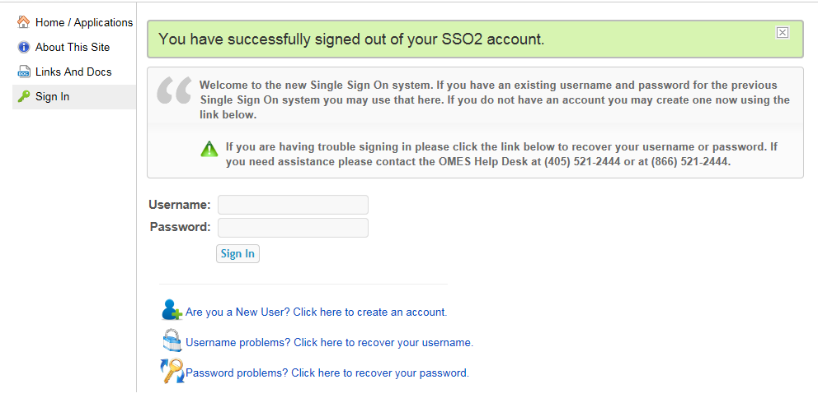
Step 1
Log onto the Single Sign On System and enter your username and password.

Slide 4

Step 2
Select Grants Management and Expenditure Reporting

Slide 5
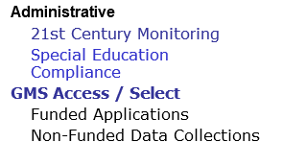
Step 3
                Select GMS Access/Select

Slide 6
Step 4
        Make sure the Year is 2024

Slide 7
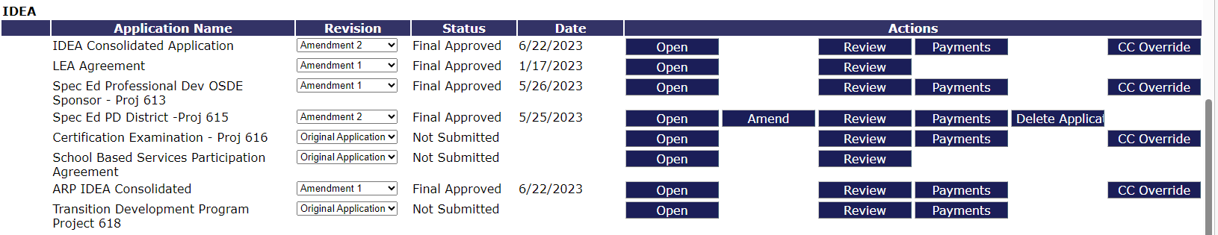
Step 5
Select the “Payments” tab for the program that you are closing out.

Slide 8
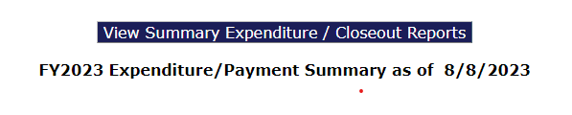
Step 6
Click on the View Summary Expenditure / Closeout Reports button

Slide 9
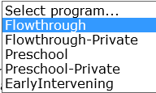
Step 7
From the Select program drop down box, select the program being closed out

Slide 10
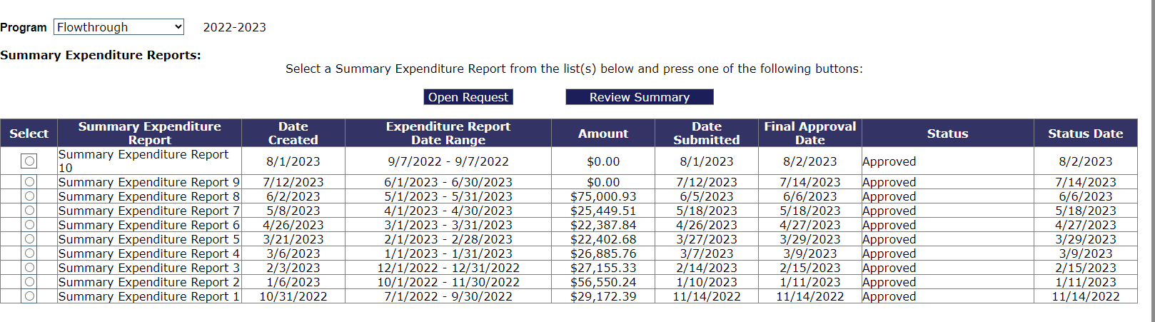
Step 8
Make sure all claims state “Approved” in the Status box
If any claim is not in an approved status, the LEA cannot close out

Slide 11
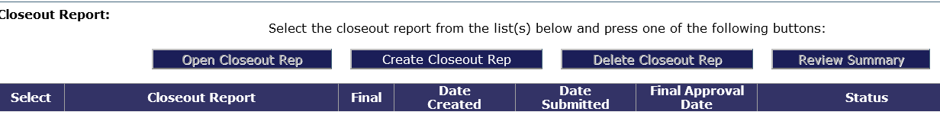
Step 9
Click the “Create Closeout Rep” button under the Closeout Report section
Again, you must verify that all Summary Expenditure Reports have been approved before taking this step.

Slide 12
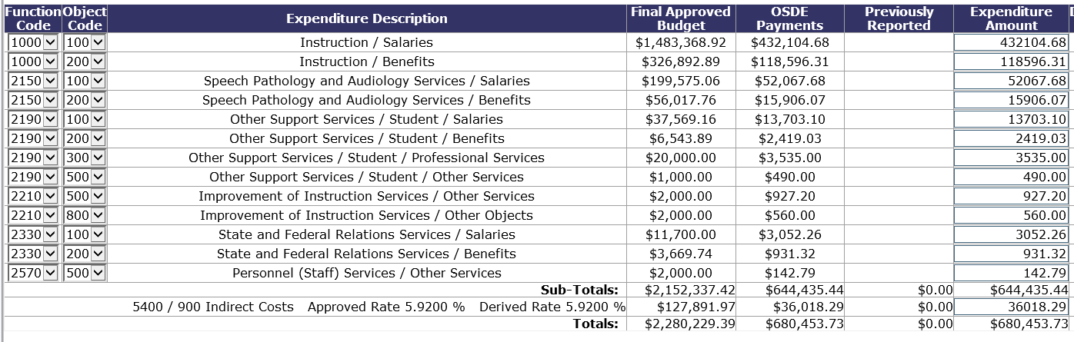
Step 10
Verify that all amounts listed under the OSDE Payments column are accurate

Slide 13
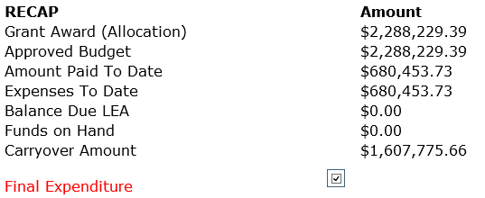
Step 11
Verify the amounts match exactly what the LEA has on record of actually being reimbursed by OSDE

Slide 14
Step 12
If all information is correct, select the Expenditure Period End Date of “6-30-2024”

Slide 15
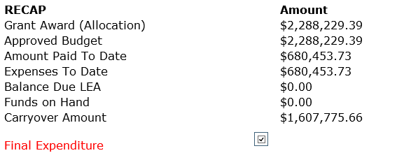
Step 13
The “Final Expenditure” box will automatically be checked and carryover amount will appear (if funds remain). This screen indicates what the LEA had available in the grant program in the 2023-2024 fiscal year and the amount of funds that are eligible to carryover into the 2024-2025 fiscal year. Should any funds show on Funds on Hand, stop the closeout process and contact your finance specialist.

Slide 16
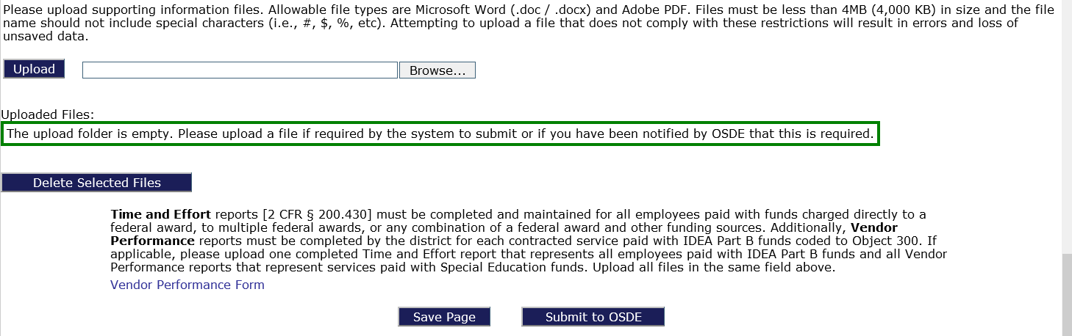
Step 14
Districts are required to upload a single Time and Effort Report if any federal funds were coded to object 100.
Districts are required to upload a Vendor Performance Form for each vendor coded to object 300. A link is provided at the bottom of the page for a Vendor Performance Review form.

Slide 17

Closeout Process
Once all steps have been completed and the LEA has verified that all figures are accurate, the LEA will need to select “Save Page” then will need to select the “Submit to OSDE” tab. Both buttons are located at the bottom of the closeout page. The Closeout Report will be forwarded to OSDE staff for review. Once the submitted report is approved, the LEA will be ready to begin the 2024-25 fiscal year application and budgeting process for the particular grant program upon release of the FY2024-2025 applications.

Slide 18
Special Education
Contact Information
Mitchell Kern, Finance Specialist – (405) 521-4857
Carole Tomlin, Project Manager– (405) 521-2335
Janet Felton, Finance Specialist – (405) 522-1578
Karen Howard, Program Manager– (405) 521-3587
Email address will be as follows:
First name.last name@sde.ok.gov

