Slide 1
Differentiated Monitoring System
Level 4 Support
Notes:
Welcome to the DMR Level 4 presentation. .

Slide 2
Introduction
What are differentiated monitoring results (DMR)
Summary/review of the required activities
Understanding the Indicators
Introduction to EdPlan Monitoring
Contact Information
Notes:
Today we will:
*Ensure you have a strong foundation of our Differentiated Monitoring Results commonly known as DMR.
Understand what activities will assist you in gaining a better understating of the reasons your district is struggling in specific areas.
Gain a stronger understanding of the indicators
An introduction to the new EdPlan Monitoring Tool.
And our contact information.

Slide 3
What is DMR
Notes:
Now let’s talk about our Differentiated Monitoring Results.

Slide 4
Differentiated Monitoring Result (DMR) System
The differentiated monitoring results system expands state monitoring of district performance into two areas beyond IDEA compliance:
  Fiscal risk to the state
  Student outcomes
This expansion meets two federal intents:
  A requirement to assess subgrantees’ risk to the state education agency (SEA)
  A goal to move towards “result-based accountability”
Notes:
Oklahoma’s Differentiated Monitoring Results, commonly known as DMR, expands our state monitoring of districts performance into two areas beyond IDEA compliance but look at a district’s fiscal risk to the state and student outcomes.
This system allows us to review a districts risk to the state education agency and to move towards a results-based accountability. Both of which are federally required.

Slide 5
Differentiated Monitoring Results (DMR)
OSDE-SES identifies each district’s DMR based on a Risk score and a Determination Rating (Accounts for IDEA compliance and student performance reporting requirements).
The DMR is reported as a level of support a district is assigned for the designated school/fiscal year.
Notes:
The DMR system assesses each district based on a Risk score and a Determination Rating. The risk score accounts for the districts risk to the SDE.
The Determination rating accounts for IDEA compliance and the student performance rating.
These two areas provide each district with the DMR Level of supports.
Refer to the General Supervision Manual for more detailed information. It can be located on the SDE website, compliance, DMR tab.

Slide 6
Level 4 Expectations
Required Activities
Notes:
This section will discuss the specific information for DMR Level 4 districts.

Slide 7
What is Level four Support?
Level Four Support assigned to districts identified as either:
Risk tier 4 (High Risk)
Determination level 4 (Needs Substantial Intervention)
Four Levels of Support
Levels 1 to 4
Level 4 is most intensive, for districts that really struggle
Notes:
There are four levels. Level 1 to 4, Level 4 is the most intensive level.
You are here because you are struggling in either Risk or Determination.
To identify which area’s, you are needing to focus your improvements , refer to the Special Education Data packet that was emailed to the Superintendent, and Special Education Director. There is a cover page that summarizes the data. You can also locate the information on the Determinations document and the District Data Profiles will provide you the information for each indicator.

Slide 8
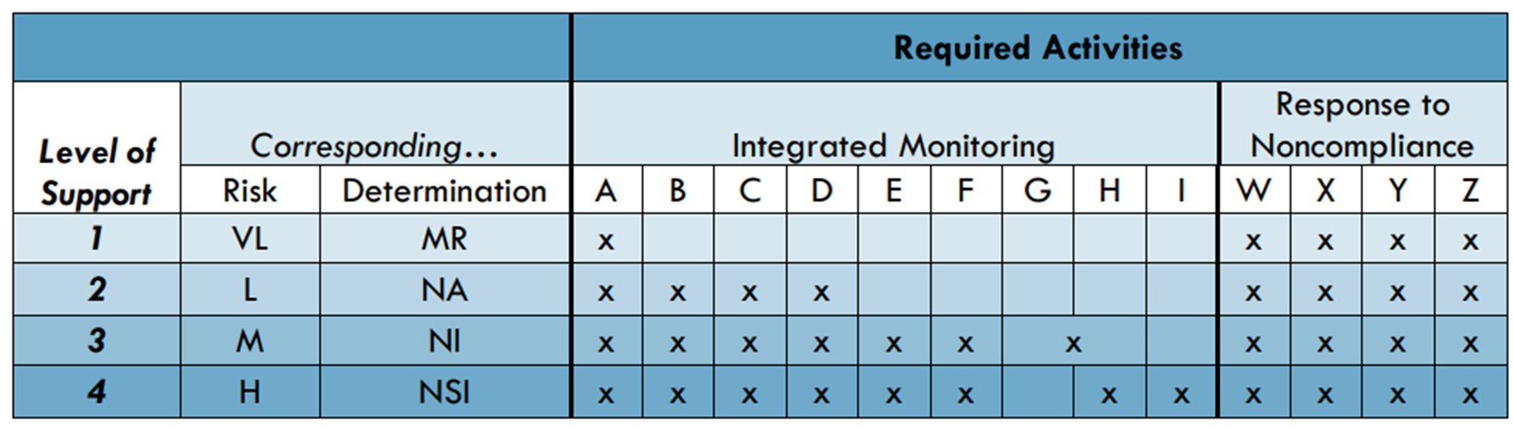

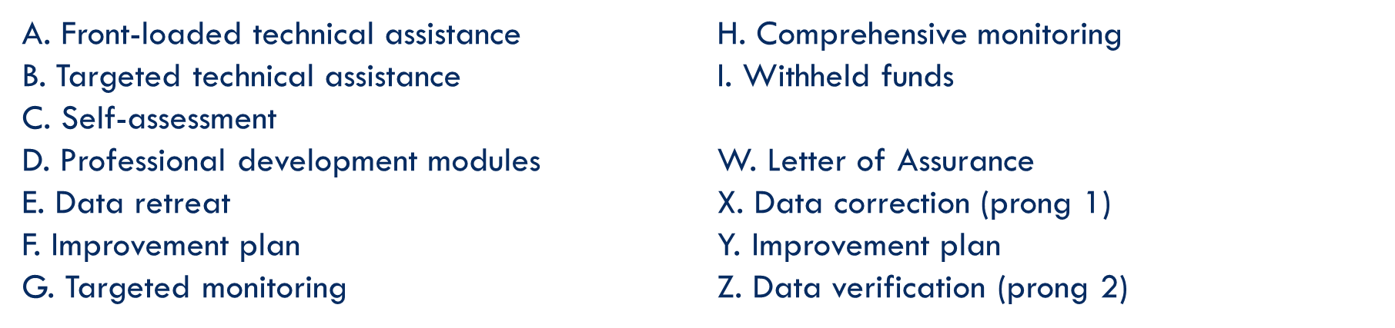
Notes:
This chart shows you the expectations for each level.

Slide 9
Notes:
Here you see the corresponding columns for risk and determinations. DMR Level of supports will be identified by looking at your risk and determination score. Which of the two is furtherest from Level 1 will be your DMR Level of supports and that will also be your focus of either Risk or Determinations.

Slide 10
Notes:
Under Required activities you will find the integrated monitoring activities for each level of supports. Below you will find explanation for the integrated monitoring activities.
As you can see, Level 4 is expected to complete integrated monitoring activities A through F. G and H boxes are combined because DMR Level 3 or 4 may receive either a targeted monitoring or a comprehensive monitoring. The SDE will identify which would be of best benefit for each district.

Slide 11
Notes:
The Response to Noncompliance, letters W through Z are required for all levels. Each time we are working with a district to improve in an area required under IDEA, the SDE requires a letter of assurance to ensure the district will strive for compliance. The improvement plan is your guide to improvement. We do review the plans to see if the district has identified the root cause and to also see what we can do to support the plan. Last, there is data corrections (Prong 1) which means you have corrected all data. Prong 2 is data verification which means the SDE is required to ensure the district has systemic compliance meaning the learned knowledge has now been implemented across the district.

Slide 12
Level 4: Required Improvement Activities
Front-loaded technical assistance
Targeted technical assistance
Toolkit(s)
Professional development (PD)
Data Retreat
Improvement Plan
Comprehensive Monitoring
Progress Review
Notes:
From the chart we just reviewed, here is the list of activities for DMR Level 4.
Front-loaded TA just means we will provide any TA needed to support the district.
Targeted TA is technical assistance specific to the areas of needed supports.
Toolkits are documents designed to assist the district with identifying the root cause, developing improvement plans, and identifying data to monitor progress.
The district must professional development to support the improvement plan. The PD is not an improvement plan, it is a step in the process.
PD is not the improvement plan, it must support and align with the improvement plan.
Every DMR Level 4 is required to attend and participate in the data retreat. The data retreat is held in November and December. The Data retreat will assist you in understanding the data needed and how to use the information for improvement. The rest of the data retreats are for the districts to report on there process, data reviewed, and how each district has identified their root cause. This is intended as a learning process from each other. Everyone’s process and data will look different because each district is unique.
Progress review is intended to assist the district in moving towards compliance and if no movement has occurred, then the team should then go back to the data and determine why and what changes need to be made.
You will also participate in a comprehensive monitoring.
The SDE expects the districts to continuously review the data to ensure movement towards compliance and to continue to review district data once a district is compliant to remain compliant.

Slide 13
Completing the Requirements
Document the identified PD
Verify the root cause identified by the team
Meet with team, review data to determine reasons for noncompliance.
Establish PD to assist in correcting noncompliance
Notes:
The first step is to gather a team. This should never be one person developing a plan because then you are missing the views of other staff that may be vital for the district improvement.
The team should include the Special Education Director, special education teacher, an administrator, a general education teacher (if areas of need is early childhood, then the general education teacher should be employed to work with students in pre-K).
Review data and identify what is needed to assist the team to determine the root cause.
Determine the root cause, develop an improvement plan and align PD to the improvement plan.

Slide 14

Data Review
Purpose: to decrease reasons for low achievement in a particular area
Content:
A series of “inquiring questions” that are intended to drive the search into low achievement
A series of “helpful hints” for data collections
A conclusion statement that summarizes your district’s investigation
An action statement defining improvement steps
A plan for the PD requirement
Notes:
Reviewing data is vital to ensure the district identifies the root cause and can then make improvement.
The data should identify the inquiring questions helping to identify additional data that assists in drilling down to the root cause.
Sometimes a district has to review data and inquiring questions several times before the true root cause is determined.
Reviewing progress, once the plan has been implemented, will determine if the true root cause has been determined. If no progress, the team may need repeat the data review process.

Slide 15
Toolkits
Comprehensive Monitoring
Progress Reviews
Notes:
This is a summary of the expectations for DMR Level districts.
Each district will have to complete a toolkit, progress review, and will receive either a targeted or comprehensive monitoring.
Let's discuss each of these.

Slide 16

Toolkits
Complete
Complete the appropriate toolkits
Identify root cause
Develop improvement plan
Identify professional development (PD) Needed
Provide
Provide the PD & implement the improvement plan
Monitor
Monitor improvement plan and report progress twice.
Notes:
Complete toolkits in EdPlan.
The toolkits are intended to guide the district through the data review process to identifying the root cause and to develop a plan for improvement.
When the root cause is identified the district can develop and implement an improvement plan, then align PD needed for improvement.
The district is expected to monitor progress using data identified in the improvement plan. If the progress review indicates little to no progress, the district may need to return to the data review and root cause to identify the needed changes.
Use the progress reviews to identify progress or lack of progress. Do not wait to make changes to your plan. If the plan is needing changes, change it.

Slide 17
Goal
Weak Goal:
We will monitor our dropout numbers.
Strong Goal:
The team will meet monthly to identify students at risk for dropping out of school. We will implement a one-on-one mentoring program and identify students that may need additional supports. When needed, we will connect with our community partners to provide the needed supports for individual students.
At this meeting, we will assign staff to connect with students that have dropped out to provide support.
For the students at risk, we will identify strategies that are working and if needed, new strategies or community supports for each student and will continue to connect, support, and monitor.
Notes:
The next few slides are examples of weak and strong goals.
Here you see the weak goal stating:… It is clear the goal is not tied to any data and a true root cause has not been identified. We also do not have have a clear understanding of how the district plans to monitor the data and what are they going to do with the information?
A strong goal will identify the plan so that everyone has a clear understanding of the process, who has what responsibilities for implementation, and what data will be used to determine the effectiveness of the plan.

Slide 18
Data
Weak
Obtain a report from the high school on the numbers of students that have dropped out of school each semester.
Strong
The team plans to review the number of students that have dropped out at our monthly meeting. We will compare the attendance and grades for these students.
The team will also identify students at risk for dropping out. To provide the appropriate supports to these students, we will review attendance data and grades.
Notes:
Here the weak goal states the district will review the dropout report each semester. It does not identify what they plan to do with the data. I am also concerned that the district plans to look at the information twice a year. Reviewing data twice a year is not enough to make progress.
Instead the >>>

Slide 19
Progress Review Examples
Weak:
Data shows progress.
Strong:
As of today, we have assisted four students as they return to school. We have a staff assigned to each student to check in weekly. We still have two students we are still working with to encourage them to complete their education.
We have identified ten students at risk for dropping out of school and have assigned staff to meet regularly with them. In the past two months, we have noticed their attendance has increased by 10% and their grades have increased by 25%.
Notes:
Here is an example of a progress review.
Twice this school year each district will be expected to report their progress towards the improvement plan. Once by March 31st and again by May 31st.
The weak example provides no specific information to help guide the team in determining if the plan is working or if the team needs to go back and review data and develop a revised plan.
The other example …..

Slide 20
Exception
If a district has been identified noncompliant and/or not met state target in the same area/indicator for three consecutive years, the district must also complete additional activities.
Activities are developed on a tiered system depending on the number of consecutive years for an area with a growth measure built in.
Notes:
If a district did not meet the target three consecutive years for the same area/indicator, you will complete additional activities.
The purpose of the activities is for the LEA to work with the staff and the community as a team to meet compliance requirements and performance expectations.
To determine if you fall in this group, you will need to locate and review the most recent and the past two DDPs.
For additional detailed information reference pages 14-16 in the General Supervision System.

Slide 21

Exception:Tiered Process
Tier 1-3rd Year
Review past 2 years root cause findings
Tier 2-4th Year
Review past 3 years root cause findings
Tier 3- 5th Year Plus
Review past 4 years root cause findings
Utilize 615 funds to address improvement plan.
Develop/utilize Parent Advisory Board
Use 615 funds to address improvement plan implementation.
Use 615 funds to address improvement plan implementation.
Develop/utilize parent advisory board.
Invite parents of students with disabilities to school board meeting.
Notes:
Activities are developed on a tiered system based on the number of consecutive years for one area with a growth measure built in.
If a 10% growth is demonstrated while implementing the improvement plan, the current tier will be the same for the next year. If there is not growth or decline the district can move to the next tier below placement.
Refer to General Supervision System for additional detailed information on pages 14-16.

Slide 22
Caseload
Review all special education staff caseload
Submit request for exception for all teachers over 1.0
Due: December 31, 2023
Located on SDE website
Notes:
As a part of the monitoring, each district is required to review the caseload for each special education teacher. Each special education teacher with a caseload exceeding 1.0. is required to submit documentation by December 31, 2023.
Upload documentation into EdPlan Monitoring System.
This is also a great time to make sure all your staff have a current teaching certificate. We do check with certification, and we do find teachers with expired certifications, or they were a boot camper that has not met the requirements.
If, after you have reviewed all your staff caseloads, and everyone is at 1.0 or below, please provide a signed statement on district letterhead and upload in EdPlan. The statement needs to state the you have completed a review of staff caseloads and at this time everyone is compliant. Title this “caseload”.
The required documents are located on the special education website – compliance – Caseload tab.

Slide 23
Comprehensive Monitoring
Looks at all areas of special education:
  Student confidential files (eligibility process and IEP)
  Financial
  Strengths and areas of concern for the district
  Staff Interviews
  Parent forum/interviews
Notes:
Looks at all areas of special education

Slide 24
Website Updates

Slide 25
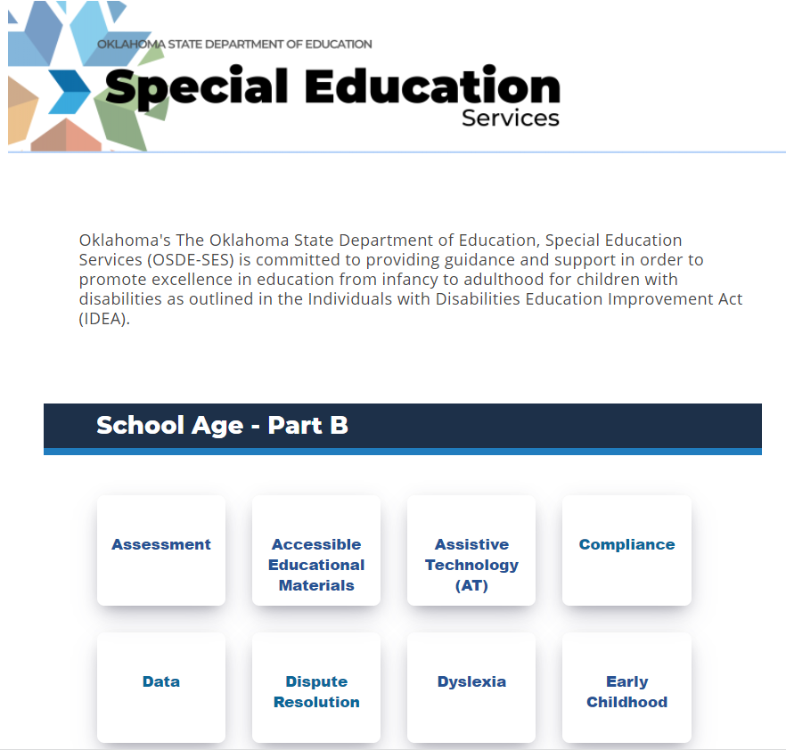

Notes:
The SDE is updating the website. Here you see the compliance tab under part B.

Slide 26
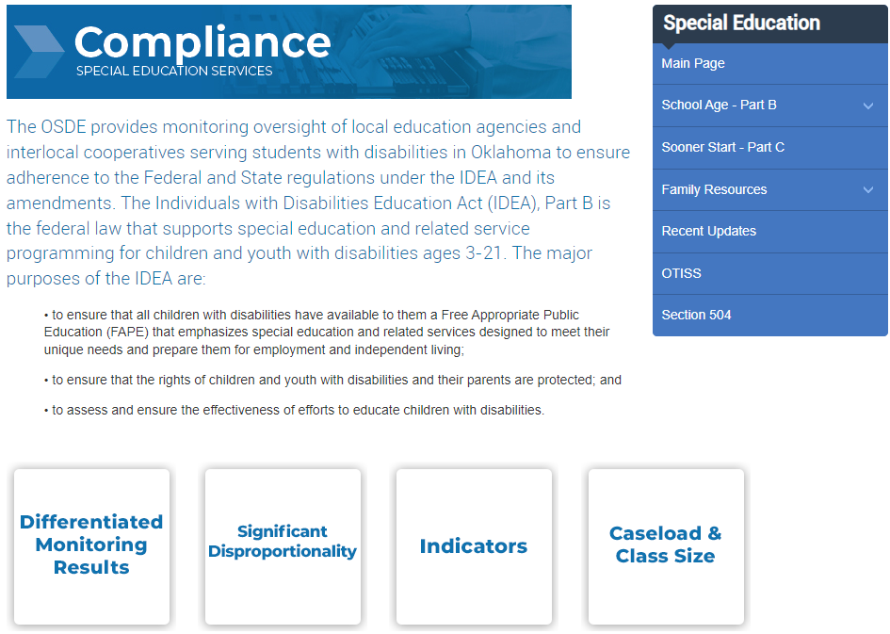
Notes:
This is the homepage for compliance. Here is the tab for caseload which will provide you the information and documents.

Slide 27
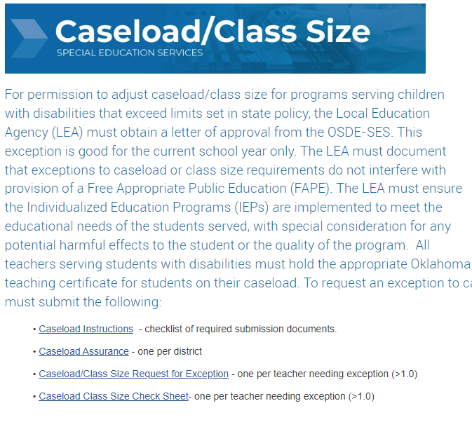

Slide 28

Notes:
This is the homepage for compliance. Here is the tab for DMR. Once you click on this tab, it will open up for additional DMR level tabs.

Slide 29
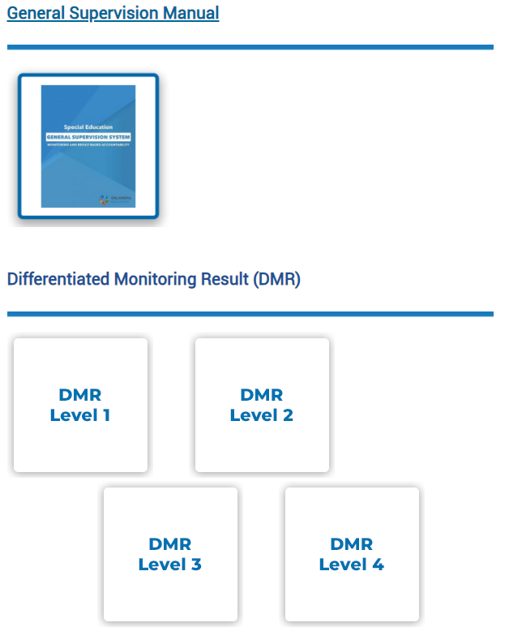
Notes:
General Supervision System Manual

Slide 30

General Supervision System
Notes:
This is the 23/24 Updated General Supervision System

Slide 31
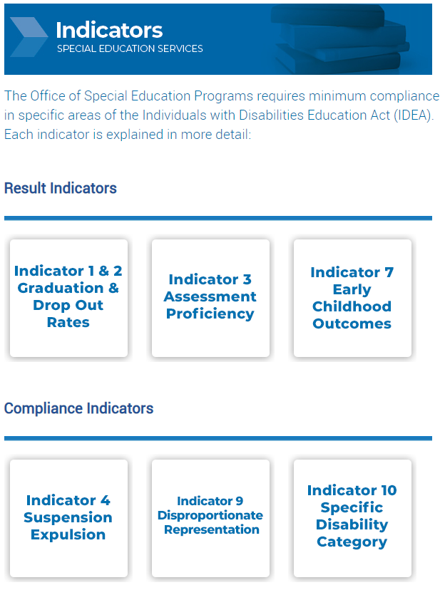

Slide 32

Notes:
This is the homepage for compliance. Here is the tab for the IDEA indicators. Here you will find a tab for each indicator with information to gain a better understanding.

Slide 33
Professional Development: Expectations
The proposed PD should:
Connect to the most challenging area of performance/weakest indicator
Be designed to support district improvement in this area
The proposed PD will need to be described in GMS.
Title and description
Date
Audience
Notes:
*Reminder that PD is only a step in the improvement plan. It cannot stand alone. The PD should be aligned to the improvement plan.

Slide 34
Accreditation Report
If a district has:
  DMR Level 3 or 4 for three consecutive years for the same focus area; and
  Below 100% for Indicators 11, 12, and/or 13 for the same indicator for three consecutive years.
  The district will receive a deficiency on their accreditation report.

Slide 35
Dates to Remember:
December 31, 2022
Toolkit (EdPlan)
Jan.–May 2023
Implement & monitor plan
31 Mar. 2023
1st Progress Monitoring
31 May 2023
Submit PD & 2nd Progress Monitoring
Spring of 2023
Comprehensive Monitoring will be scheduled in the Spring of 2023. A letter will be provided to explain the process and to assist in preparing for the monitoring.
Jan.-Feb. 2023
Data Retreat
13 Jan. 2023
Caseload review
Notes:
This is a summary of the expectations.
A review of the caseload is due December 31st.
The toolkits are due January 12th
Data retreat is November and December
Improvement plan is expected to be implemented and monitored January through May
First progress review is March 31st
Second progress review is May 31st.
PD due May 31st
Spring semester – each district will be monitored.

Slide 36
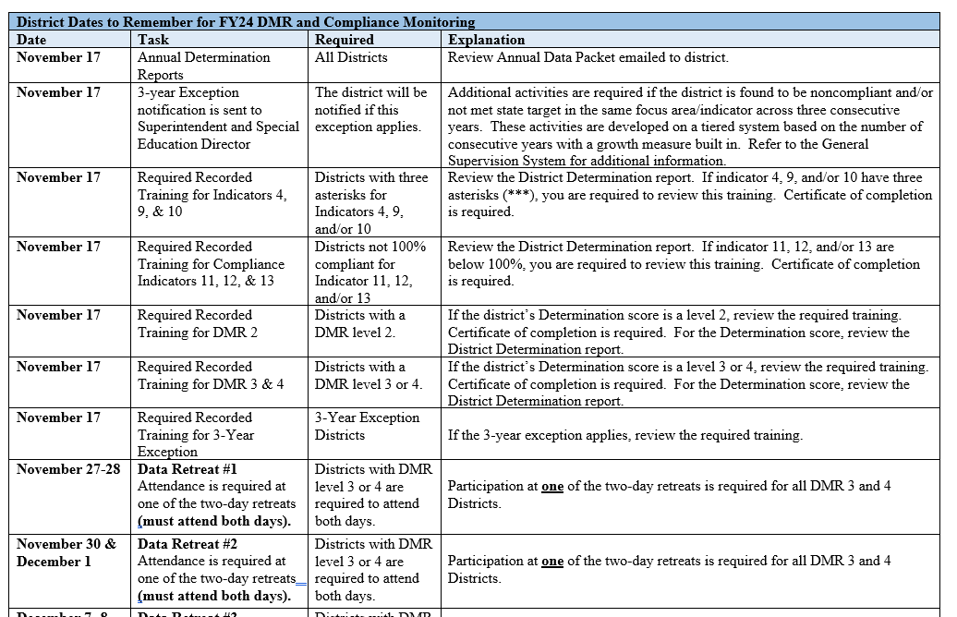

Slide 37
Understanding the Indicators
Notes:
Now let’s review the indicators.

Slide 38
Assessment
Indicator 3A for reading and math (grades 4, 8, & 11): percent of students with disabilities participating in statewide assessments.
Indicator 3B at what rate are these students proficient or advanced on math and reading academic standards
  Always reported a year behind: 2020 results reported in Feb. 2021
  DDPs/Determinations based on the previous February APR submission.

Slide 39
Consider the Following
Data to consider
  State assessments for the past several years
  District benchmark data
Questions to consider
  What is the assessment data showing?
  How do you analyze data to determine program effectiveness for students with disabilities?
  Is the IEP developed and implemented to promote growth?
Notes:
What you should consider

Slide 40
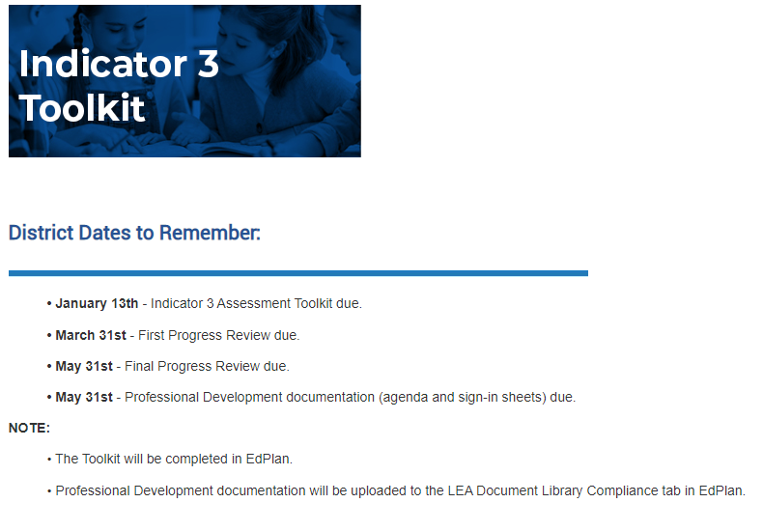

Slide 41
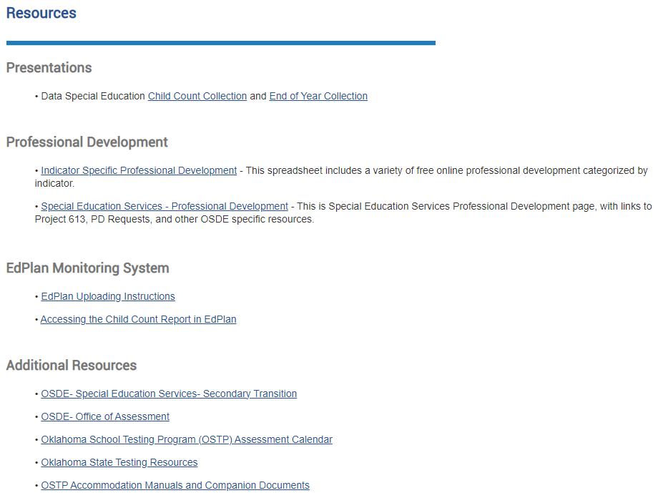

Slide 42
Early Childhood
Indicator 7 (A1, B1, C1): percent of students aged 3-5 that show improvement on their EC Outcome ratings between entry to and exit from the EC program.
ECO exits must be completed when the child exits preschool or no later than June 30th.
  Data collected through the End-of-year data collection on June 30 for the previous full year.
  DDPs/Determinations based on the future February APR submission.

Slide 43
Consider the Following
Information to consider
  EdPlan Advanced Reporting – Early Childhood Outcomes report
  Policy, procedures, and/or practices
Questions to consider
  What tools are staff using to ensure consistent evaluation?
  Are parents and general education staff included in the entry and exit determination?
  How do you analyze data to assess whether early childhood students are improving?
  How are Eco monitored?
Notes:
What you should consider

Slide 44
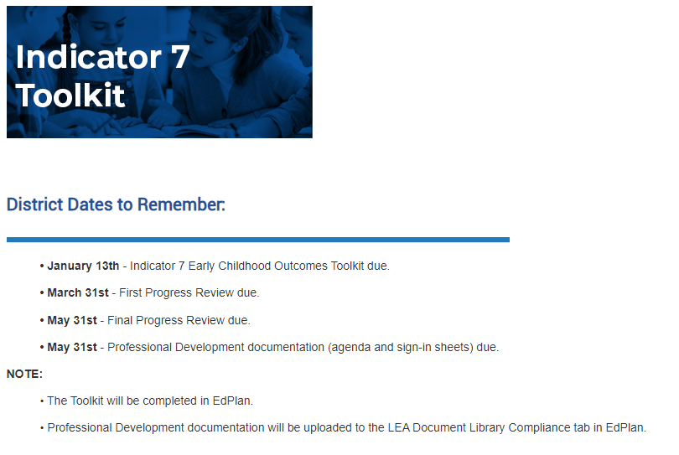

Slide 46
Graduation
Indicator 1: percent of students with disabilities (ages 14-21) reported as graduated.
  Source – exiting data for prior year pulled from EdPlan.
  DDPs/Determinations based on the future February APR submission.

Slide 47
Consider the Following
Data to consider
  Attendance data
  Suspension data
  State assessment data
Questions to consider
  How do you analyze attendance data to determine if there is a relationship between the attendance rates of students with and without disabilities who do not graduate on time and/or have dropped out of school?
Notes:
What you should consider

Slide 48
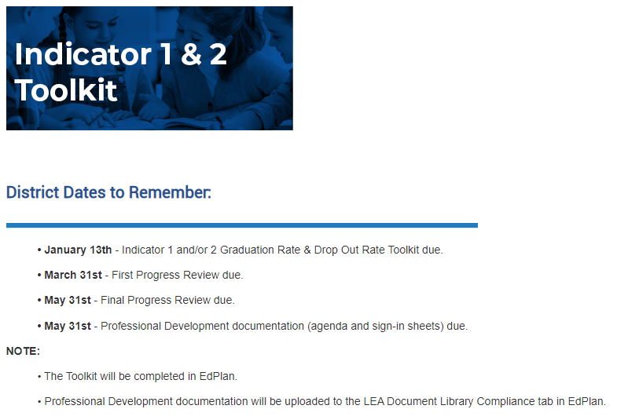

Slide 50
Drop-out
Indicator 2: percent of students with disabilities reported as dropped-out.
  Source – exiting data for prior year pulled from EdPlan.
  DDPs/Determinations based on the future February APR submission.

Slide 51
Consider the Following
Data to consider
  Data on student’s reasons for dropping out (past two years)
  Transcripts of past two years students dropped out
Questions to consider
  Do you have a program to identify students at risk of dropping out?
  How do you analyze the transcripts of students who drop out? What have you learned?
Notes:
What you should consider.

Slide 52
Fiscal
Level 3 Support for Risk:
Not meeting Excess Cost requirements
Audit findings related to SPED
Working with finance staff is critically important to avoid Excess Cost and/or Audit findings
Notes:
*Review Risk Report sent out in annual November packet.

Slide 53
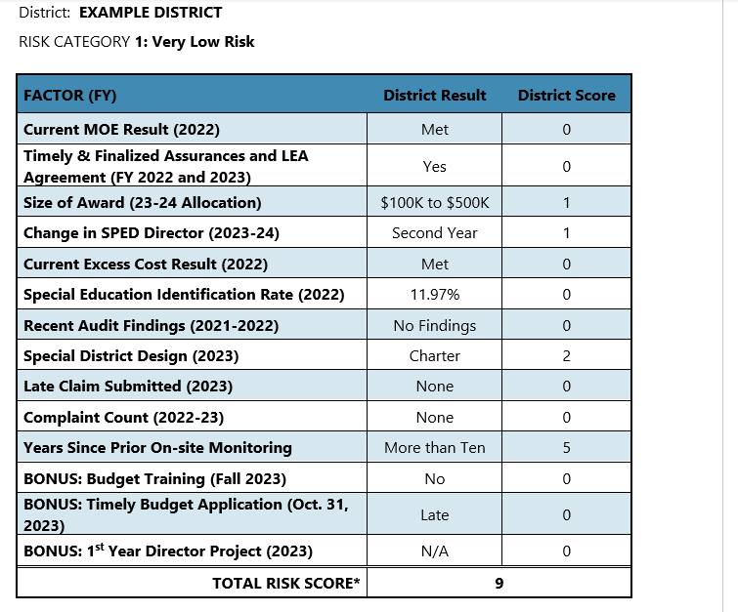
Risk Score

Slide 54
Consider the Following
Information to consider
Policy, procedures, and/or internal practices relating to:
Maintenance of effort (MOE)
Claim submission process
Questions to consider
How do you monitor the use of Federal IDEA funds and state funds for students with disabilities?
Have you submitted a late claim? Why?
Notes:
What you should consider

Slide 55
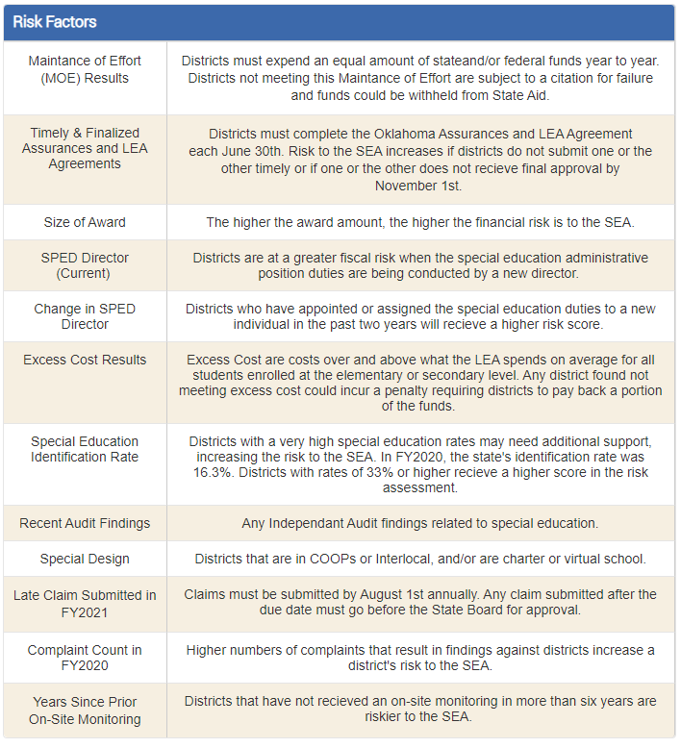
Notes:
MOE
Are budgets submitted timely?
Excess Cost

Slide 56
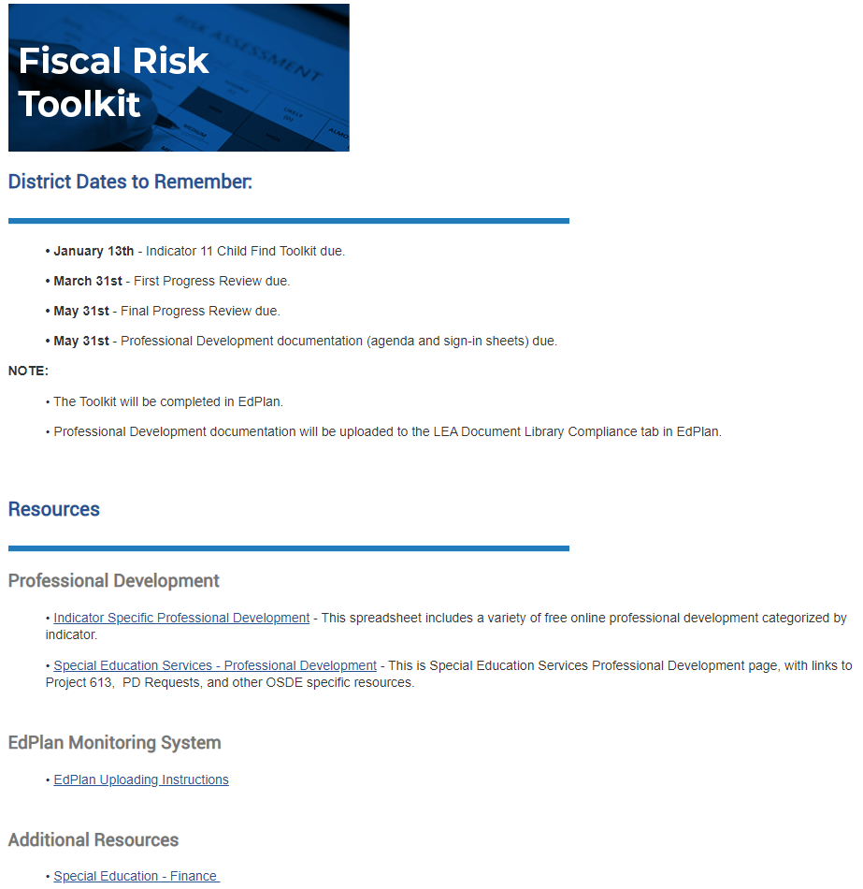
Notes:
Update

Slide 57
Introduction to EdPlan Monitoring

Slide 58
EDPlan Monitoring Tool
Streamlines the monitoring process
Allows SDE and districts to maintain compliance documentation in one central location
Provides districts the opportunity to be directly involved in monitoring process
Provides districts with a structure for ongoing internal monitoring
Streamlines the monitoring process
Allows SDE and districts to maintain compliance documentation in one central location
Notes:
Compliance Monitoring now located in EdPlan.
The monitoring tool is in a central location and it streamlines the monitoring process
You can also access and review information at any time

Slide 59

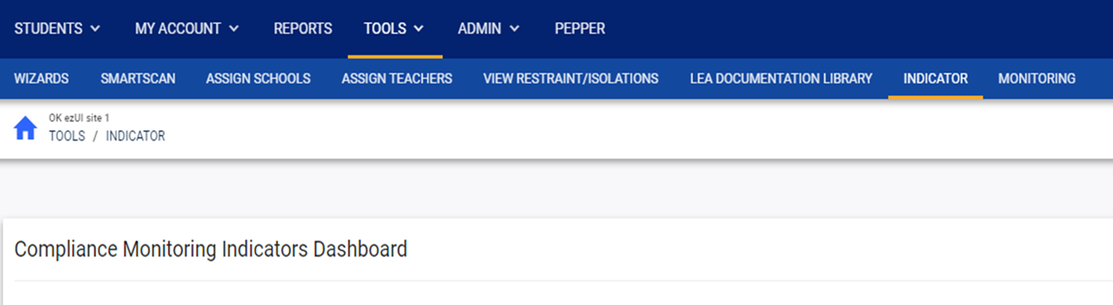
Toolkits
Notes:
Toolkits are located in EdPlan. Select Tools from the menu bar.
OSDE and EDPlan District Admins can upload documentation here

Slide 60

Toolkits
Notes:
Once you click Tools, the secondary menu bar opens, and you will click on the Indicator tab.
OSDE and EDPlan District Admins can upload documentation here

Slide 61

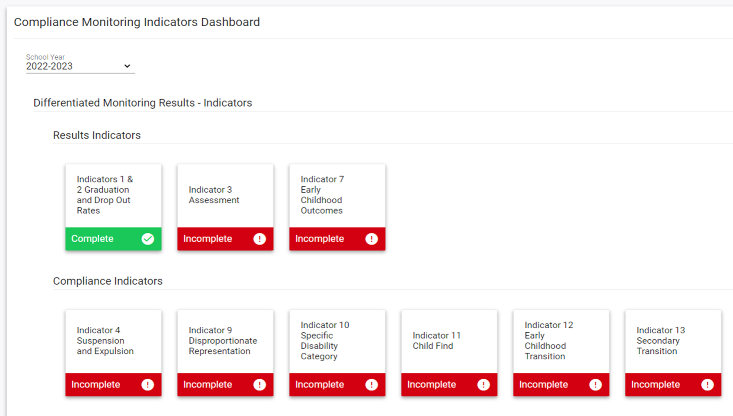
Notes:
Select the current school year.
You will be able to return to the previous year’s plan to review the plan and progress from the previous by selecting the previous year.
This will assist you with completing the current year’s plan.

Slide 62
Notes:
Select the current school year.
You will be able to return to the previous year’s plan to review the plan and progress from the previous by selecting the previous year.
This will assist you with completing the current year’s plan.

Slide 63
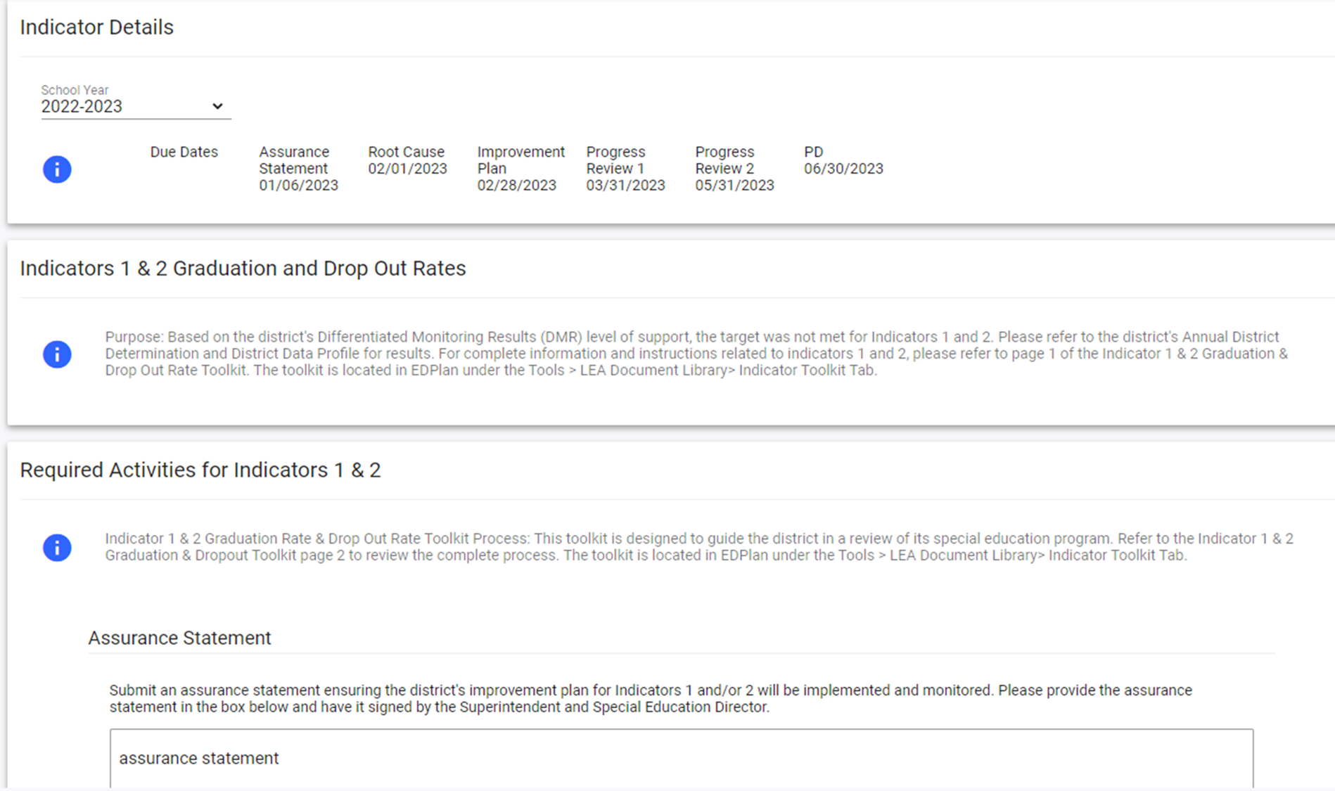

Notes:
The Indicator tile will open to the indicator detail page. Select the current year.

Slide 64
Notes:
The Indicator tile will open to the indicator detail page. Select the current year.

Slide 65
Notes:
Each toolkit will list the purpose of the indicator with a reminder for the toolkit location. .

Slide 66
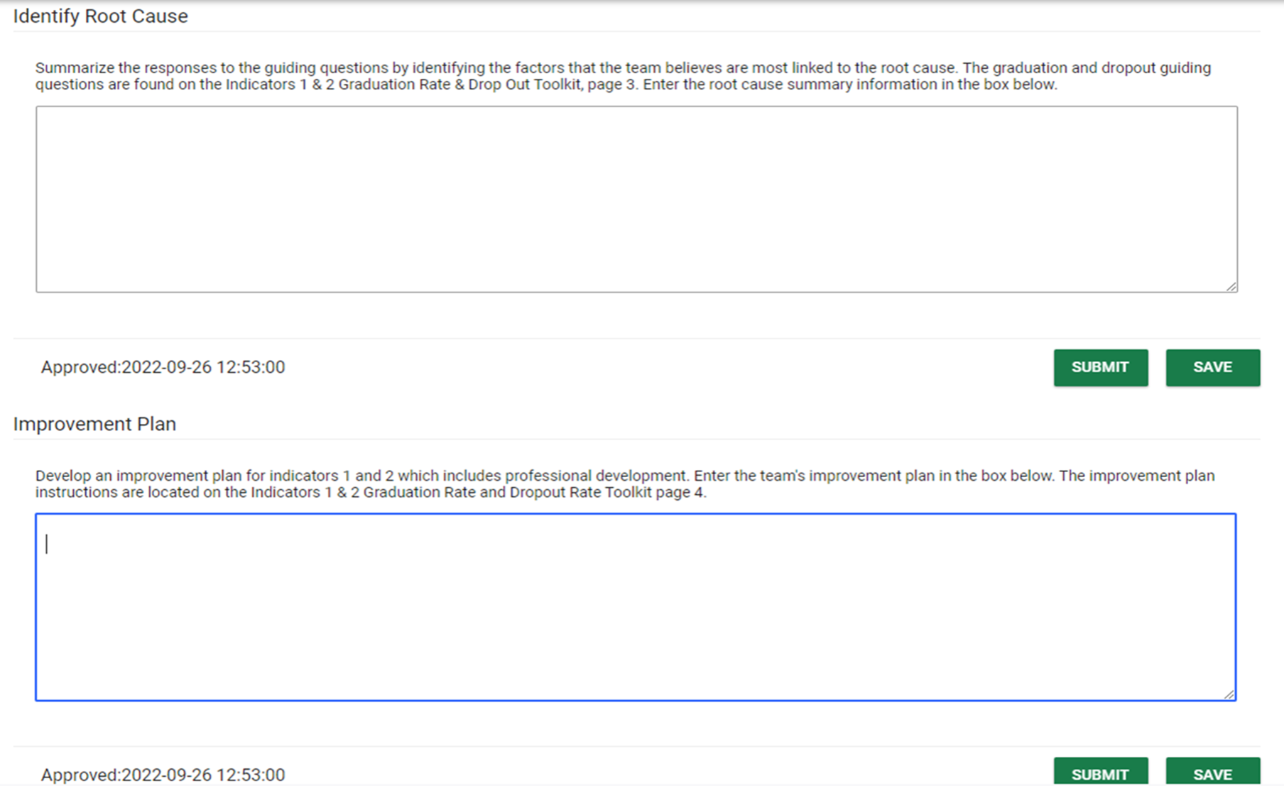

Notes:
Identify and submit the root cause summary here.

Slide 67
Notes:
Identify and submit the improvement plan here.

Slide 68

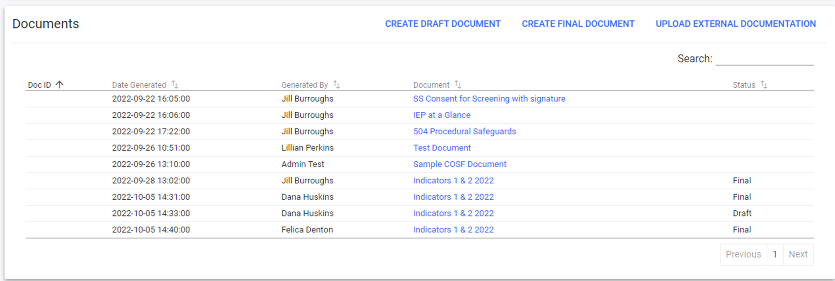
Notes:
Upload supporting documentation here.
Located at the bottom is where you will upload your policy, procedures, and practices. Please make sure and title your uploads.

Slide 69
District Documentation Page
Notes:
Select Tools from the menu bar.

Slide 70
District Documentation Page
Notes:
Once you click Tools, the secondary menu bar opens, then click the LEA Document Library tab to upload documentation.
OSDE and EDPlan District Admins can upload documentation here

Slide 71
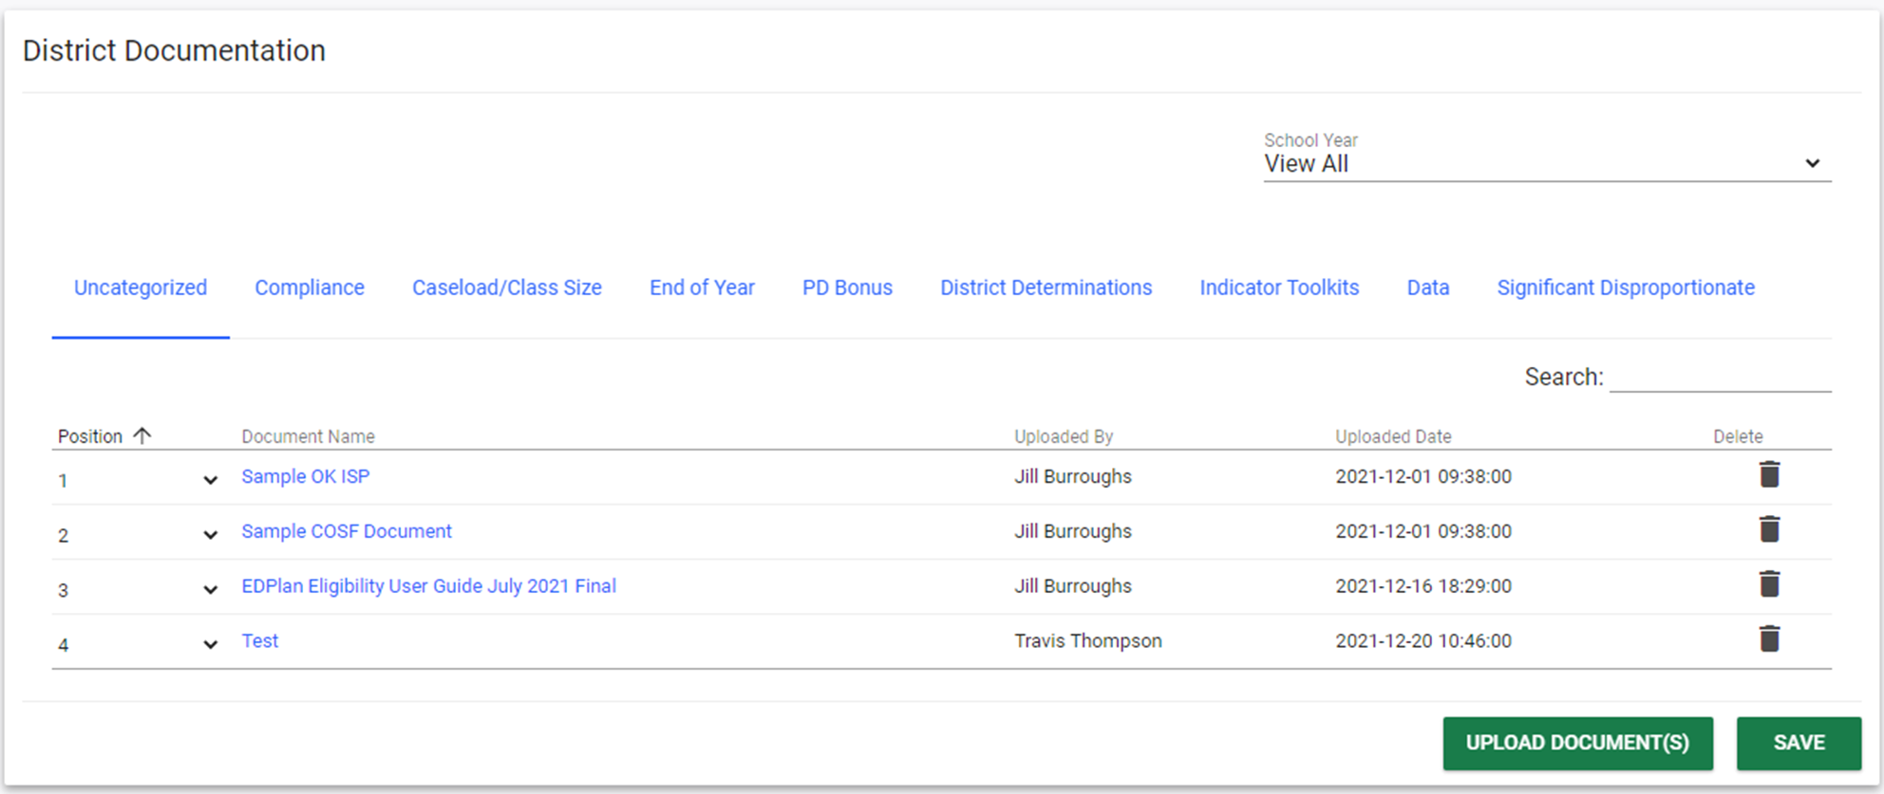

Notes:
Once you click Tools, the secondary menu bar opens, then click the LEA Document Library tab to upload documentation.
OSDE and EDPlan District Admins can upload documentation here

Slide 72
Notes:
Select the category to upload documentation.
OSDE and EDPlan District Admins can upload documentation here

Slide 73
Notes:
Select upload documents at the bottom of the page.
OSDE and EDPlan District Admins can upload documentation here

Slide 74
EDPlan Monitoring Tool
District Level Monitoring Roles
LEA IDEA Admin
  Can upload documents to District Documents page
  Can assign LEA Monitor role for other staff
  Responsible for overseeing and finalizing the district’s monitoring review
LEA Monitor
  Completes student file review (as assigned by LEA IDEA Director)
  Person(s) to fulfill this role is determined by LEA IDEA Director
Notes:
Districts select staff who will do first level monitoring.
Could be the special education teacher, or a district wide consultant…it’s up to the LEA IDEA Admin

Slide 75

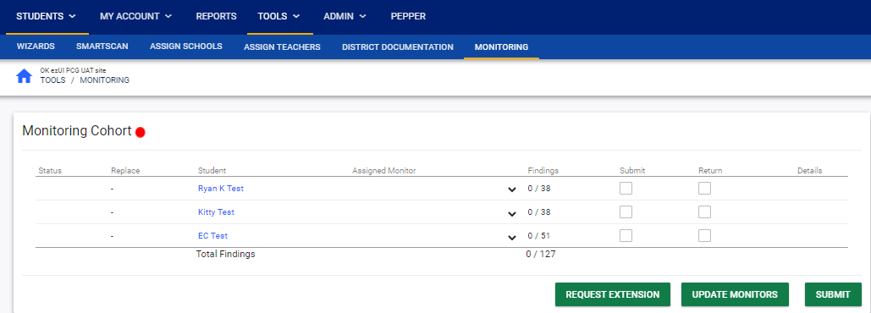
Accessing the Monitoring Dashboard

Slide 76
Assigning LEA Monitor
Notes:
LEA Admin will assign an LEA Monitor for each child in the cohort.
Select Monitor from drop list (add LEA monitor permission in individual user screen, everyone who can be LEA Monitor will show in this list)

Slide 77
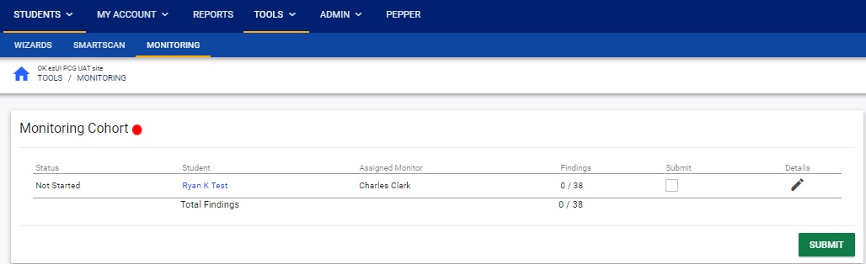
LEA Monitor Process
Notes:
Tools > Monitoring
Click on student’s name to open the student’s records in a new browser window
Click on Details to access monitoring questions

Slide 78
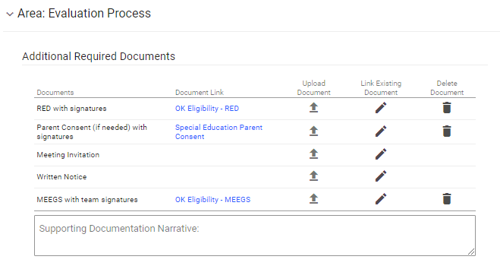

LEA Monitor File Review
Notes:
Supporting documentation can be uploaded or linked to documents in EDPlan

Slide 79
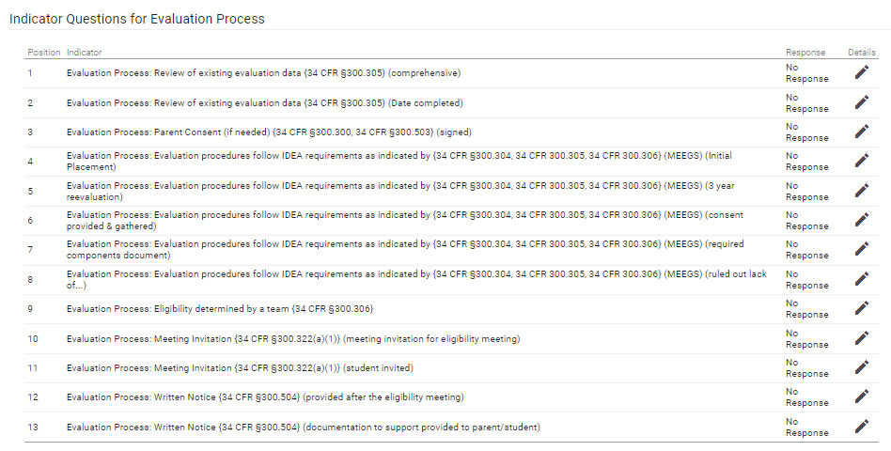
LEA Monitor File Review

Slide 80
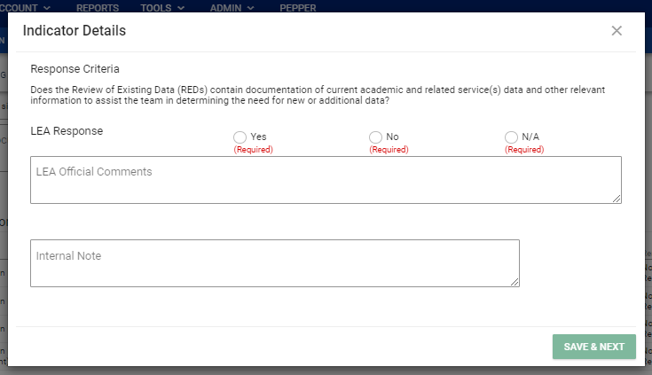
LEA Monitor File Review
Notes:
LEA Monitor will answer each question with Yes, No, or N/A
If the answer is No, LEA Official Comment is required
Monitor can also include internal notes that are only shared with the LEA IDEA Admin

Slide 81
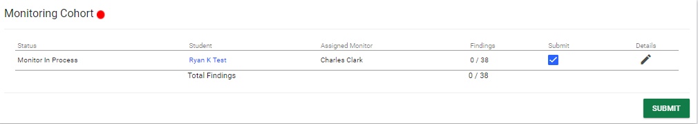
LEA Monitor File Review
Notes:
Click Submit to return the file to the LEA IDEA Admin

Slide 82
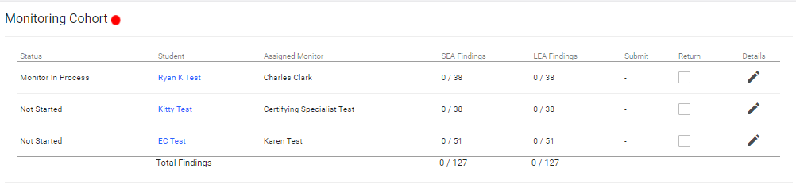
LEA Admin File Review
Notes:
LEA Admin can see where each file is in the process

Slide 83
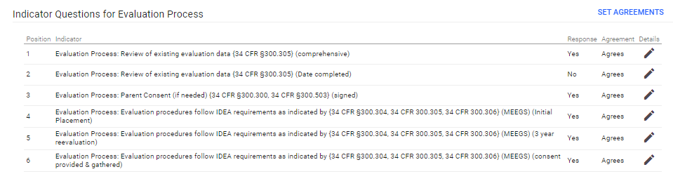
LEA Admin File Review
Notes:
LEA Admin sees the same set of questions the LEA Monitor answered and can review each response, or can use the Set Agreements button to apply an ‘agree’ response to all of the LEA Monitors responses, or can apply ‘agree’ response only to the Yes responses.

Slide 84
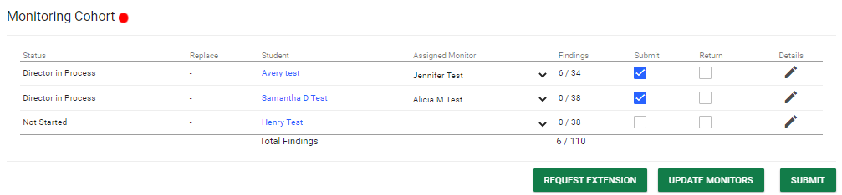
LEA Admin File Review
Notes:
Once all records have been reviewed by the LEA Admin, click Submit button to return results to OSDE
OSDE staff will review and issue a report

Slide 85
Recap

Slide 86
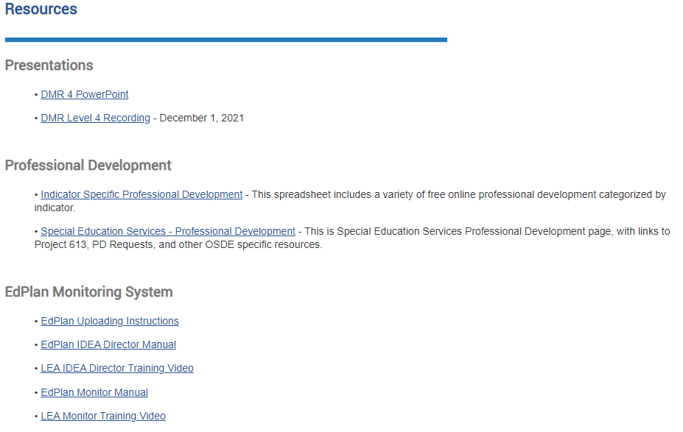
Notes:
Update

Slide 87
DMR Level 4 Expectations
Complete the appropriate Toolkit – Due January 12th
Provide the identified professional development (PD) – Due May 31st
Progress Review (at least two times) – March and May
Targeted or comprehensive monitoring – Spring Semester.
Caseload Review – December 31st
Notes:
The targeted and comprehensive monitoring has two steps. The first step is the district review of student confidential files. The second step is the SDE review of the student files and a review of the district process and data.

Slide 88
Dates to Remember: Do NOT miss any Timelines
December 31, 2023
Toolkit (EdPlan)
Jan.–May 2024
Implement & monitor plan
31 Mar 2024
1st Progress Monitoring
31 May 2024
Submit PD & 2nd Progress Monitoring
Spring of 2024
Targeted or Comprehensive Monitoring will be scheduled in the Spring of 2023. A letter will be provided to explain the process and to assist in preparing for the monitoring.
Nov-Dec.
2023
Data Retreat
12 Jan. 2024
Caseload review
Notes:
This is a summary of the expectations.
A review of the caseload is due December 31st.
The toolkits are due January 12th
Data retreat is November and December
Improvement plan is expected to be implemented and monitored January through May
First progress review is March 31st
PD and second progress review is May 31st.
Spring semester – each district will be monitored.
*** Please make sure you are meeting all timelines. If you miss one timeline, the SDE is required to withhold funds.

Slide 89
Contact Information

Slide 90
Contact Information: Data Team
Travis Thompson
Project Manager of Data
Travis.Thompson@sde.ok.gov
405-522-5203
Brooks Sawyer
Specialist of Data
Brooks.Sawyer@sde.ok.gov
405-521-4871

Slide 91
Contact Information: Compliance Team
Felica Denton
Fiscal Monitoring Coordinator
Felica.Denton@sde.ok.gov
405-522-9562
Megan Withers
Early Childhood Specialist
Megan.Withers@sde.ok.gov
405-522-5168
Tina Spence
Assistant Program Director of Special Education Services
Tina.Spence@sde.ok.gov
405-521-4513

