Slide 1
IDEA Part B
State Advisory Panel
June 10, 2021

Slide 2
AGENDA
Welcome – Linda Jaco
State of Special Education – Christa Knight
Equity in Accessing Curriculum - Chelsea Bowlan & Michele DeBerry
Safe and Healthy Learning Environments - Chelsea Bowlan & Michele DeBerry
Panel Recommendations – Dr. Penny Cantley
Nominations for Vice Chair 2021-2022
Closing – Linda Jaco

Slide 3
State of Special Education

Slide 4
OSDE Recovery Efforts
Ready Together Oklahoma - An Action Plan for Supporting Students Through the Pandemic and Beyond
  https://readytogether.sde.ok.gov/
More guidance is being added.

Slide 5
IDEA Funding
IDEA Part B Grant Application received by the Office of Special Education Programs
Additional ARP funds for IDEA Part B and C
  Part B funds will be allocated to districts (no set-aside funds)
  Guidance will be provided to districts in mid-July

Slide 6
Grant Application
FFY21
Regular Award - $164,049,191 (FFY20 - $161,932,580 )
Administration- $3,197,655
Other State Level Activities - $17,821,513
  Includes 2.5 million for High Needs Fund
Additional Allocations through ARP - $35,368,904
Preschool - $3,848,803 (FFY20 - 3,838,038)
Additional Allocations through ARP - $1,993,411

Slide 7
Special Education Activities
Micro-credential for Severe/Profound certification
  OSDE is working with UCO on a micro-credential program
  Other vendors may offer their own program, pending State Board approval
OEQA is working on the Special Education Comprehensive Certification Examination
  Combining Severe/Profound and Mild/Moderate examinations

Slide 8
Special Education Activities
Updated EdPlan User Interface
Additional Modules on EdPlan:
  Seclusion/Restraint Reporting and Documentation
  Monitoring and Compliance
  LNH Applications

Slide 9
Special Education Activities
Guidance Documents:
  Handbook review and revision
  Dyslexia Handbook review and revision if necessary
  21-22 School Year Considerations Document
  Parent Rights
  Private School Guidance
Updating Determinations and General Supervision process

Slide 10
Special Education Activities
SPP/APR Target Setting
  Stakeholder meetings to set targets for the new cycle will be July 13-16 (watch for announcements)
  Graduation, assessment and EC placement have been changed
State Systemic Improvement Plan

Slide 11

State Systemic Improvement Plan
Using the SSIP to better improve literacy outcomes across our state

Slide 12
Why the State Systemic Improvement Plan (SSIP)?
For over 30 years, there has been a strong focus on regulatory compliance with the Individuals with Disabilities Education Act (IDEA) and Federal regulations for the timely provision of special education services. ​
As a result, compliance has improved, however the Office of Special Education Programs (OSEP) at the U.S. Department of Education determined that the data did not indicate improvement in children's outcomes.
Notes:
A little over six years ago, OSEP moved toward a results-based accountability focus, moving away from a dominating emphasis on compliance. As part of this shift, OSEP decided to implement requirements for states to submit State Systemic Improvement Plans focusing on improvement in addition to compliance to regulations.​

Slide 13
State Identified Measureable Result (SiMR)
By FFY 2025, Oklahoma will see improved early literacy skills in targeted low-performing schools as identified by the state’s ESSA plan.
  Specifically, students on IEPs in kindergarten and first grade will show progress towards meeting benchmark as measured by the Oklahoma State Board of Education preapproved universal screeners.

Slide 14
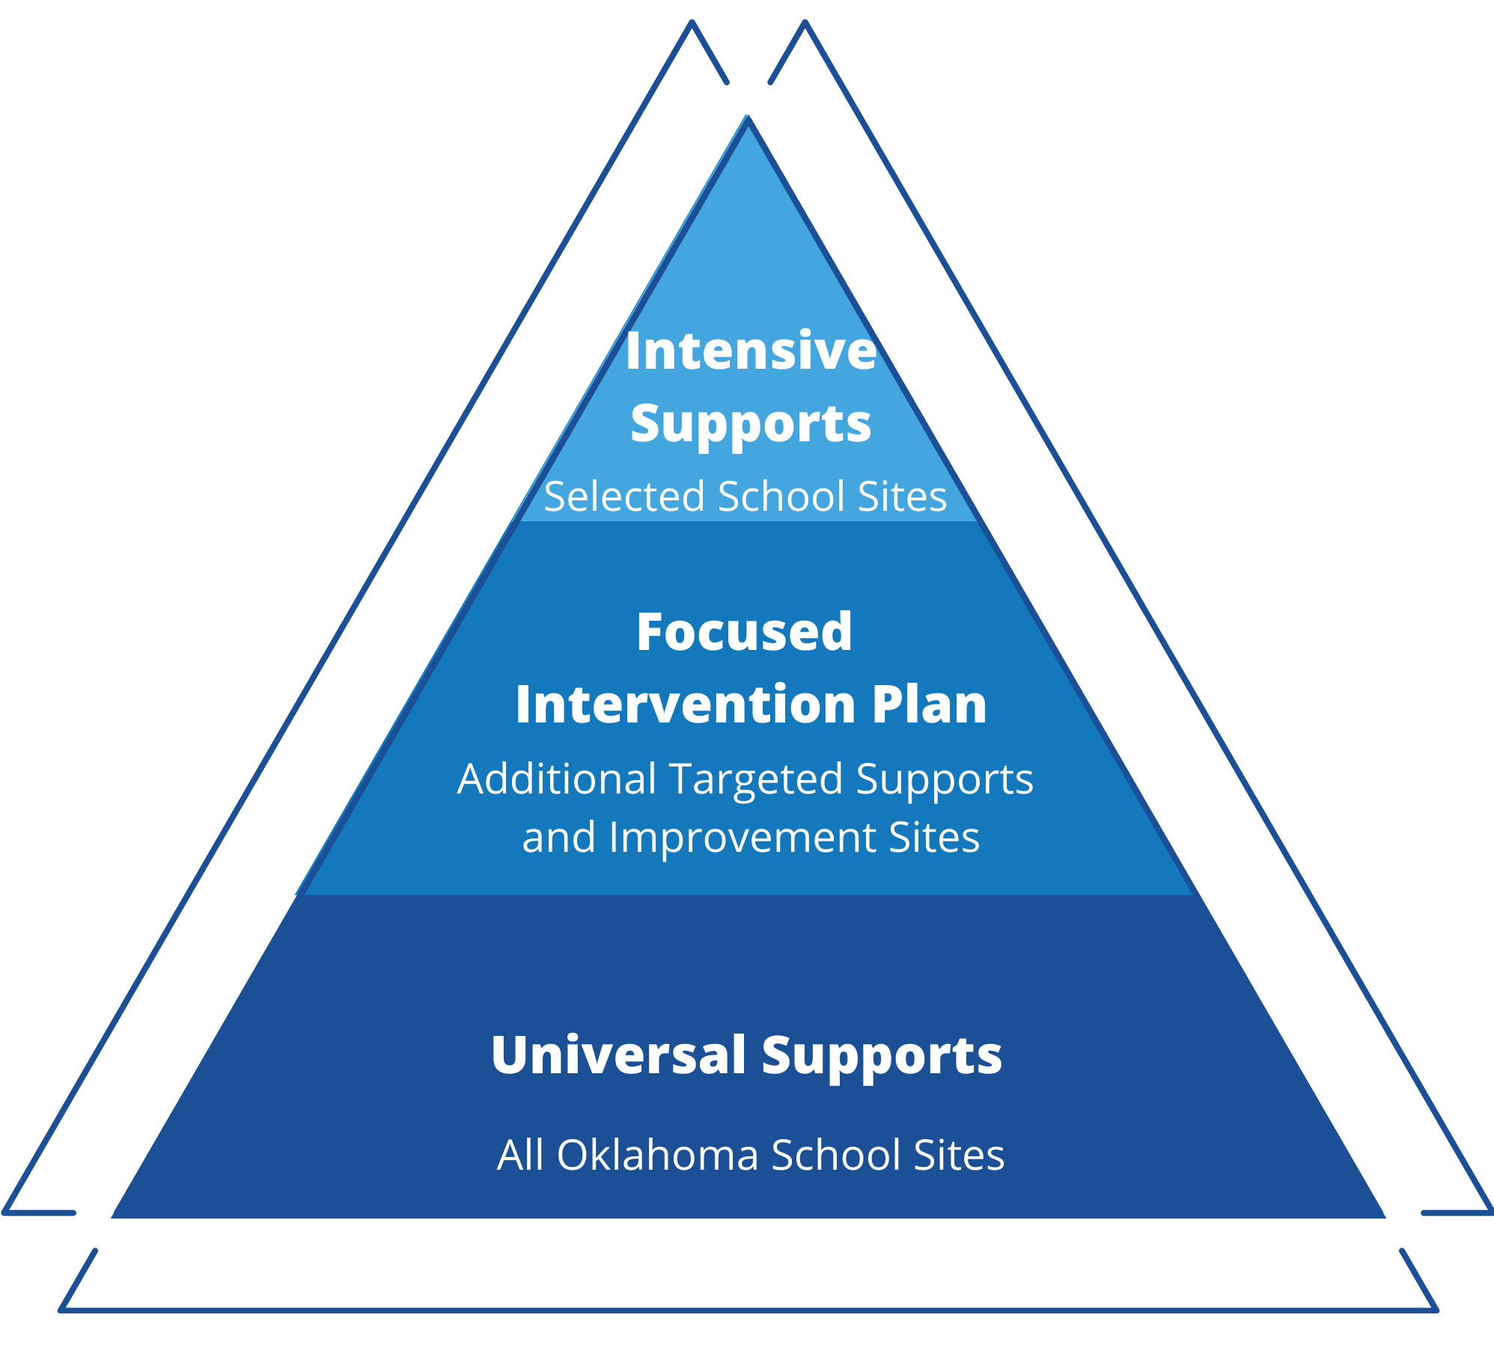
The SSIP Framework

Slide 15
Panel Priorities for
2020-2021

Slide 16
Panel Priorities
Main Priority - virtual learning for students with disabilities. Focusing on evidence-based virtual learning practices will allow the panel to address four priorities panel members identified in the survey completed during September/October. Those priorities include:
Virtual Learning (curriculum, assessments, what works, access to resources)
COVID-19 (academic achievement and Increased accessibility)
Equity in Accessing Curriculum (general education and curriculum support for special education teachers)
Safe and Healthy Learning Environments
Focusing on these four priorities will also help address the need for accessible curriculum for students receiving services in alternative placements including juvenile correction facilities. Panel recommendations will be based on learner needs and outcomes, accessibility, deliverability, and effective instruction.

Slide 17
IDEA – B State Advisory Panel
Equity in Accessing Curriculum
Safe and Healthy Learning Environments

Slide 18
Agenda
Equity in Accessing Curriculum
Moving Forward: Recommendations for the LEA
Safe and Healthy Learning Environments
Supporting Students Using Trauma Informed Practices
Preventing Crisis
IDEA – B State Advisory Panel June 2021​

Slide 19
Equity in Accessing Curriculum
General Education and Curriculum Support for Special Education Teachers

Slide 20
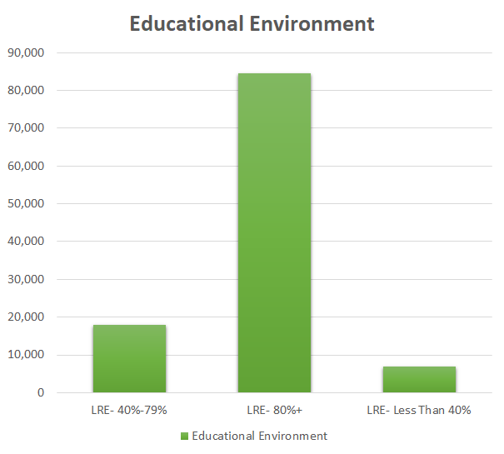
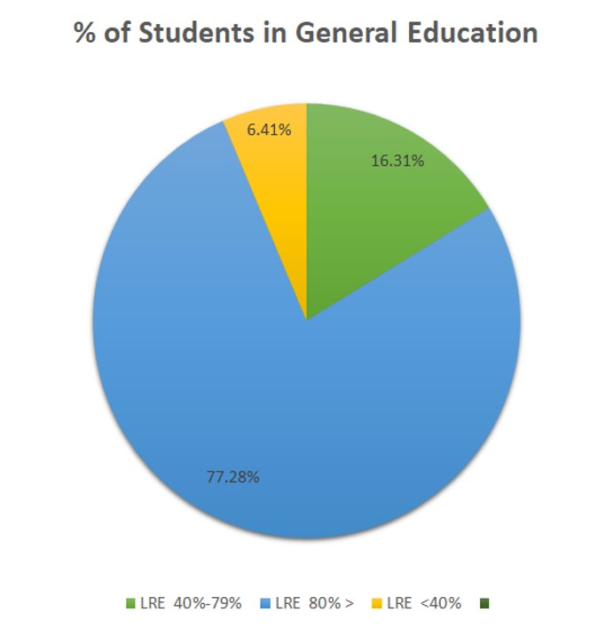
Students with IEPs in the General Education Setting
84,476
17,832
7,002
IDEA – B State Advisory Panel June 2021

Slide 21
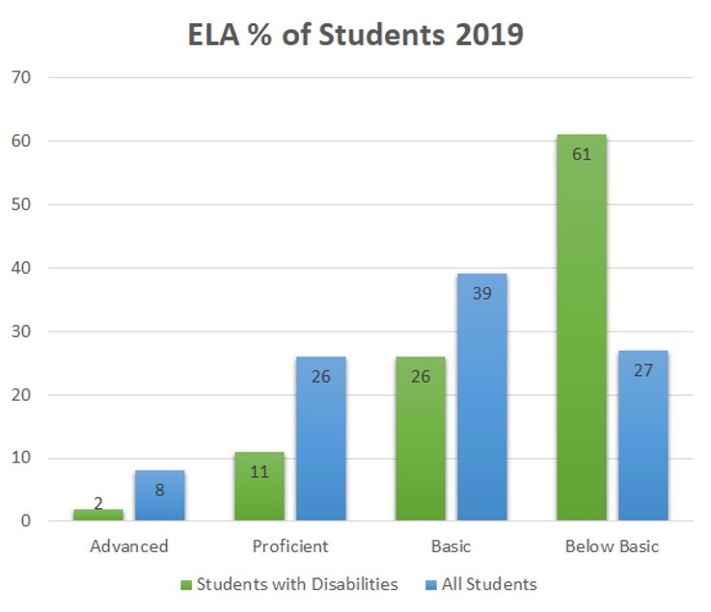
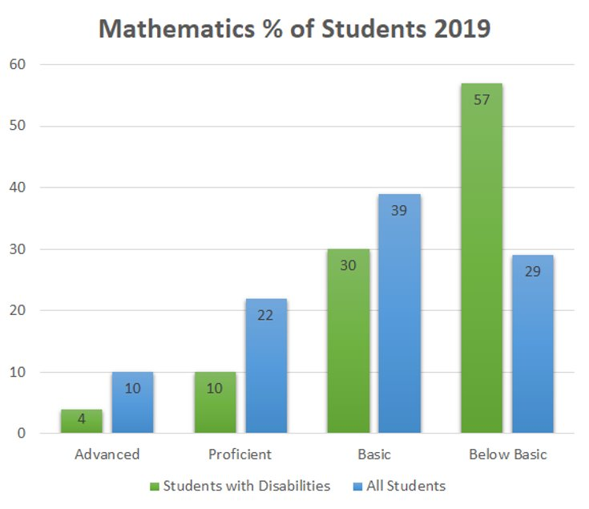
Student Assessment Performance
IDEA – B State Advisory Panel June 2021

Slide 22




Accessibility
All students served on an IEP have the right to a Free and Appropriate Public Education
Oklahoma Academic Standards outline the expectations of the knowledge and skills that all students should gain by the end of each grade level
Providing access to grade-level content may involve the implementation of accommodations or modifications

Slide 23
Collaboration
Collaboration between general and special educators promotes trusting relationships and student-centered decision-making.
Good collaboration skills are good communication skills.
Great teaching partners communicate regularly, plan for a variety of instructional approaches, share resources and accountability.
Collaboration among team members means working through problems to manage conflicts or disagreements, relying on student data to support decisions and find consensus.

Slide 24

Questions for Group Collaboration
Why should we treat behavioral problems the same way we treat academic problems?
In what ways are addressing behavioral problems and academic deficits similar?
Why should desired be explicitly taught and modeled?
Should data inform teachers’ work in the behavioral domain as much as in the academic domain? Why or why not?
What does [respect, responsibility, best effort, etc.] mean or look like in your classroom?
Do the classroom and school expectations, rules, and procedures reflect the cultures, values, and beliefs of the students and families we serve?
Why should school staff provide students with a rationale for the importance of expectations, rules, and procedures?

Slide 25

Student-Centered Decisions
This is hard work!
Determining staffing needs
Many student variables
Time
Translating evidence-based instructional practices into classroom instruction

Slide 26
Keys to Success
High Leverage Practice
Student Engagement
Multiple Sources of Data
Explicit Instruction

Slide 27

Equity is not equality.

Slide 28

Accommodations v. Modifications
Accommodation
Modification
Change the
presentation,
response,
setting, or
timing/
scheduling
Allow
access
to the
general
education
curriculum
Change the
expectations
compared
to typical
peers
Do not​
fundamentally​
alter the​
requirements

Slide 29
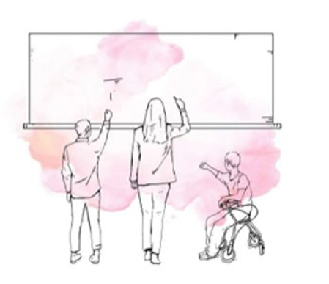
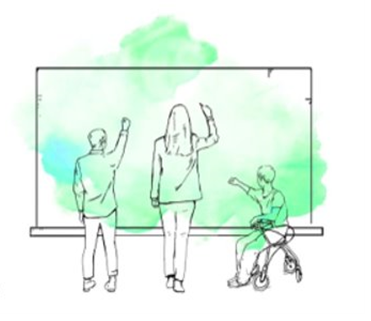
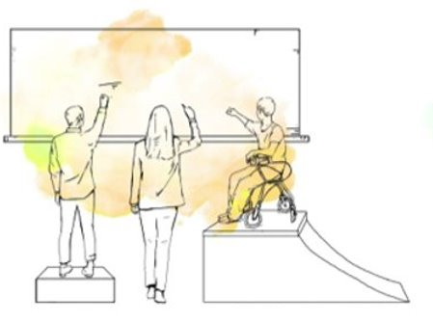
Remove the Barriers

Slide 30
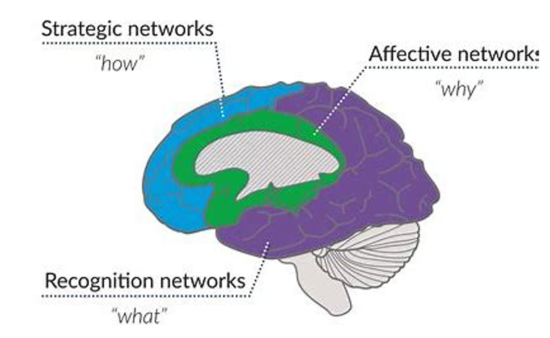
The Brain and UDL
Strategic networks
"how"
Affective networks
"why"
Recognition networks
"what"

Slide 31



UDL Components - 1

Slide 32



UDL Components - 2
Multiple Means of Engagement
Multiple Means of Representation
Multiple Means of Action/Expression
Stimulate motivation and sustained enthusiasm for learning by promoting various ways of engaging with material.
Present information and content in a variety of ways to support understanding by students with different learning styles/abilities.
Offer options for students to demonstrate their learning in various ways (e.g., allow choice of assessment type).

Slide 33


Remember UDL...
Is a proactive approach for our dicerse classrooms
Addresses the need of classrooms filled with students who...
  Have a wide span of needs
  Have different attention spans
  Have a variety of language abilities
  Come from a variety of backgrounds (cultural, educational, etc.)
Meets the needs of ALL learners by promoting students to be purposeful, motivated, resourceful, knowledgeable, strategic, and goal oriented
IDEA – B State Advisory Panel June 2021​

Slide 34
Resources
Key Questions to Consider when Planning Lessons https://drive.google.com/file/d/1Js7OA0j6aqUhZy20748BiYfDWiiSFEcU/view?usp=sharing
UDL Guidelines https://drive.google.com/file/d/1_IPJ3fZso2O4LSw4x3AmfMhnCvvdaJK1/view?usp=sharing
CAST https://udlguidelines.cast.org/
Iris Center Accommodations and Modifications Module IRIS | Page 1: Accommodations (vanderbilt.edu)

Slide 35
Safe and Healthy Learning Environments
If children experience stress (trauma) but also have a warm, loving adult to support them, then that child will be able to respond to and recover from even the most difficult of circumstances.” Melissa Bright, Research Scientist University of Florida

Slide 36
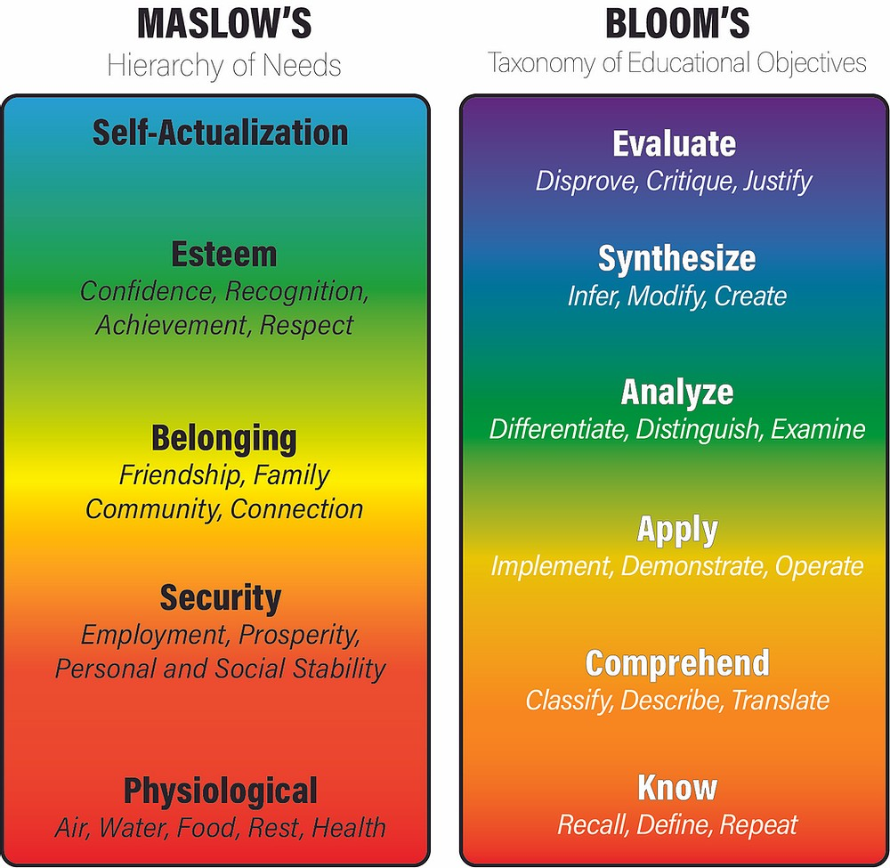
Goal: Keeping kids safe and maintain a motivating and successful learning environment for all.
IDEA – B State Advisory Panel June 2021​
Notes:
Maslow before Bloom
Educators of students who have experienced trauma and display significant behavior issues must be equipped to respond to severe aggression, de-escalate and support a student in crisis, as well keep students emotionally and physically safe at all times.

Slide 37
Trauma Defined
Trauma is an emotional or psychological injury.
Physically or emotionally harmful or life threatening and that has lasting adverse effects.
Trauma occurs when an actual or perceived threat of danger [or loss] overwhelms a person’s usual coping ability. –Beverly James
What is traumatic for one person won’t necessarily traumatize another.
Notes:
Trauma is an emotional or psychological injury, usually resulting from an extremely stressful or life‐threatening situation rendering the person temporarily helpless, and breaking past ordinary coping and defense mechanisms (Childhood Traumas: An Outline and Overview, pg. 11).
Trauma results from an event, series of events, or set of circumstances that is experienced by an individual as physically or emotionally harmful or life threatening and that has lasting adverse effects on the individual's functioning and mental, physical, social, emotional, or spiritual well-being.
Trauma occurs when an actual or perceived threat of danger [or loss] overwhelms a person’s usual coping ability. –Beverly James
What is traumatic for one person won’t necessarily traumatize another.
Types of Trauma:
Acute Trauma - A single, isolated event.
Chronic Trauma - Experiences that are prolonged and repeated.
Complex Trauma - Chronic exposure that begins early in life, often with caregiver, leads to short and long-term effects.
Historical Trauma - Collective and cumulative trauma experienced by a group,

Slide 38
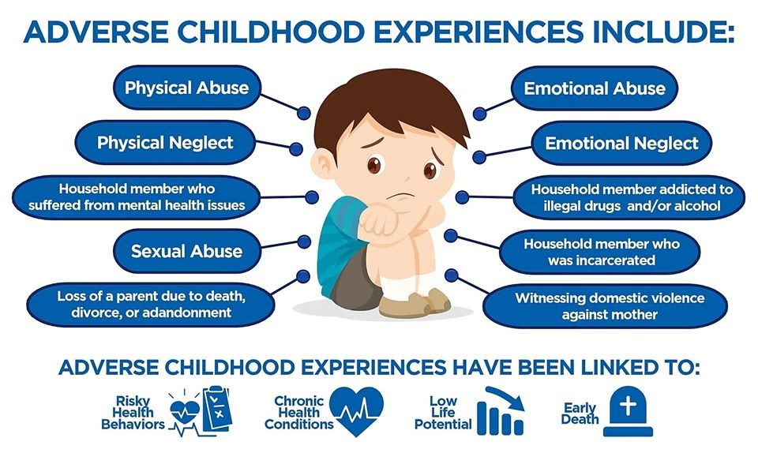
Adverse Childhood Experiences - ACES
Adverse Childhood Experiences (ACEs) describe traumatic experiences in a person’s life occurring before the age of 18.
IDEA – B State Advisory Panel June 2021​
Notes:
ACEs have an enormous impact on school-age students
Neurological development
Decreased resilience
Increased rates of mental illness
Increased stress response (fight or flight)
Low emotional regulation
Hyper-vigilance (on edge)
Social misattributions (hostile bias)
Academic difficulties
Problems with concentration and attention
Difficulty trusting others
Low self-worth and self-concept
High risk behaviors (substance abuse, domestic violence, etc.)
Long-term health problems and early morbidity
Compared to someone with no ACEs, students are:
3 times more likely to experience academic failure
4 times more likely to have poor health reports
5 times more likely to have school attendance problems
6 times more likely to have evident school behavior problems
Impact of ACEs varies by:
Point in time trauma occurs
Nature of adverse experience
Relational environment & supports present
Student resilience

Slide 39
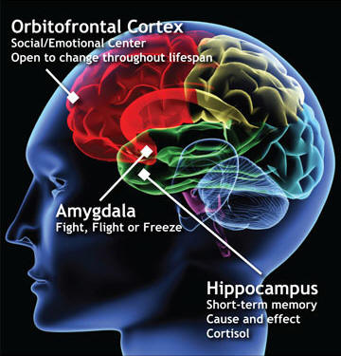
Trauma and the Brain
Amygdala
  Overdeveloped
  Emotions, survival, instincts, and memory
  This can make a person more likely to react to
  triggers, especially emotional ones
Hippocampus
  Underdeveloped which can affect attention,
  learning, and memory
  Short-term, long-term memory, and spatial
  memory
Prefrontal cortex
  Underdeveloped
  Complex behaviors, planning, personality development
  Very vulnerable to traumatic stress
Trauma affects our ability to think. It makes us less able to learn because we are always in survival mode (Courtois & Ford, 2009).
IDEA – B State Advisory Panel June 2021​
Notes:
Cortisol levels rise-extreme stress means there is more cortisol in our system
Cortisol is pretty powerful:
Built-in alarm system
Body’s main stress hormone.
It controls your mood, motivation, and fear.
Produced in adrenal glands.
Fuels your body’s “fight-or-flight” instinct in a crisis
Students who haven’t developed healthy coping skills find other ways to respond to their environment.
These developed responses become automatic any time a person is feeling fear, frustration, anger or shame, “Trauma Response.”
A trauma response will typically present as either Fight, Flight, or Freeze.
A trauma response may manifest as challenging behavior.

Slide 40
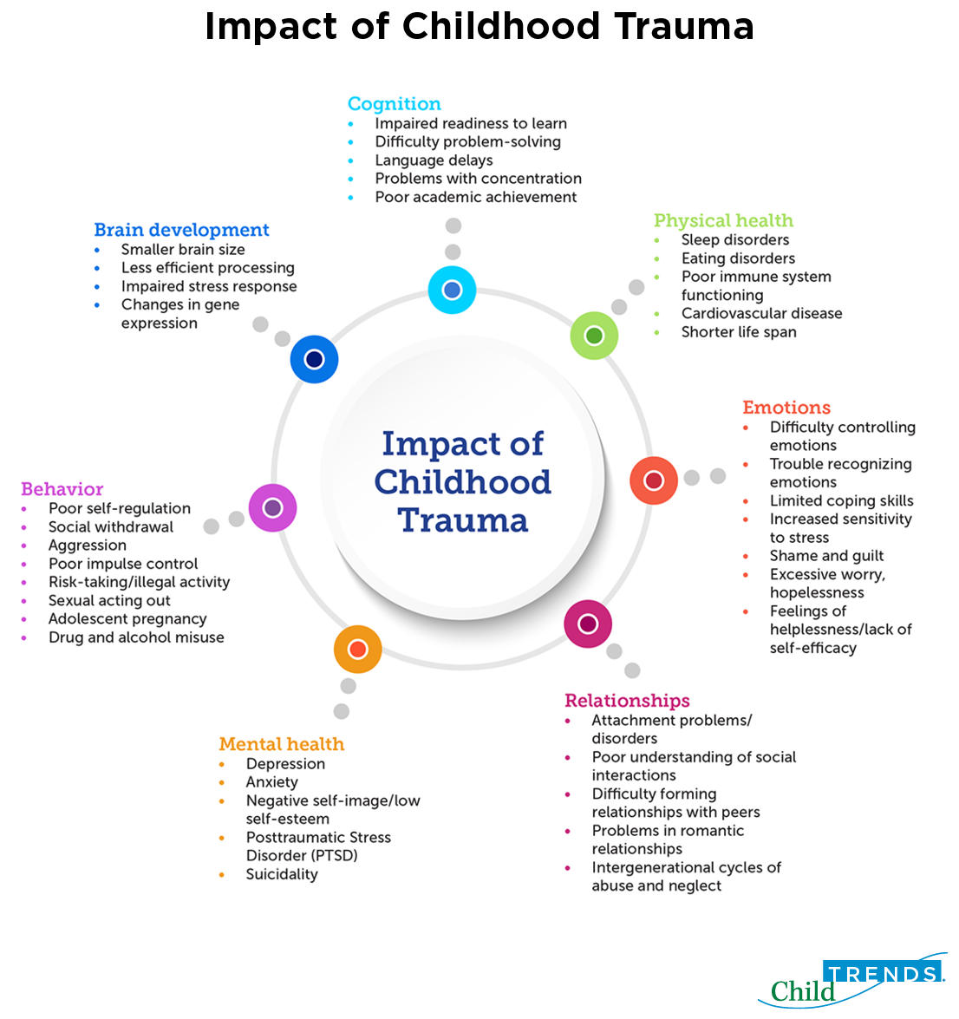
IDEA – B State Advisory Panel June 2021​
Notes:
Students exposed to trauma have increased risk of school failure and learning issues:
Developmental delays
Delayed language acquisition
Working memory difficulties
Difficulties maintaining focus and attention
Executive functioning delays
Chronic absenteeism
Substance abuse
Impulsivity
Anxiety, depression, apprehension

Slide 41
Effects of Trauma in Developmental Stages
Preschool Children
Elementary School Children
Middle and High School Children
Feel helpless and uncertain
Fear from being separated from parent/caregiver
Cry and/or scream a lot
Eat poorly and lose weight
Return to bedwetting
Return to using baby talk
Develops new fears
Has nightmares
Recreates trauma through play
Are not developing to the next growth stage
Have changes in behavior
Ask questions about death
Become anxious and fearful
Worry about their own or others’ safety
Become clingy with a teacher or parent
Feel guilt or shame
Tell others about the traumatic event again and again
Become upset if they get a small bump or bruise
Have a hard time concentrating
Experiences numbness
Have fears that the event will happen again
Have difficulties sleeping
Show changes in school performance
Become easily startled
Feel depressed and alone
Discuss the traumatic events in detail
Develop eating disorders and self-harming behaviors such as cutting
Start using or abusing alcohol or drugs
Become sexually active
Feel like they are going crazy
Feel different from everyone else
Take too many risks
Have sleep disturbances
Don’t want to go to places that remind them of the event
Say they have no feeling about the event
Show changes in behavior
IDEA – B State Advisory Panel June 2021​
Notes:
Trauma is extremely prevalent in school-age children
Behavior-emotional dysregulation associated with trauma frequently results in behavior problems in the classroom.
Adult’s response to students with trauma often serves to increase difficulties, increase over-stimulation, and decrease trust.
Trauma-informed instruction requires a different approach to understanding students and creating interventions that lead to success.

Slide 42
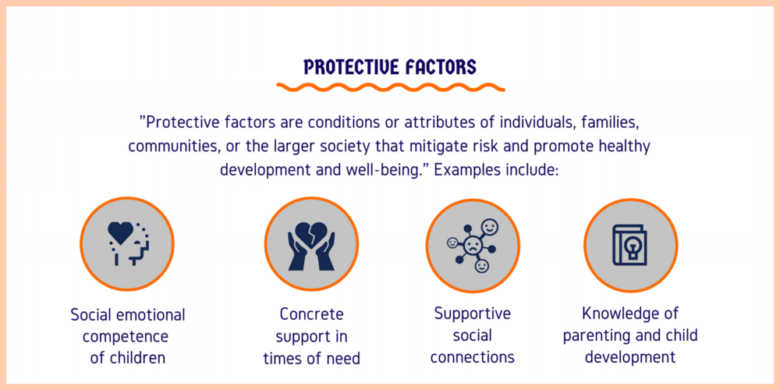
We can help children with trauma
by activating counter-ACEs!
IDEA – B State Advisory Panel June 2021​
Notes:
Liking school
Teachers who care
Opportunities to have fun
A predictable home routine
Having a caregiver with whom the child feels safe
Belief system that provides comfort
Having good friends and neighbors

Slide 43
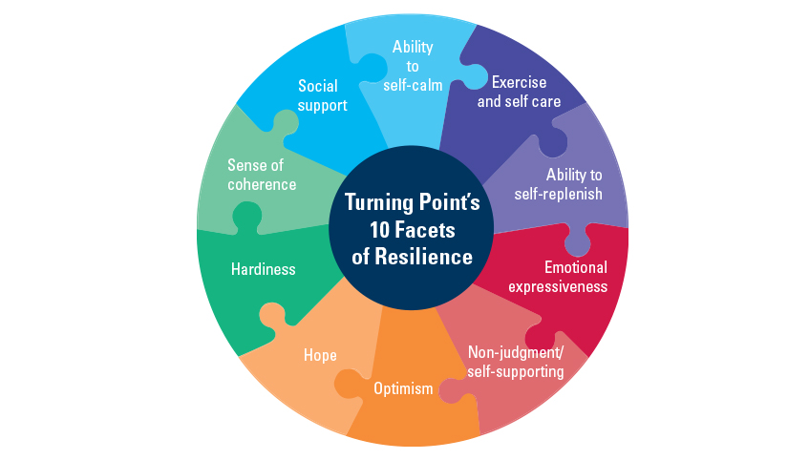
Resilience
Resilience is an adaptive response in the face of stress.
A key goal of a trauma-informed approach is to build student resilience.
IDEA – B State Advisory Panel June 2021​
Notes:
Part of our response or goal is to help student’s build resilience.
Just as the brain can change in response to negative stress, it can also become more resilient.
Social Support or Relationships: At least one stable and supportive caring adult relationship
Ability to self-calm – give opportunities to make their own decisions and help them problem-solve
Exercise and self-care – reminders that we can’t control everything that happens to us, but we can control how we respond.
Ability to self-replenish – reframe challenges as short-term problems and opportunities for learning
Emotional expressiveness-validate their fears and help them to make plans to do things even if they are scared
Non-judgement/self-supporting taking reasonable risks and experience natural consequences
Optimism – talk about stories of people who faced hard times, persisted and grew stronger as a result
Hope –sadness doesn’t last forever
Hardiness - A sense of mastery: Good self-efficacy, “I can do it!”
Sense of coherence – nurturing the coping skills: that help regulating emotions, inhibiting impulses to consider multiple options
Supportive and affirming faith and cultural traditions: faith, cultural and community supports

Slide 44

We must practice a change in thinking
Think: lack of skill, not intentional misbehavior
Think: building/teaching missing skills, not shaming for lack of skills
Think: nurture, not criticize
Think: teach, not blame
Think: discipline and consistency, not punishment
IDEA – B State Advisory Panel June 2021​
Notes:
Developing a Trauma Informed IEP
Relationship building is key
Identify and reduce environmental triggers
Strength based
Parent concerns
Present levels of performance should detail academic levels and social-emotional functioning
Identify skills that need to be taught
Goals should focus on learning new skills
Goals should be ambitious and attainable
A functional behavior analysis and subsequent behavior intervention plan may be necessary

Slide 45
Preventing Crisis
“Every child deserves a champion, an adult who will never give up on them, who understands the power of connection and insists they become the best that they can possibly be.” Rita F. Pierson
IDEA – B State Advisory Panel June 2021​

Slide 46



Safety From Different Perspectives
KEEPING STAFF SAFE
KEEPING THE INDIVIDUAL IN DISTRESS SAFE
KEEPING OTHERS AROUND THEM SAFE
IDEA – B State Advisory Panel June 2021​
46

Slide 47
Key Components
All behavior is a form of communication.
    Your approach changes everything.
        Behavior influences behavior.
IDEA – B State Advisory Panel June 2021​
47

Slide 48

Integrated Experience
KNOWN
UNKNOWN
IDEA – B State Advisory Panel June 2021​
48

Slide 49

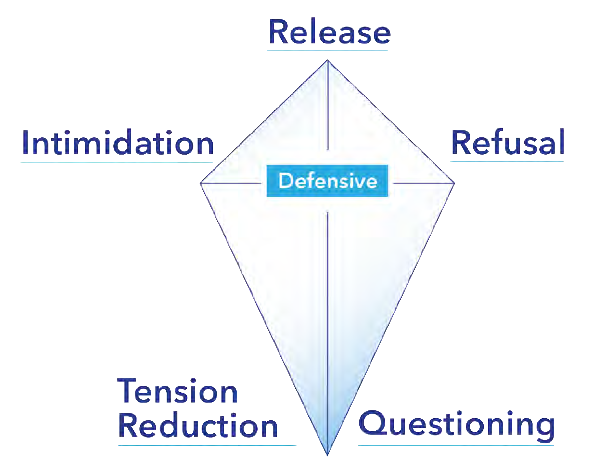
Defensive Behaviors and the Verbal Escalation ContinuumSM
The CPI Crisis Development ModelSM Verbal Escalation ContinuumSM
Crisis Development/ Behavior Levels
Staff Attitudes/ Approaches
1. Anxiety
1. Supportive
2. Defensive
2. Directive
3. Risk Behavior
3. Safety Interventions
4. Tension Reduction
4. Therapeutic Rapport
IDEA – B State Advisory Panel June 2021​
49

Slide 50
Non-restrictive interventions first
Remove items that could be dangerous.
Remove the person.
Remove other people.
Ask a staff member to help.
Call for help.
IDEA – B State Advisory Panel June 2021​
50

Slide 51
Restrictive intervention only as a last resort
What are the foreseeable risks if I do something
and the foreseeable risks if I do nothing?
Choose the option that presents the least amount of risk.
IDEA – B State Advisory Panel June 2021​
Notes:
Is the risk of doing nothing greater than the risk of doing something?

Slide 52
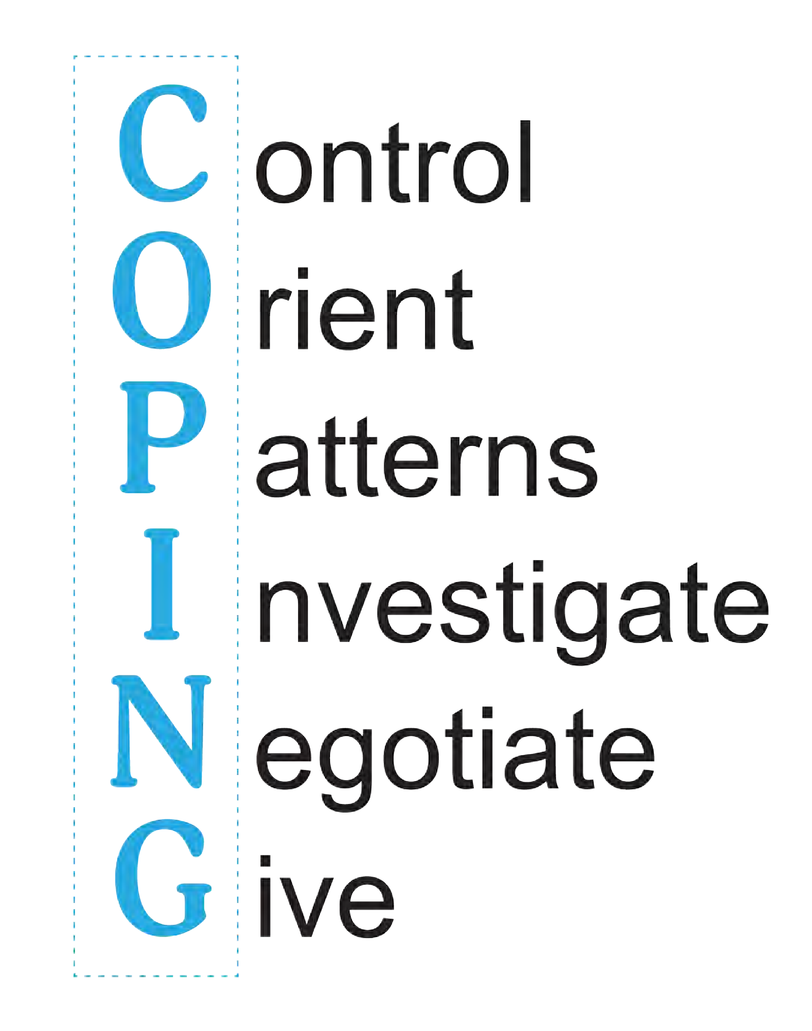
The COPING ModelSM
IDEA – B State Advisory Panel June 2021​

Slide 53
Moving Forward: Recommendations for the LEA
Most schools have crisis plans to support student safety, but few plans address the complex needs of students with disabilities. School supports should include analysis of school plans and student strengths and needs to ensure that students with disabilities have the best opportunity to be safe in school crises.
IDEA – B State Advisory Panel June 2021​

Slide 54
Developing Emergency Preparedness Programs that Support Students with Disabilities
Prevention
Mitigation
Preparedness
Response
Recovery
IDEA – B State Advisory Panel June 2021​
Notes:
School emergency procedures are crucial to the safety of students. However for students with disabilities, there is no national model for school-based crisis preparedness.
Develop a Team - The team should evaluate your school's safety plan and create a basic plan for all students with disabilities. It's a good idea to include key personnel who regularly support and know the students, such as teachers, paraprofessionals, therapists, etc.
Checklist - Consider developing an individual checklist or written plan for emergency plans that teachers and administrators could use to determine the supports needed for a student in an emergency. The checklist should consider both the general characteristics of the student, but also as questions, such as, “Can the student…”
Be part of a large crowd during an evacuation?
Process information when directions must be followed quickly?
Move through a classroom or hallway independently?
Process the visual or auditory output from alarm systems, sirens, or people shouting?
Maintain a lockdown position for an extended period of time without medication and/or medical devices?
Does the student need special equipment to evacuate down steps or use of noise-reducing headphones?
Communication with First Responders – Get input about safety plans and communicate with First Responders about safety compliance, high areas of student need, and when changes are made to safety plans.

Slide 55
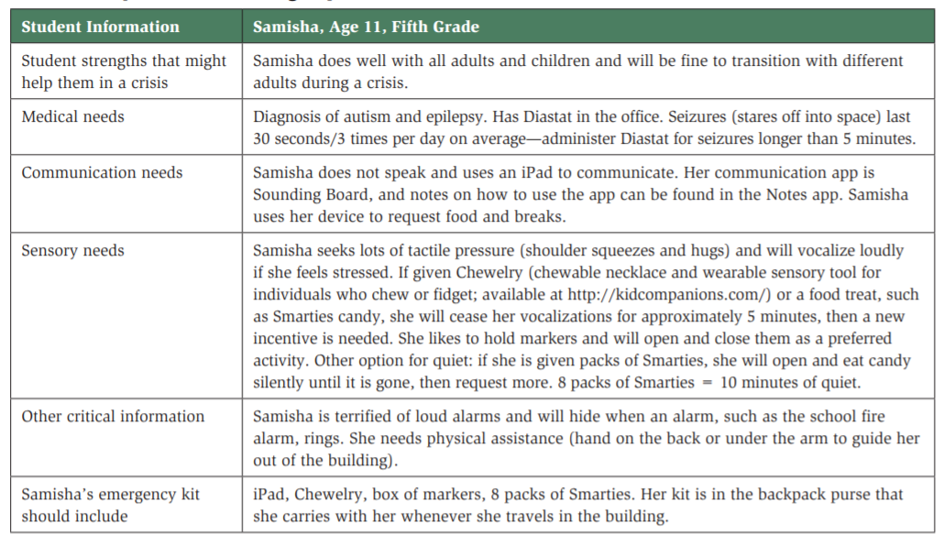
Sample Individual Emergency and Lockdown Plan
IDEA – B State Advisory Panel June 2021​
Notes:
Table 2. Tools for Teaching
Tool How It Can Be Used
Individual emergency and lockdown plan One created for and kept with each student; ensures that emergency personnel will know what the child needs to support his or her physical and emotional/sensory/communication needs.
Social narrative Teach steps of lockdown drill in each location; what student should do in each environment.
Individual student lockdown bag To support a child during a lockdown. Purpose is to keep the student quiet. Bag should include preferred tasks that the student could access if alone during lockdown. Items to include low-light flashlights for students who are afraid of the dark or social story for students to remind them what they should be doing.
Sensory items For students with specific sensory needs, include sensory items in the bag. Provide hiding spots in each location that might support those needs. A student who seeks lots of pressure might do well hiding under the sink, where he or she can push against the cabinet. Allow student to practice using this location.
Picture schedule To remind the student of what is happening (“First we hear the announcement or an adult tells us to hide”) and what might happen next.
Behavior plan/ incentives For students who have issues with following directions. Build compliance by awarding stickers or usual reward for every few minutes of compliance. Include incentives in the emergency bag for self-rewards as needed.

Slide 56

Analyze the overall state, district, and school crisis and disaster plans.
Use the student's IEP, schedule, and school layout to evaluate what might happen in an emergency.
Review the school layout and note any barriers to the student's access.
Brainstorm solutions to barriers.
Create an Individualized Emergency and Lockdown Plan (IELP).
Help students learn, understand, and practice the specific skills they will need to develop to stay safe.
IDEA – B State Advisory Panel June 2021​

Slide 57
Resources
ASCD’s Whole Child Initiative http://www.ascd.org/ASCD/pdf/siteASCD/publications/wholechild/wscc-a-collaborative-approach.pdf
Crisis Prevention Institute https://www.crisisprevention.com/
Oklahoma State Department of Education School Safety and Security Office https://sde.ok.gov/school-safety-and-security
Oklahoma State Department of Education Special Education Services https://sde.ok.gov/special-education
Supporting Students With Disabilities During School Crises A Teacher’s Guide Laura S. Clarke, Dusty Columbia Embury, Ruth E. Jones, and Nina Yssel. https://crcog.org/wp-content/uploads/2017/12/Supporting-Students-with-Disabilities-During-School-Crisis.pdf
IDEA – B State Advisory Panel June 2021​

Slide 58

Michele DeBerry,
MS, CCC-SLP
Certified School Psychometrist, EACS Doctoral Student
Related Services, Dyslexia,
and Evaluation & Eligibility
Program Specialist
michele.deberry@sde.ok.gov
405-522-3246
Chelsea Bowlan,
M.Ed.
Program Specialist
State Systemic Improvement Plan (SSIP), Instruction, and IEP guidance
chelsea.bowlan@sde.ok.gov
405-521-2081
IDEA – B State Advisory Panel June 2021​

Slide 59
Panel Recommendations

Slide 60

Jamboard - Let’s Interact
http://bitly.ws/e6VD
Notes:
Jamboard Link

Slide 61
Recommendations
What additional guidance should the OSDE provide to schools and districts?
What additional resources or services should the OSDE provide to schools and districts?
How can the OSDE better support parents and students?

Slide 62
Nominations for Vice Chair 2021-2022

Slide 63
Nominations
https://osde.co1.qualtrics.com/jfe/form/SV_6yU3RiUh66l0VHE
This link will be emailed.
Vice Chair: Serves as Chair in his/her absence, leads the Membership Committee, serves on the Executive Committee and develops meeting agendas.
Please nominate by July 1.

Slide 64
Nominations
The Vice Chair will become the Chair for 2022-2023:
Lead all IDEA B Advisory Panel meetings
Appoint committee members
Serve on Executive Committee
Develop meeting agendas
Coordinate with the Executive Director of Special Education all IDEA B Advisory Panel activities
Establishing sub committees with the approval of the Executive Director of Special Education
Assure that all meetings of sub committees are reported at the succeeding IDEA B Advisory Panel meetings and that recommended action is recorded
Assure that IDEA B Advisory Panel minutes are completed and mailed or emailed to members and other appropriate recipients no later than 30 calendar days after each meeting
Receive and respond to correspondence with the Oklahoma State Department of Education

Slide 65
Closing

