Slide 1
Technology Accessibility in K-12

Slide 2

Speech Control

Slide 3

The Mouse-less Web

Slide 4
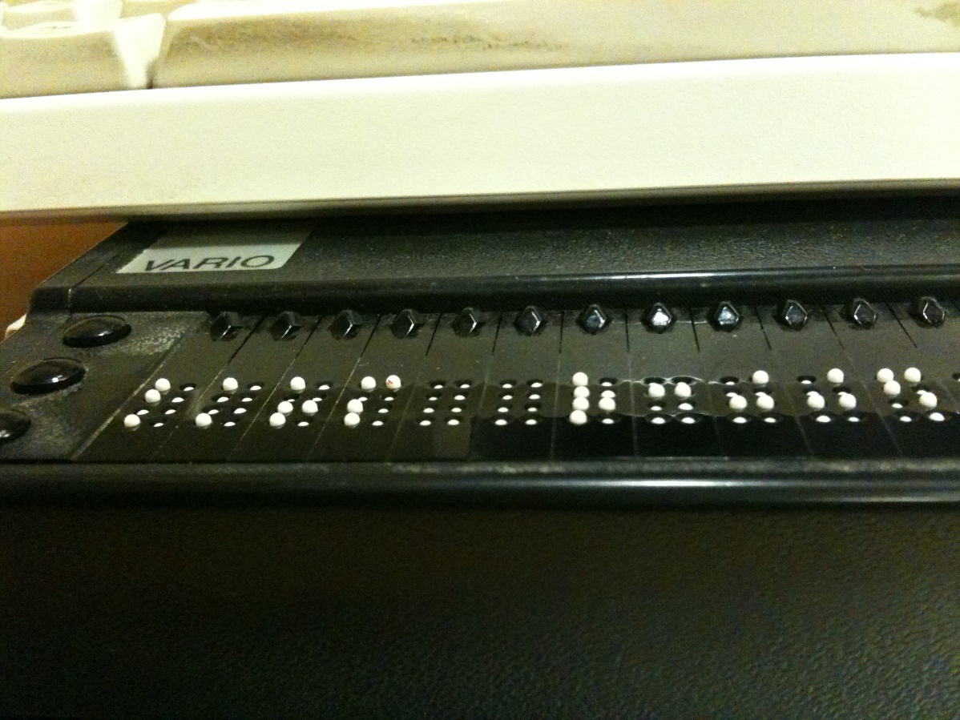
Screen Reading Software and Refreshable Braille Displays
By Eddau (Own work) [CC0], via Wikimedia Commons

Slide 5
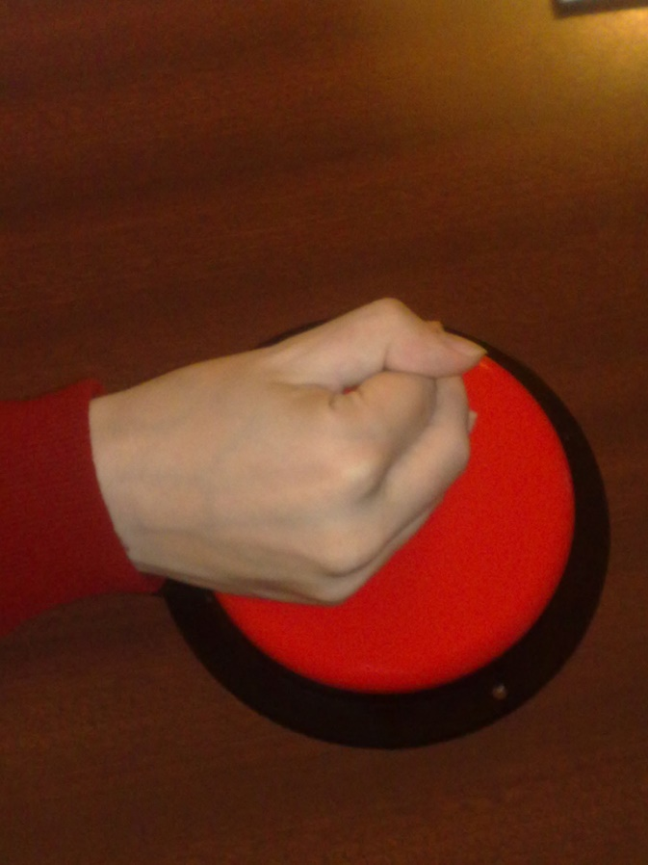
Switch Interface
By vtsaran - http://www.flickr.com/photos/7871760@N02/2956430381/sizes/l/, CC BY 2.0, https://commons.wikimedia.org/w/index.php?curid=20938797

Slide 6
About Assistive Technology
Not everyone with a disability uses it
Assistive technology does not equal accessibility
Assistive technology may change an interaction with a device
Web must be able to interact and inform

Slide 7
Accessibility Defined
“Accessible” means that individuals with disabilities are able to independently acquire the same information, engage in the same interactions, and enjoy the same services within the same timeframe as individuals without disabilities, with substantially equivalent ease of use.
  From Department of Education Office of Civil Rights

Slide 8
We Know what Accessible Looks and Acts Like
International standards
  Federal policy
    State law

Slide 9
Legal Stuff (Stay with Me)
Individuals with Disabilities Education Act (IDEA)
Section 504
The Americans with Disabilities Act

Slide 10
Intersections
Students
Technology
Civil Rights

Slide 11
Technology
Classroom and educational technology
Digital curricula
Administrative and productivity tools
Websites
Social media
Mobile apps

Slide 12
How?
Moving Accessibility Forward

Slide 13
Big Picture Steps
Bake accessibility into creation
Build accessibility into technology use and purchase decisions
Integrate accessibility from the start

Slide 14
Practically Speaking
Time is money
Doing accessibility at the end costs time

Slide 15
Address Accessibility Holistically
Who creates and influences our technology?
  Special educators
  Teachers
  Classroom technology experts
  Information technology
  Marketing and web
  Purchasing
  Etc.

Slide 16
Q’s and A’s
Fire away!

