Slide 1
Oklahoma State Textbook Committee Meeting
February 3, 2023

Slide 2
Overview of the Instructional Material Review Process

Slide 3
Subject Specific Evaluation Rubrics
The State Textbook Committee, in consultation with the State Department of Education, shall adopt a rubric to be used by the review teams as a means of evaluating textbooks submitted for review.
The rubric shall contain a three-tiered rating system in which the first tier shall be labeled "Exemplifies Quality", the second tier shall be labeled "Approaching Quality", and the third tier shall be labeled "Not Representing Quality".
~ 70 O.S. § 16-102

Slide 4
Tiered Evaluation Process
Exemplifies Quality,
Approaching Quality,
Does Not Represent Quality.
State-approved items are those in which the publishing company has contracted with Oklahoma to ensure the lowest price for districts and accessible formats for all Oklahoma learners.
~ 70 O.S. § 16-104
These resulting ratings are recommendations for state approval.

Slide 5
Subject Matter Expert Review Teams
Review teams will review all materials according to the rubric adopted by the State Textbook Committee.
The State Textbook Committee must consider, but not accept, the review teams’ recommended ratings.
The State Textbook Committee may request additional information or may provide its’ own justification utilizing the adopted rubric.
~ 70 O.S. § 16-102

Slide 6
Approval and Publications
The State Textbook Committee adopts final ratings of textbooks or other instructional materials reviewed.
Completed rubrics, including Content Review Teams’ recommendations, must be made publically available on the State Textbook Committee website.
The State Textbook Committee selects only those textbooks or other instructional materials that receive a review rating of “Exemplifies Quality” or “Approaching Quality”. ~ 70 O.S. § 16-102

Slide 7
Presentation of Instructional Material Evaluation Rubrics for 2023 Adoption Cycle
Notes:
6.4.21 STC Agenda Item #8 Remaining slides of presentation

Slide 8
Proposed 2022 Adoption Cycle Rubrics
PreK-5 Mathematics
6-12 Mathematics
Early Childhood Education (Comprehensive)

Slide 9
Rubric Development
Reviewed existing tiered evaluations
Tested rubrics for interrater
reliability
Developed
and revised rubric content
Evaluated rubric points and rating validity
March 2022
April - October 2022
October - November 2022
December 2022 - January 2023

Slide 10
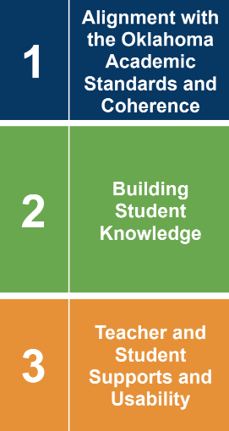
Tiered Evaluation Process
Gateways: Prioritize the evaluation sequence.
Criterion: Represent a group of indicators with a singular focus.
Notes:
Provide graphic/visual to support rubric structure explanation.

Slide 11
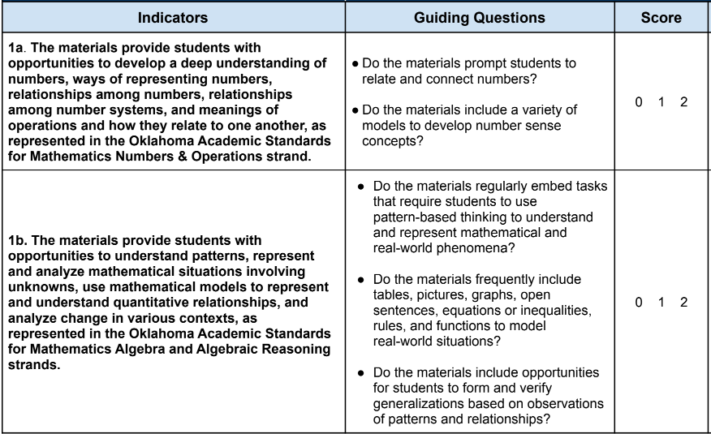
Tiered Evaluation Process
Indicators narrow the evaluation focus to guide the reviewer to collect specific types of evidence to support ratings.
Guiding questions provide further clarification to support accurate scoring.

Slide 12
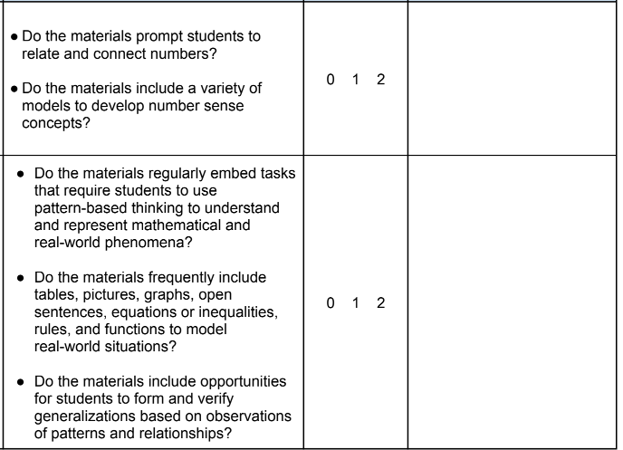
Tiered Evaluation Process
Content Review Team members will cite collected evidence from instructional material samples for justification.
Notes:
Provide graphic/visual to support rubric structure explanation.

Slide 13
Tiered Evaluation Process
Does the gateway rating Exemplify Quality or Approach Quality?
YES: Continue to the next gateway.
A summary of criterion ratings are provided here. All approved results are publicly available.

Slide 14
Interrater Reliability
Separate blind reviews were conducted with reviewers who evaluated instructional materials with the rubrics.
Most differences in reviewer scores across criteria and gateways were minimal.

Slide 15
Interrater Reliability
Interrater Reliability Scale¹
% Alignment | < or = 0 | 1 - 20% | 21 - 40% | 41 - 60% | 61 - 80% | 81 - 100%
Degree Alignment | None | None to Slight | Fair | Moderate | Substantial | Almost Perfect
1 - McHugh, M. L. (2012). Interrater reliability: the kappa statistic. Biochemia medica, 22(3), 276-282.
Notes:
ECE rubric interrater reliability values:
Gateway 1 - 92%
Gateway 2 - 83%
Gateway 3 - 78%
Overall - 85.7%
Math rubric interrater reliability values:
Gateway 1 - 62.5%
Gateway 2 - 75%
Gateway 3 - 62.5%
Overall - 68%

Slide 16
Next Steps
An application for content-expert reviewers will be posted by March 2023.
Content Review Teams will participate in training on the subject area rubrics they will utilize to conduct evaluations in Summer 2023.
Content Review Teams will conduct evaluations of bid materials July - October 2023.

Slide 17
Next Steps
The State Textbook Committee will have access to draft reviews conducted by the Content Review Teams prior to the November 2023 meeting date.
The State Textbook Committee will vote on evaluations of bid items to determine the approved list of materials on November 17, 2023.

Slide 18
Out-of-Cycle Evaluation
The State Textbook Committee members will evaluate the out-of-cycle bid items for subjects that do not have a Committee-approved rubric with the criteria utilized in previous adoption cycles. ~ 720:10-5-3
Notes:
With the exception of Elementary ELA and PK-12 Computer Science, Secondary ELA and PK-12 World Languages Other Than English we will reach out ot reviewers from past years or recruit people as needed using the current application approved by the Committee this year.

Slide 19
Questions

